Slide 1
A LaBr₃ Fast Timing Array of NUSTAR detectors at JYFL
NPL Meeting, March 2015
David M. Cullen.
School of Physics and Astronomy, University of Manchester, Manchester, M13 9PL, U.K.

Slide 2
UK Fast-Timing Array
NPL Meeting, March 2015
Part of STFC funded NuSTAR Project to build and commission ‘stand alone’ fast-timing gamma-ray array for use with AIDA at focal plane of (S)FRS at GSI/FAIR (part of DESPEC collaboration).
People:
  U. Brighton (Alison Bruce, Oliver Roberts [PDRA])
  U. Surrey (Paddy Regan, Zsolt Podolyak, Christopher Townsley)
  U. West of Scotland (John Smith, Kieran Mullholland [PhD])
  STFC Daresbury Laboratory (Ian Lazarus-DAQ)
  U. Manchester (David Cullen, Andy Smith - design of frame).
Currently have purchased:
  31 LaBr₃ detectors (2” x 1.5” cylinders)
  Cost £186,852

Slide 3
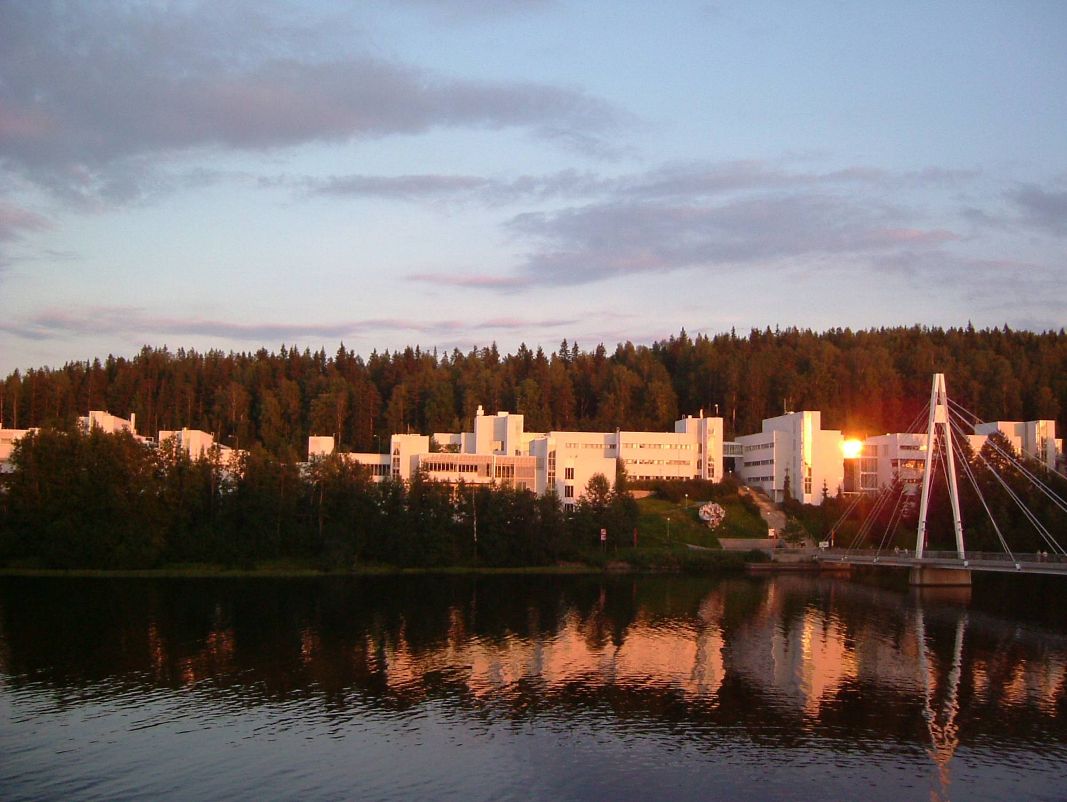

A Fast-Timing Array at focal plane of RITU / MARA spectrometers at University of Jyväskylä.
  Lifetimes of nuclear states populated in delayed spectroscopy
  e.g. Recoil-, proton-, isomer-, beta-, electron-tagged spectra)
NPL Meeting, March 2015

Slide 4
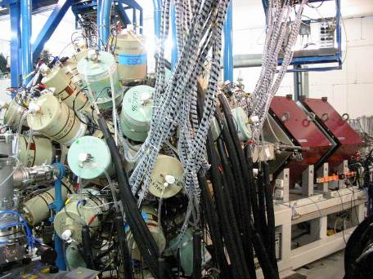
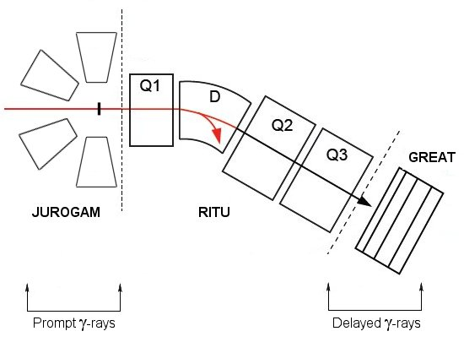
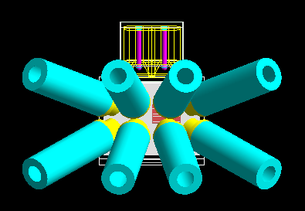
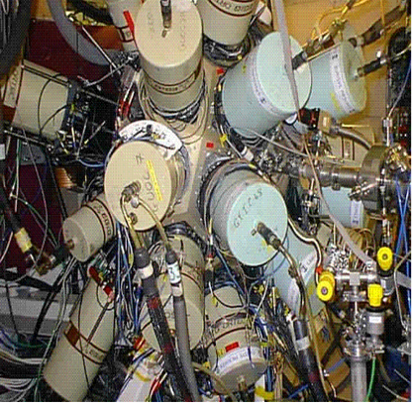
Fast Timing Methods at Jyväskylä
JUROGAM, RITU, GREAT and the TDR.
Isomeric state
Delayed Gammas
PROMPT gammas
Isomeric state
LaBr₃ Array
Trigger-less Data Acquisition System
NPL Meeting, March 2015

Slide 5
Technique
Isomeric state (~100ns – several µs)
Delayed γ rays but in prompt coincidence with each other (ps lifetimes)
Measure LaBr₃ – LaBr₃ coincidences with ~200ps intrinsic LaBr₃ timing resolution.
Possible to extract lifetimes down to ~5ps (centroid shift) with good statistics.
~ 5ps
~ 50ps
~ 100ps
Ground state
NPL Meeting, March 2015

Slide 6
LaBr₃ Project JYFL
Status: 5 days beam time approved to test 8 LaBr3 detector array to measure lifetimes fed by delayed/isomer spectroscopy at focal plane of RITU. Experiment will likely take place in the summer 2015.
Key point: Ascertain how distribution of recoils across focal plane affects measurement of short ps lifetimes.
  e.g. 2 events separated by a few cm will have different gamma transit times (of order of ~ps) to reach the same detector.
  This can be somewhat corrected for by first calibrating the effect using source measurements from various positions across the DSSD.
  However, this assumes you know the recoil position in the DSSD. This is easy for alpha, beta tagging, but not so obvious for isomer tagging.
  This needs physics input from community now.
  If test is successful, then we may want to investigate the possibility to place up to 28 detectors (geometry permitting) around the focal plane for campaigns of physics experiments with RITU/MARA... in ~2016/2017/2018?
NPL Meeting, March 2015

Slide 7
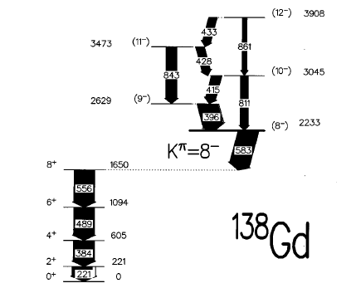
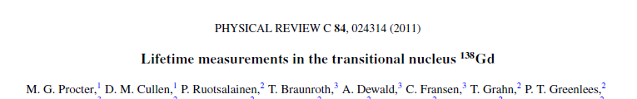
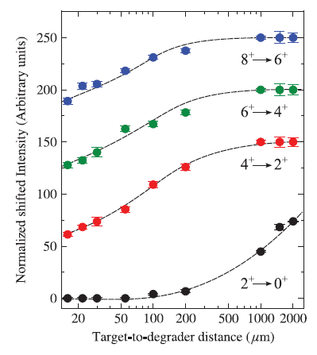
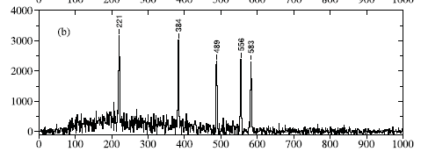
Test Experiment ¹³⁸Gd
T_{1/2} = 6µs
Plunger T_{1/2}
1.8(4) ps
3.8(15) ps
13(3) ps
308(17) ps
106Cd(36Ar,2p2n)138Gd reaction
Cross section ~100mb to ¹³⁸Gd and 1% to K=8 isomer ~ 1mb
NPL Meeting, March 2015

Slide 8

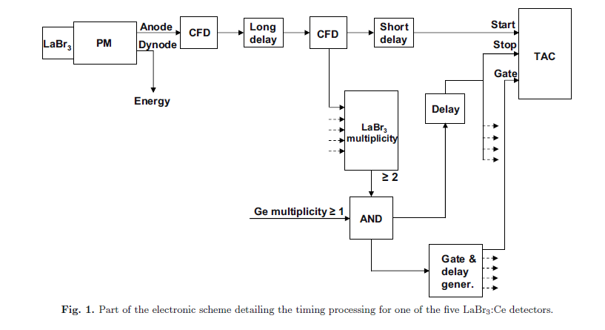
Timing setup - 1 TAC per detector
Planar removed but
still have clover detector above
NPL Meeting, March 2015

Slide 9
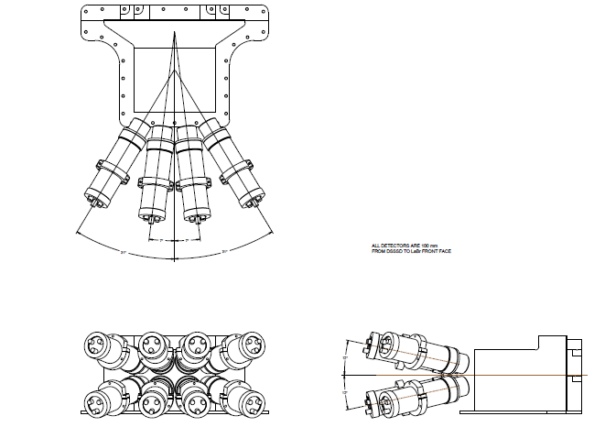
8 Detector setup
All detectors are 100mm from DSSD to LaBr front face (compared with 70mm if pack 2 directly at back as close as possible).
NPL Meeting, March 2015

Slide 10
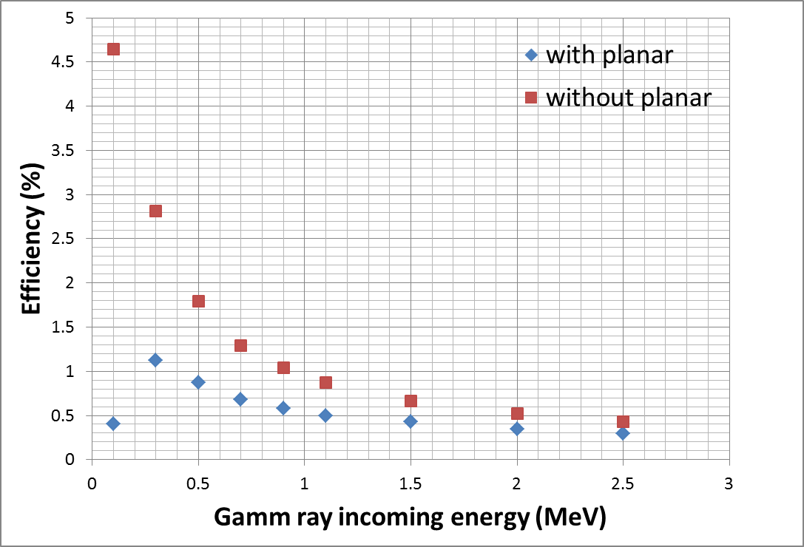
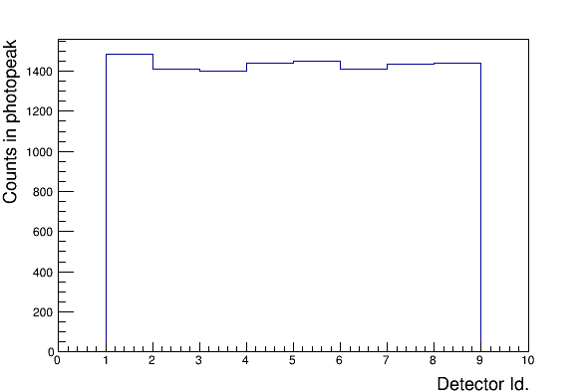
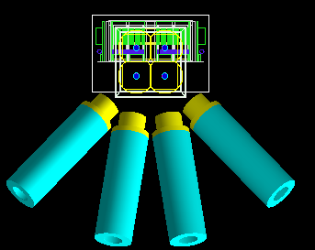
8 LaBr₃ Design Simulation
138Gd isomer
Range 200-600 keV
View from the back
Count distribution in the 8 detectors
View from the top
Marc Labiche
NPL Meeting, March 2015

Slide 11
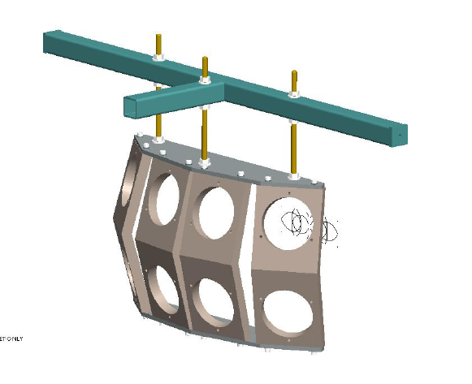
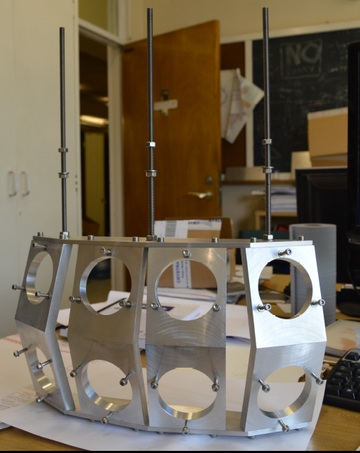
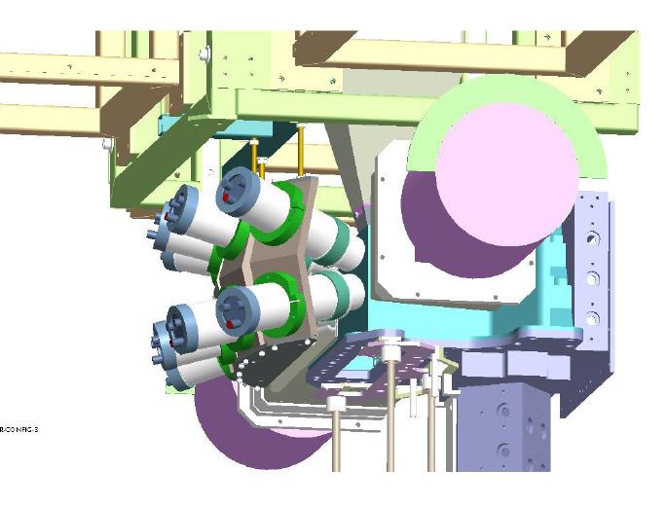
8 detector LaBr₃ frame design (D. Seddon)
Bolts onto existing JYFL blue frame
NPL Meeting, March 2015

Slide 12
Possibilities after this 8 detector test experiment?
NPL Meeting, March 2015

Slide 13
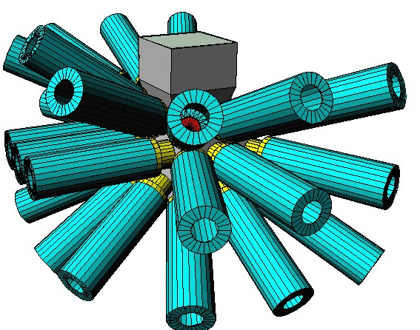

Remove planar when not needed?
M. Labiche
138Gd isomer
Range 200-600 keV
NPL Meeting, March 2015

Slide 14
Cross sections accessible with a larger array?
NPL Meeting, March 2015
This can only really be fully known once the results of the test experiment are Validated against the test experiment simulation.
However, in the mean time can make order of magnitude estimate.
Assume:
Each LaBr detector has efficiency 0.5%
DSSD efficiency for recoil detection ~ 80%
If require 1000 counts in a peak to use centroid shift method, this means:
g-g-g analysis requires 1000/(0.8*0.005³) ~ 10¹⁰ recoils
g-g analysis requires 1000/(0.8*0.005²) ~ 50x10⁶ recoils
Using R = N φ σ and RITU transport efficiency of 30% for typical reaction
(5pnA beam on 1mg/cm² target for 7 days),
Gives cross section estimated limits for
LaBr-LaBr-LaBr coincidences is ~ 500 mb
LaBr-LaBr-Clover coincidences is ~50 mb (using clover efficiency=5%)
LaBr-LaBr coincidences is ~ 3 mb.
Need to start to think about physics ideas to Dave.cullen@manchester.ac.uk

Slide 15


Thanks to…
M. Labiche, D. Seddon, D.M.Cullen, A.Smith, M. Taylor, C.Scholey, P.Greenlees, P.Rahkila, R.Julin,
and the
UK-NUSTAR Collaboration (A.M. Bruce, Z. Podolyak, P. Regan,...)
Physics ideas to Dave.cullen@manchester.ac.uk

