Slide 1

FATIMA DESPEC TDR
IDS experiments
L.M. Fraile on behalf of FATIMA collaboration
Grupo de Física Nuclear, Dpto. Física Atómica, Molecular y Nuclear, Universidad Complutense, E-28040 Madrid, Spain

Slide 2
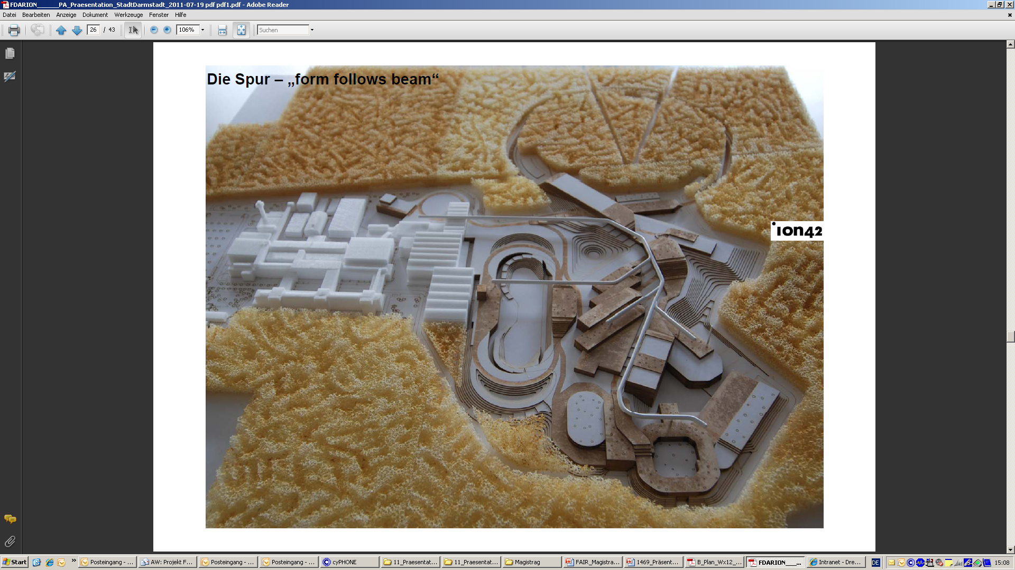
Facility for Antiproton and Ion Research
Primary Beams
SIS100/300
10¹²/s; 1.5 GeV/u; ²³⁸U²⁸⁺
10¹⁰/s ²³⁸U⁷³⁺ up to 35 GeV/u
3x10¹³/s 30 GeV protons
Secondary Beams
range of radioactive beams up to
1.5 - 2 GeV/u; up to factor 10 000 higher in intensity than “presently”
antiprotons 3 - 30 GeV
Rare-Isotope
Production Target
SuperFRS
Storage and Cooler Rings
radioactive beams
10¹¹ antiprotons 1.5 - 15 GeV/c,
stored and cooled
NUSTAR
Notes:
FAIR will be an excellent place where to study the decay properties of the UNEXPLORED neutron rich side of the nuclide chart.

Slide 3
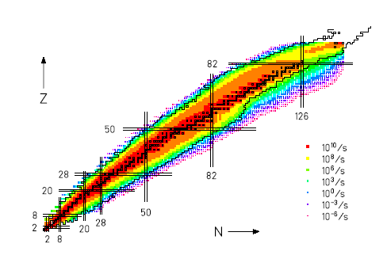
Predicted production rates
FAIR CDR
Half-lives > 100 ns

Slide 4
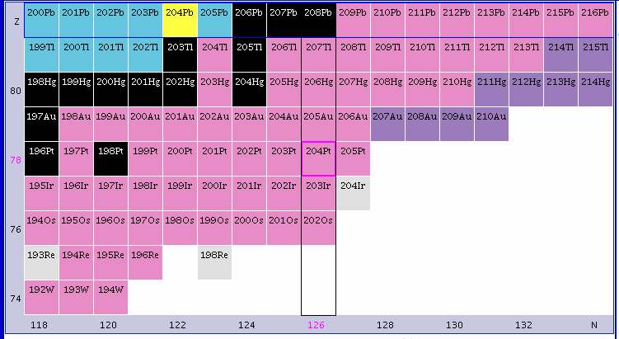
A physics “case”: N = 126
even-even 2⁺ & 4⁺ systematics
r-process path half-lives
P_{n} values, beta-delayed neutrons
Beta-decay: FF νi_{13/2} → πh_{11/2} dominating; GT νh_{9/2} → πh_{11/2}
role of first forbidden transitions
Isomers
Transition rates

Slide 5

Transition rates – electronic timing
^{A}Z
^{A-3}(Z+1)
β⁻
Q_{β}
^{A-2}(Z+1)
S_{3n}
n
S_{2n}
^{A-1}(Z+1)
S_{n}
γ
^{A}(Z+1)
Absolute transition rates

Slide 6
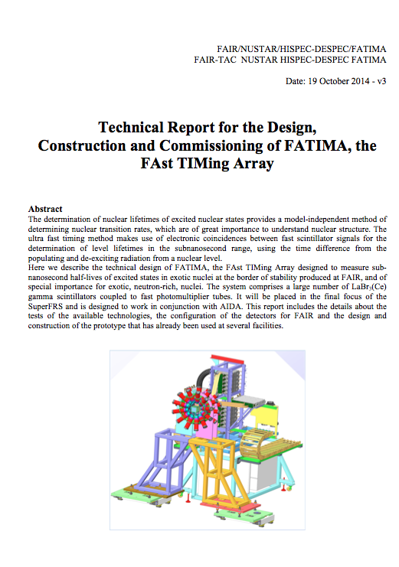
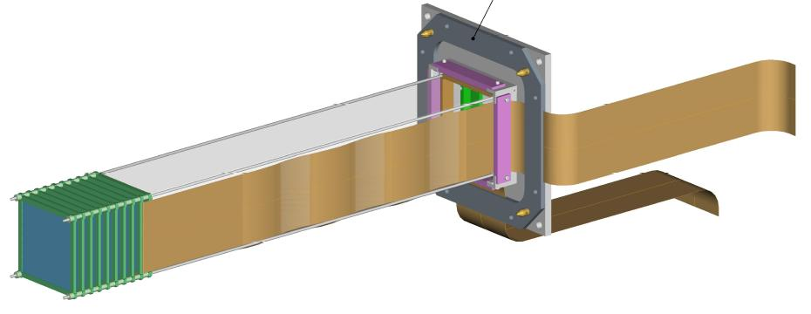
FATIMA TDR
Combined with the fast ion
active stopper: AIDA
October 2014
TDR to be submitted by
31 March 2015
HISPEC_DESPEC.1.2.2.15 FATIMA

Slide 7
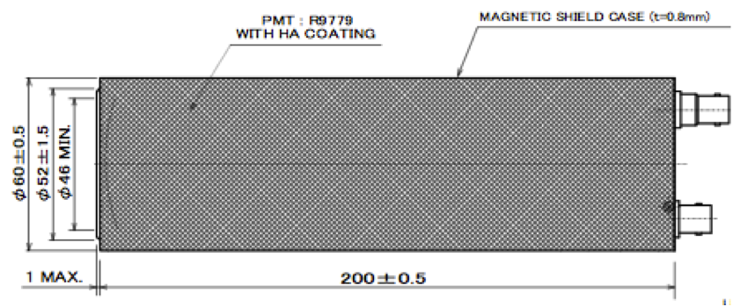
Technical specifications and design details
Choice of crystal type
  Development of LaBr3:Ce
  Doping (size, shape)
  Other options considered: CeBr₃
    Timing and linearity Good time resolution of (119±2) ps at ⁶⁰Co
  Efficiency simulation and measurement
Choice of photosensor
  PMT selection and development
  SiPMs

Slide 8
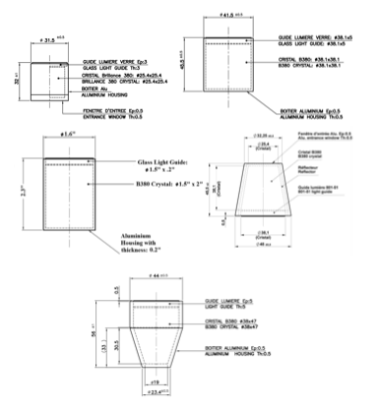
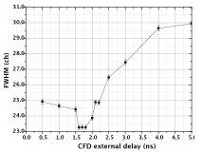
Technical specifications and design details
Selection of crystal shape and detector evaluation

Slide 9
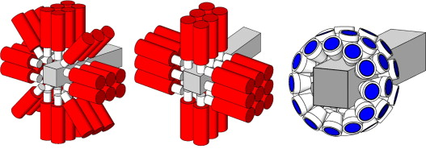
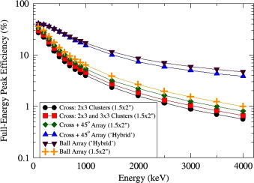
Technical specifications and design details
Summary of Monte Carlo simulations
Ball array
(“hybrid”)
CRT ~ 160 ps
FWHM (⁶⁰Co)
V. Vedia et al.
Cross + 45º
1.5x2”
CRT ~ 210 ps
FWHM (⁶⁰Co)
Cross
1.5x2”
CRT ~ 210 ps
FWHM (⁶⁰Co)
Efficiency array
O.J. Roberts, A.M. Bruce et al., NIM A 2014

Slide 10
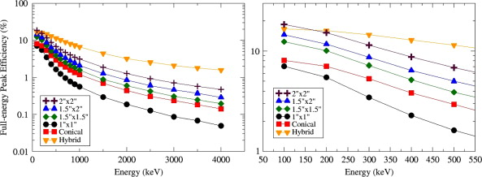
Geant4 simulations
O.J. Roberts, A.M. Bruce et al., NIM A Feb 2014, accepted, http: //dx.doi.org/10.1016/j.nima.2014.02.037
  Studsvik “hybrid”
  1.5” x 1.5” cyl.
  1.5” x 2” cyl.
Efficiency for 1 ring

Slide 11
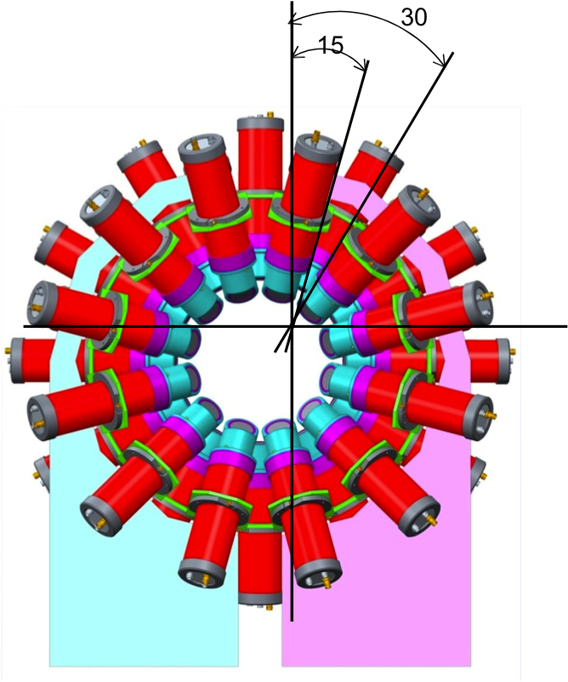
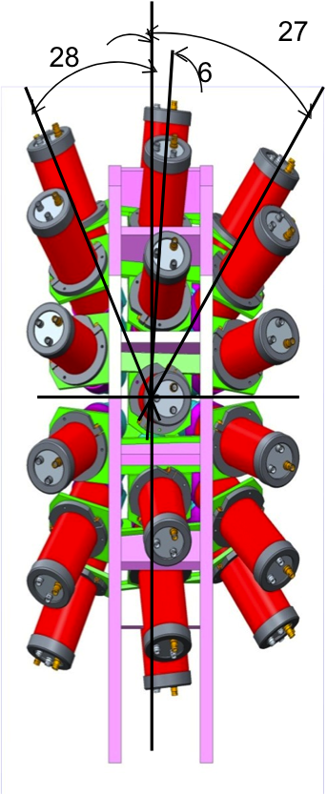
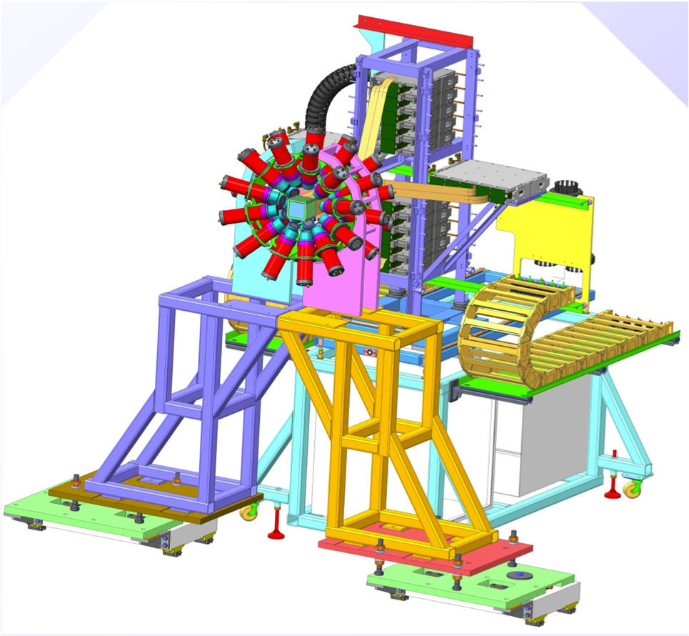
Technical specifications and design details
Background and shielding
Beta detection
Layout of the fast timing array
STFC, UK

Slide 12
Technical specifications and design details
Electronics and Data Acquisition System
  Dynode (E) + Anode (t)
  CAEN V1724 100 MHz digitizers, V1751 1 GHz for E
  Analog ORTEC: CFD 935 + TDCs
  CFD
    V1290 TDC (25 ps LSB)
    Use of TRB3: a 264 ch “high-precision” TDC at GSI
    Mesytec 10 ps TDCs

Slide 13
Technical specifications and design details
Digitizing algorithms
  tests
Analysis methods
J.-M. Régis et al., Nucl. Instrum. Methods A726 (2013) 191

Slide 14
Previous prototypes and test experiments
  ROSphere
  A mixed array of EXOGAM and FATIMA detectors at ILL
Radiation environment and safety issues
Production, quality assurance and acceptance tests
Calibration with test beams
Civil engineering and cave
Installation procedure and logistics

Slide 15
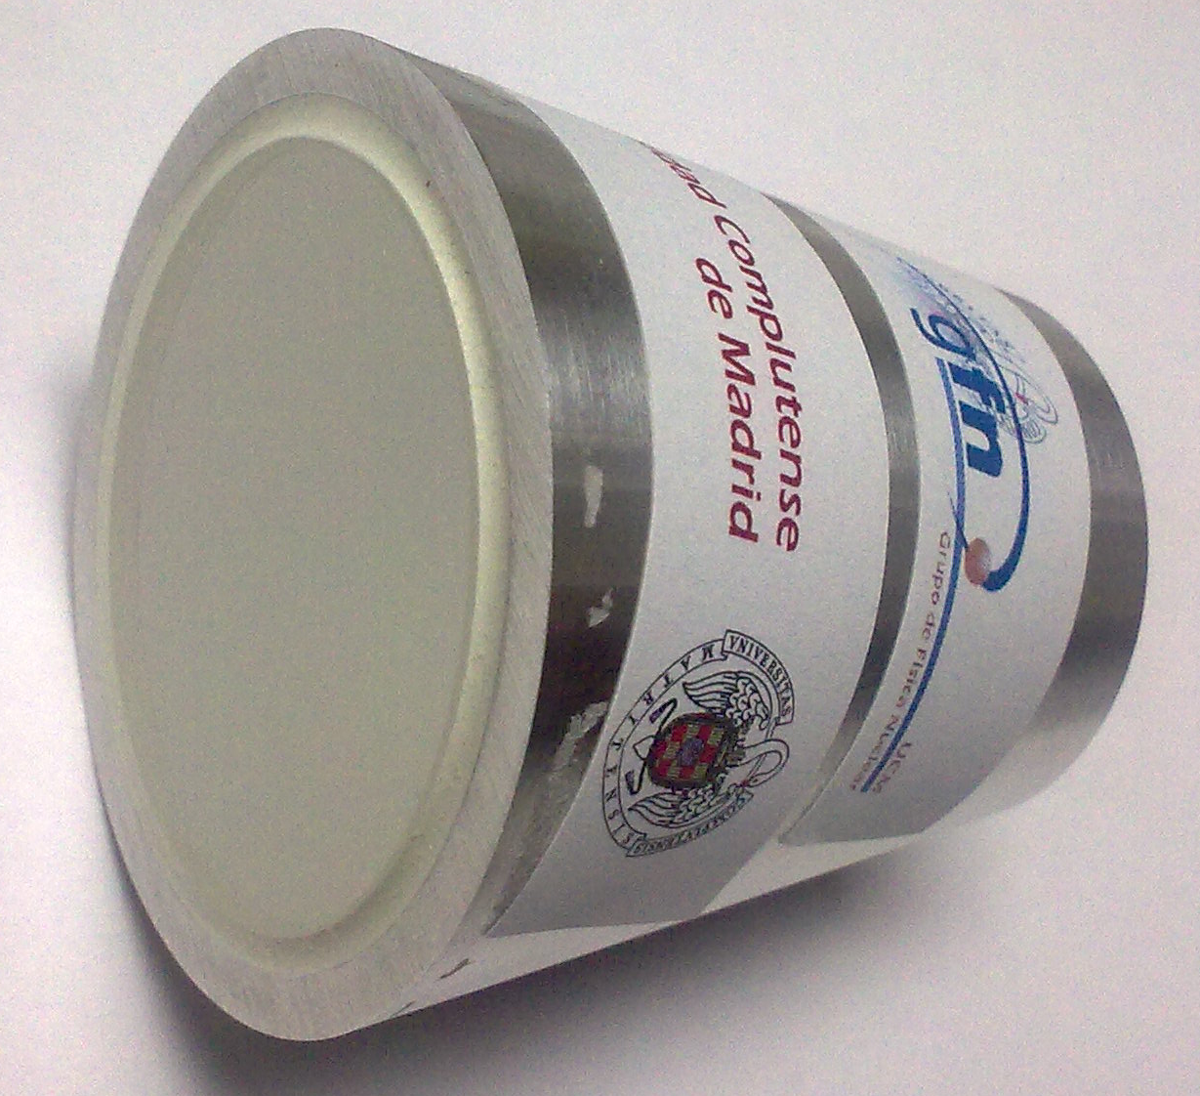
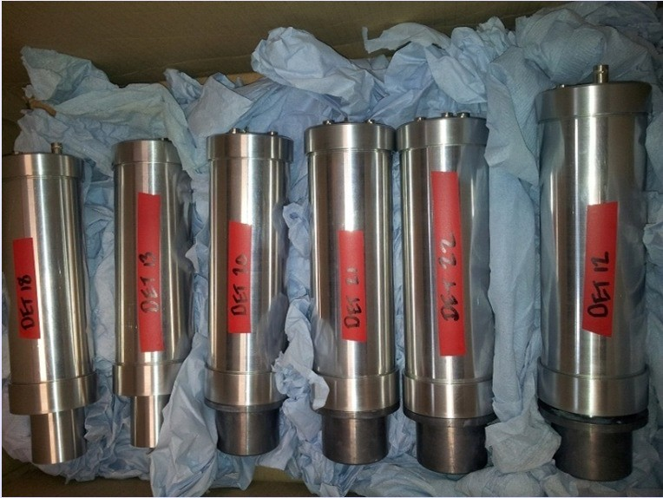
FATIMA
36 UK cylindrical detectors
12 conical detectors
  Electronic chains
To be submitted soon
HISPEC_DESPEC.1.2.2.15 FATIMA

Slide 16
ISOLDE Decay Station experiments

Slide 17
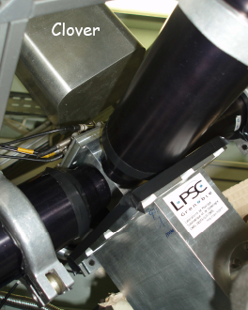
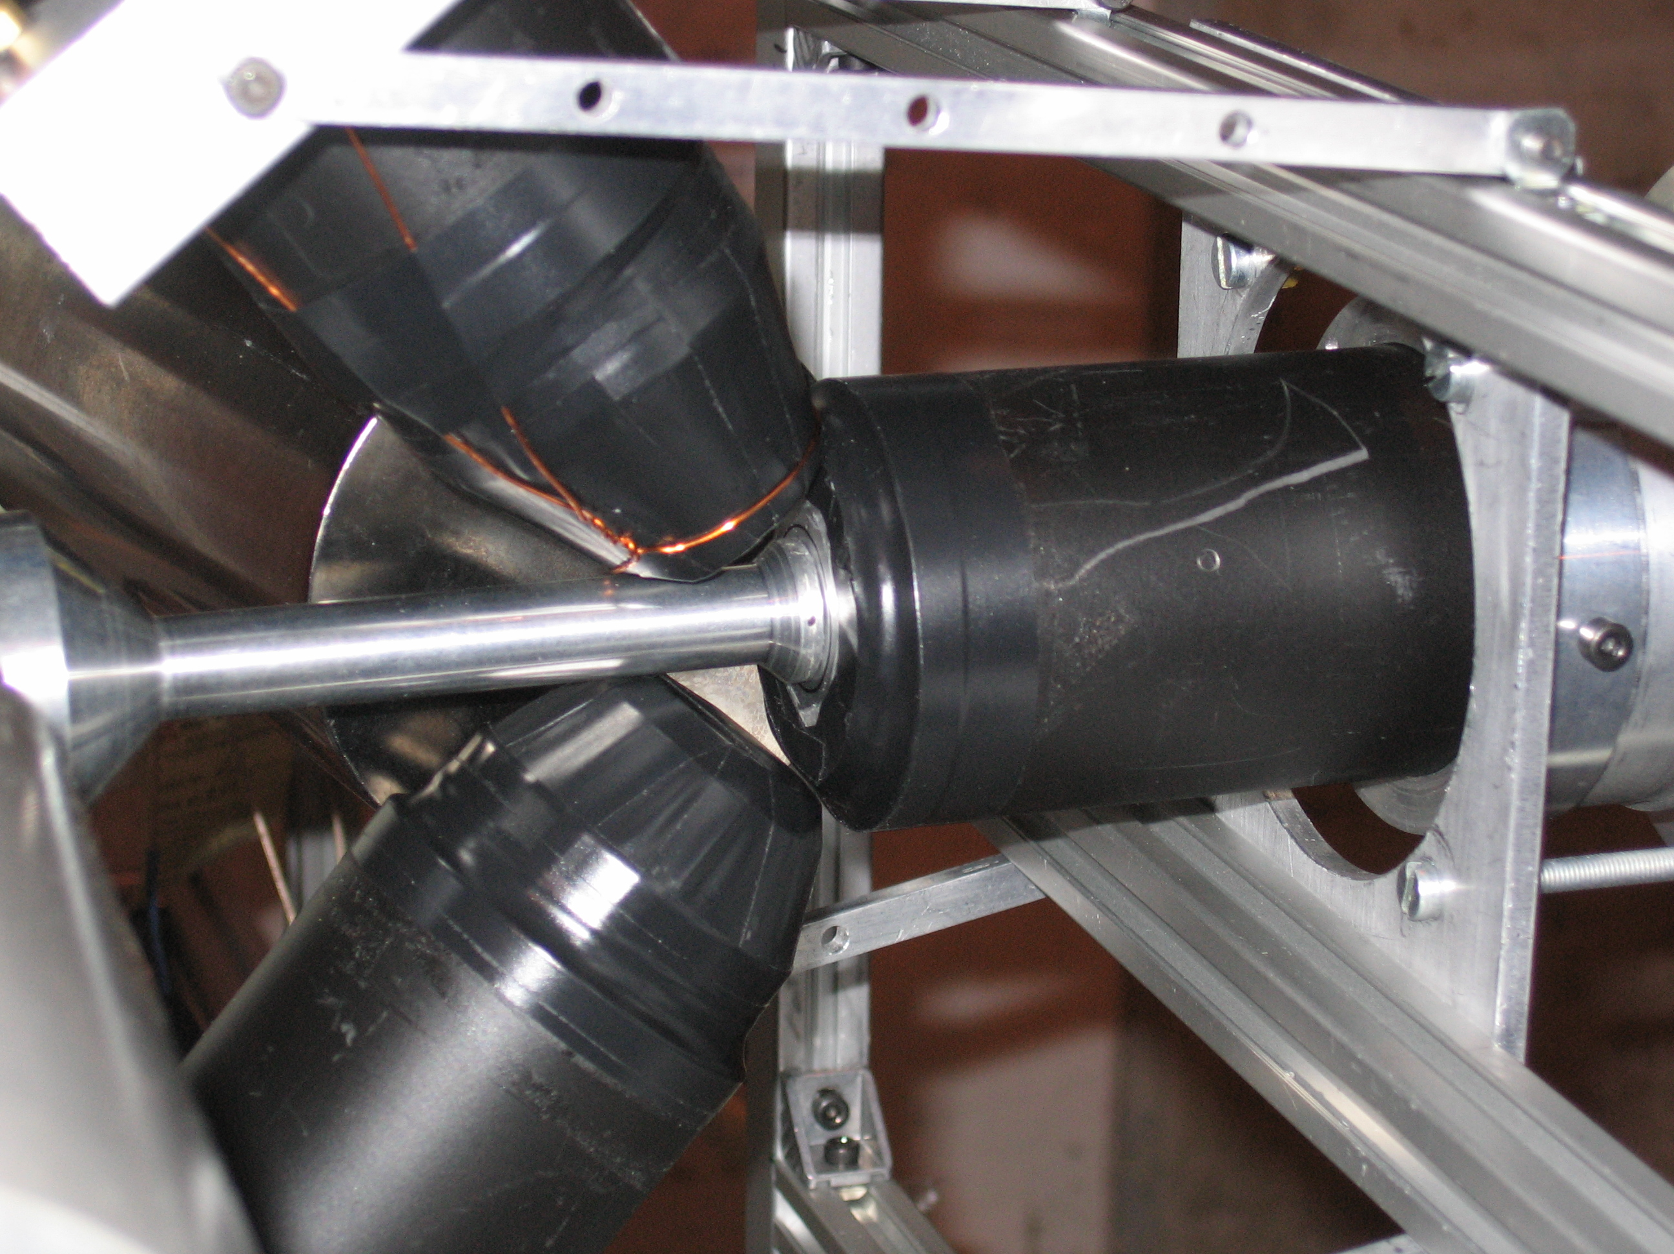
Compact setup
BaF₂
HPGe
Fast β
ISOLDE beam
LaBr₃(Ce)
ISOLDE
Lohengrin - ILL
βγγ(t) setup
HPGe:
High energy resolution
Poor time response
TIMING
LaBr₃(Ce): Fast response γ-detectors / poor energy resolution
Plastic β scintillator: Fast response / efficient start detector
Notes:
Fast timing detectors were prepared at the OSIRIS separator at Studsvik; timing equipment in part from the Fast Timing Pool of Electronics.

Slide 18
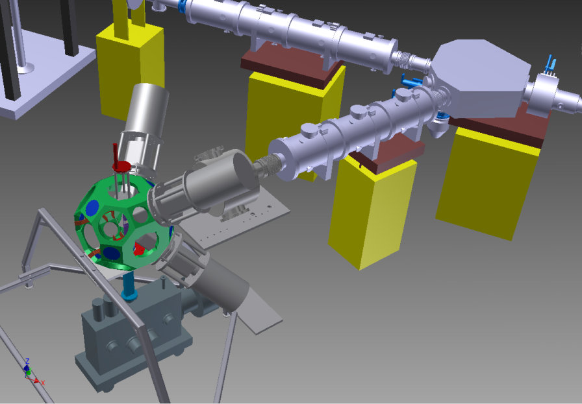
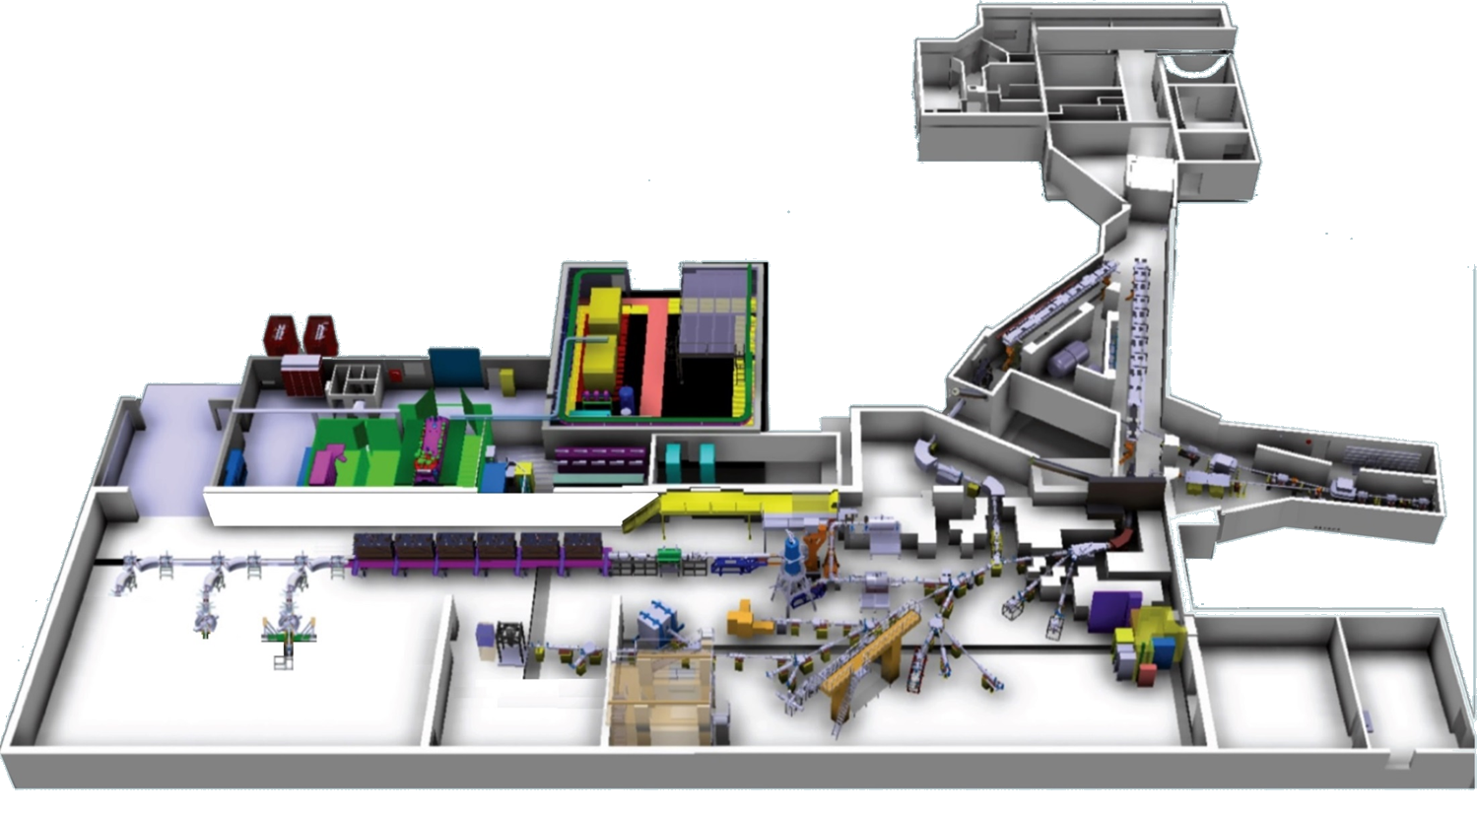
IDS in the ISOLDE hall
Frame Osiris IFIN Bucharest
Tape station KU Leuven
2 clovers IFIN Bucharest
2 clovers KU Leuven
LaBr₃ (Ce) detectors UCMadrid / IFIN Bucharest
Beta detectors
NICOLE
IDS
ISOLTRAP

Slide 19
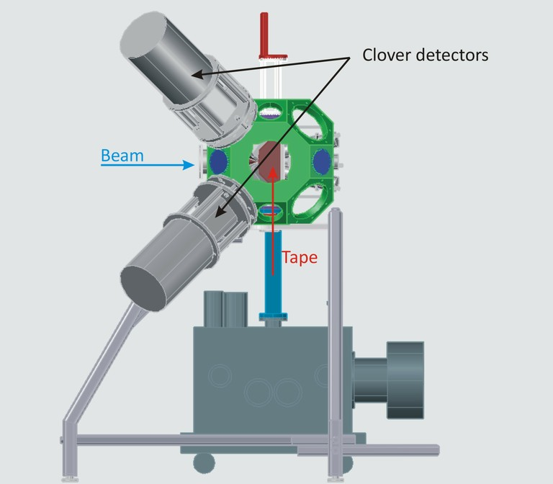

Slide 20
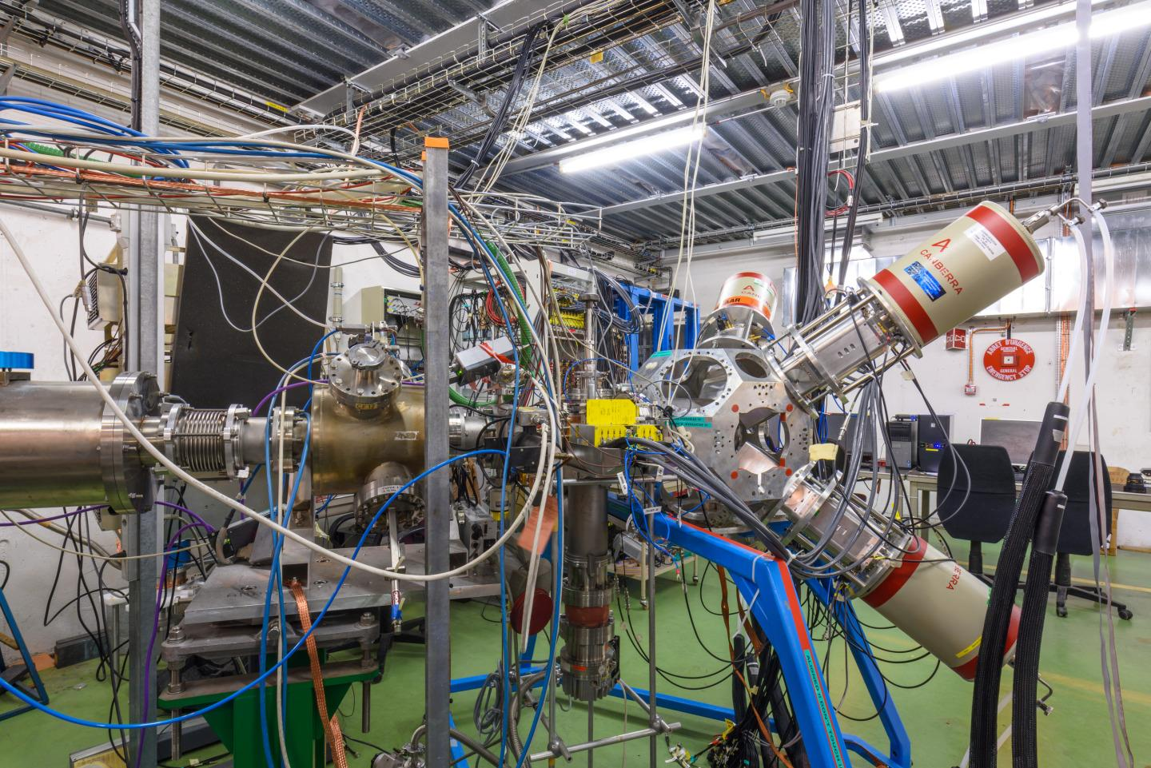

Slide 21
IDS experiments 2015
Study of octupole deformation in n-rich Ba isotopes populated via β decay (IS579)
Core breaking and octupole low-spin states in ²⁰⁷Tl (IS588)
Characterization of the low-lying 0⁺ and 2⁺ states of ⁶⁸Ni (IS590)
Beta-3p spectroscopy and proton-gamma width determination in the decay of ³¹Ar (IS577)
Beta-decay study of neutron-rich Tl and Pb isotopes (IS584)

Slide 22
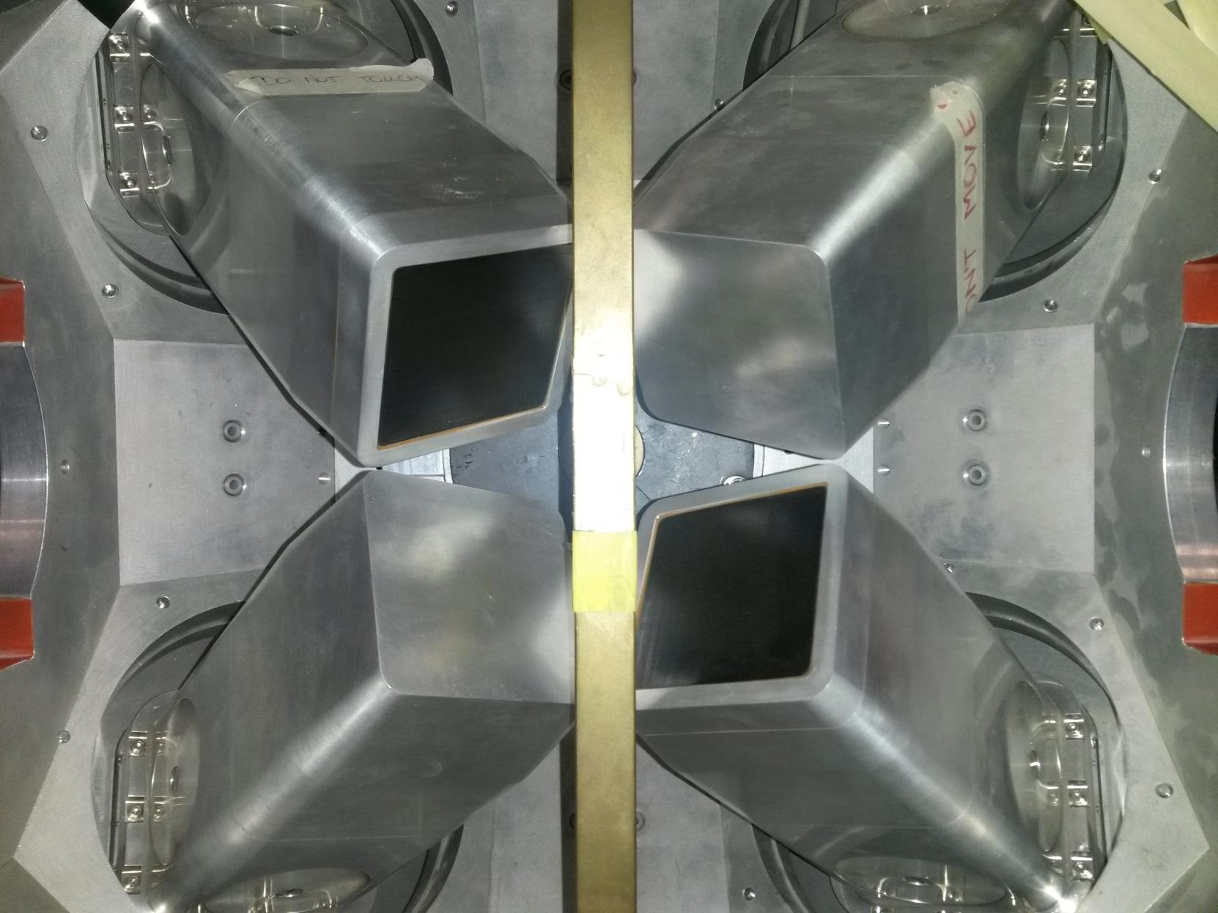
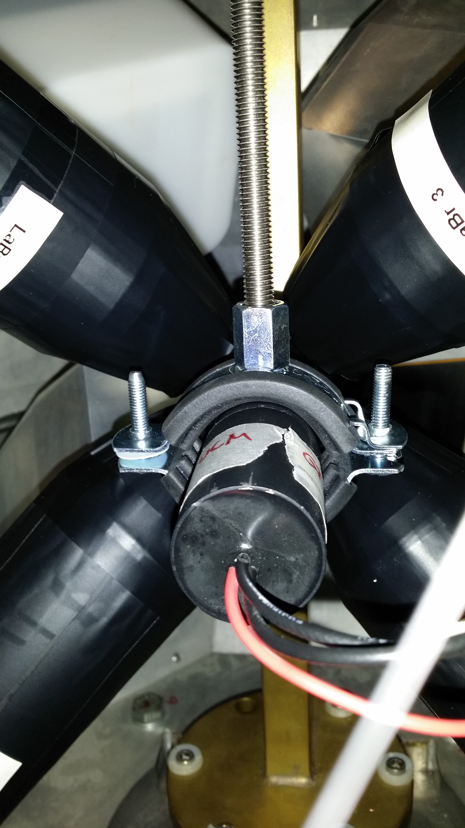

Slide 23
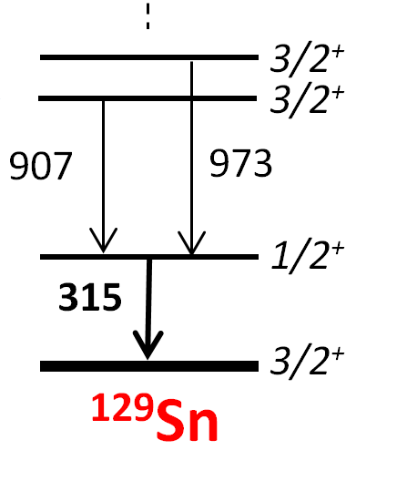
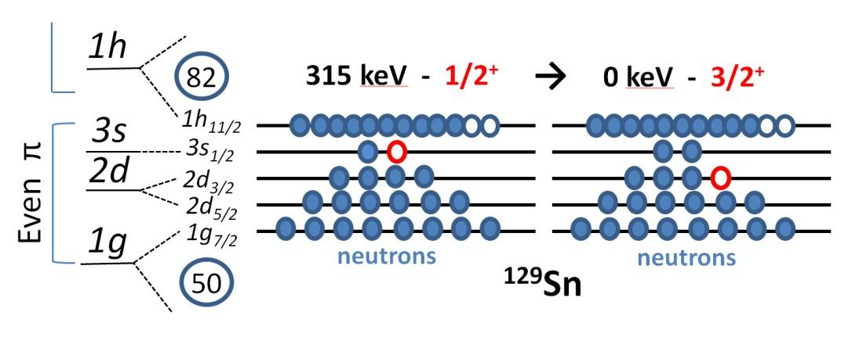
Structure of ¹²⁹Sn
Clovers + fast timing LaBr₃(Ce) detectors
  ¹²⁹Sn – semi-magic three neutron hole system
  Long-lived state is predicted: accessible via fast-timing
  Calculations available (A. Gargano)
H. Gausemel et. al, PRC 69, 054307 (2004)
[Razvan Lica]

Slide 24
Calculations available
Shell model (A. Gargano)
  ¹³²Sn core
  CD – Bonn
  ESPs from ¹³¹Sn
  effective charges and g-factors from Danchev et al.
    E(1/2⁺) = 294 keV
    3s_{1/2} → 2d_{3/2} M1 l-forbidden: matrix element ~ 0
    T_{1/2} ~ 4 ns

Slide 25
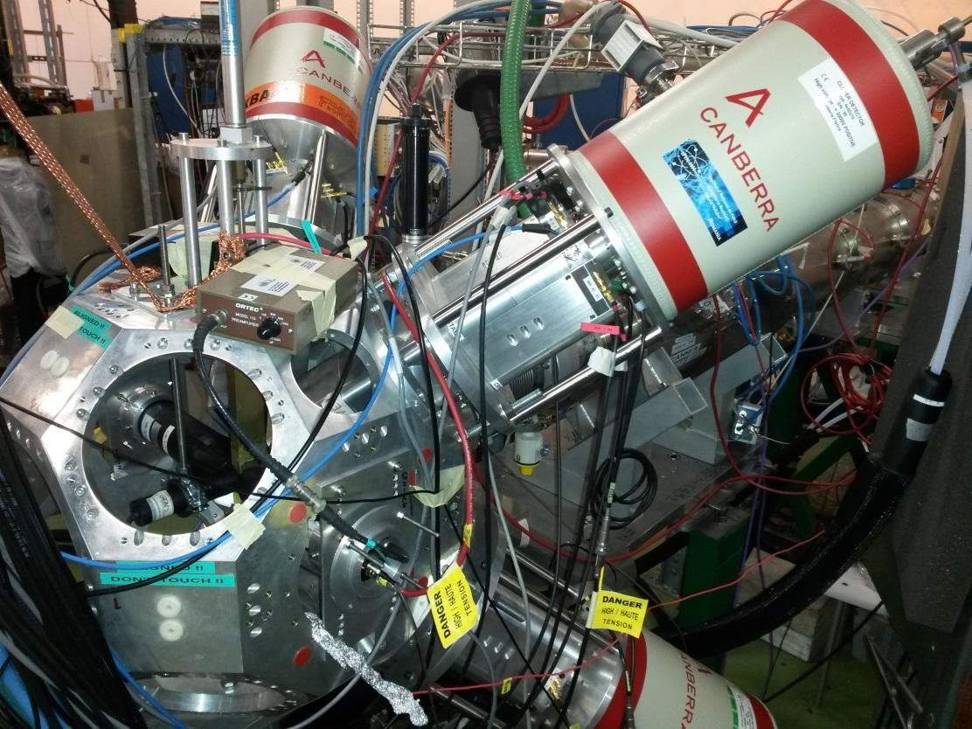
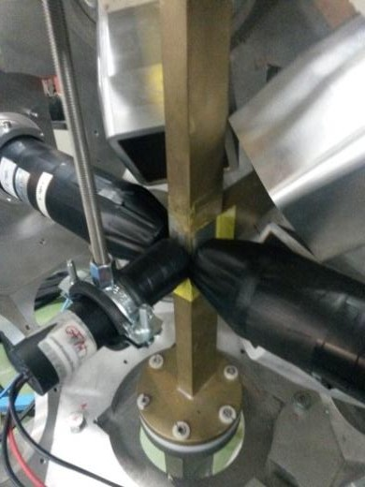



Measurements
September 2014: First fast-timing experiment at IDS
¹²⁹In pure beam
Modified setup
CFD + TAC timing
Dynode energies
Gain matching
Nutaq (+Grain + MIDAS

Slide 26
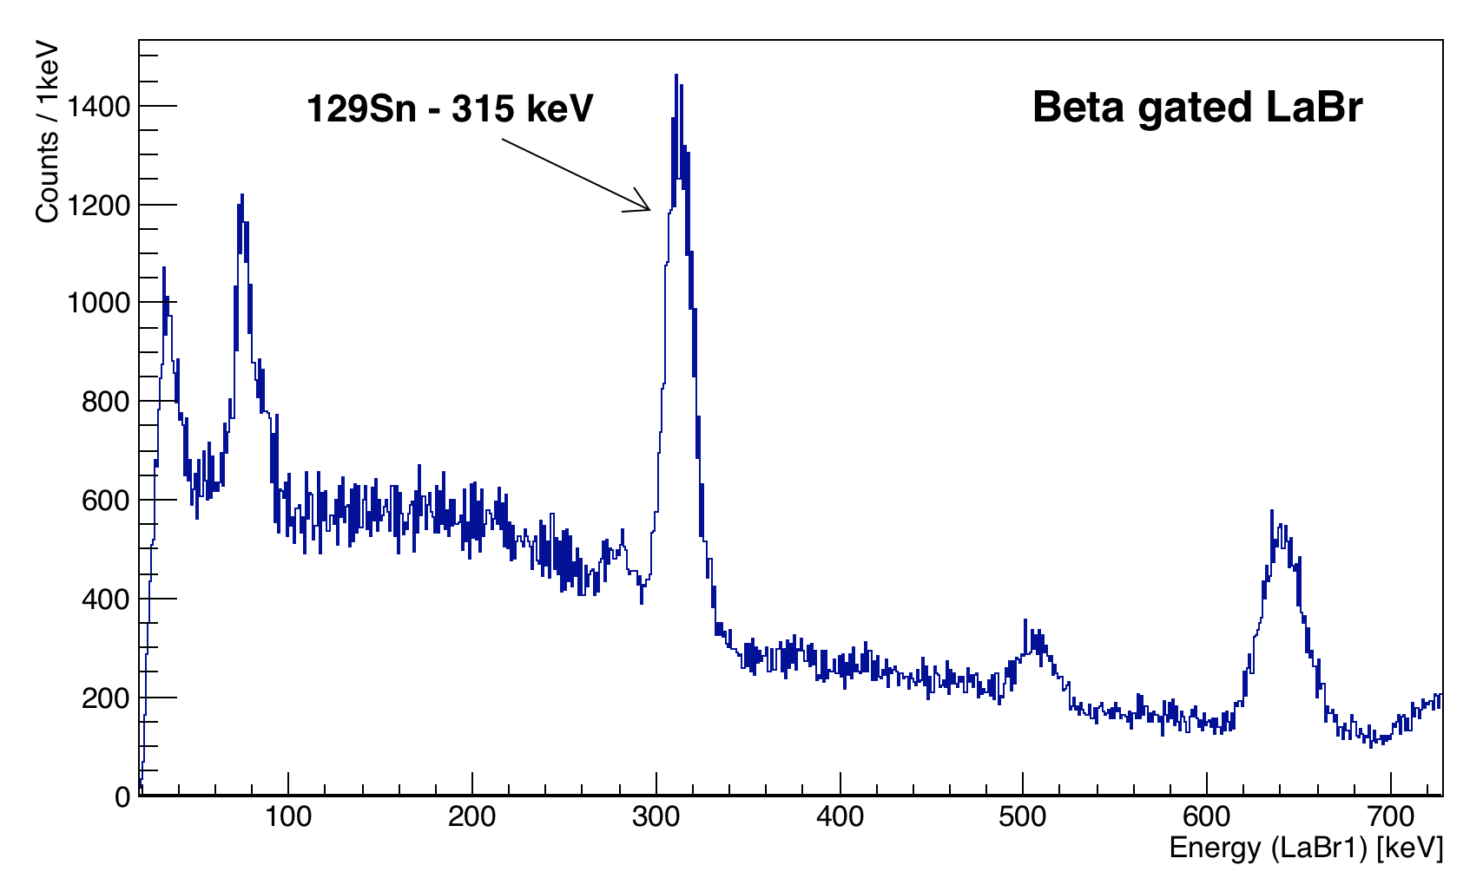
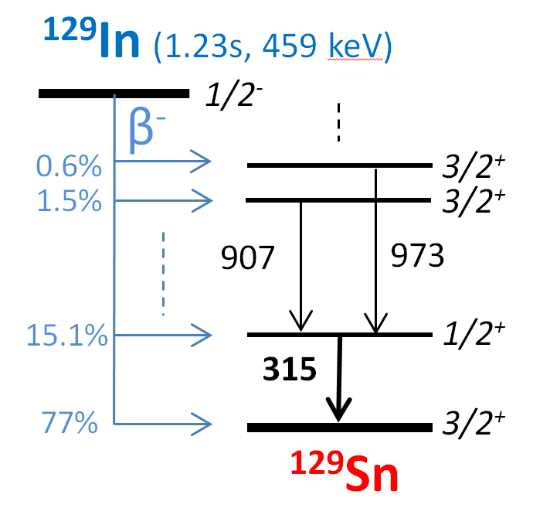
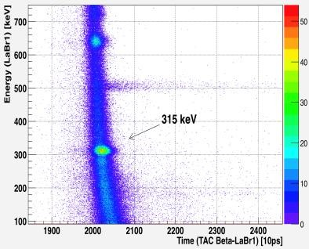
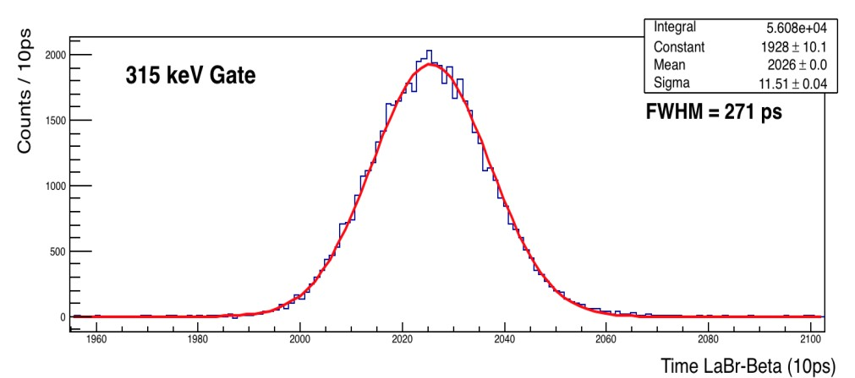
Analysis
[Razvan Lica + Henryk Mach]

Slide 27
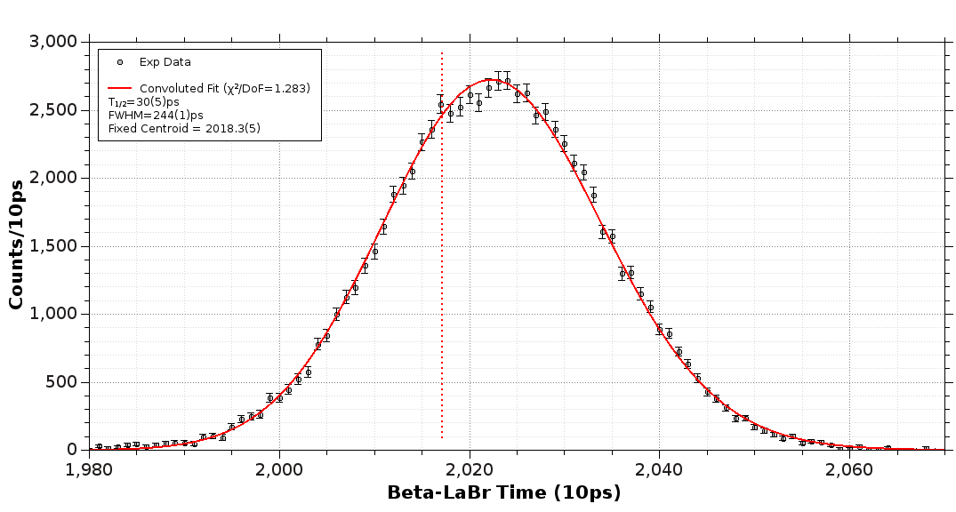
Preliminary results – conclusion
There is no indication of a long lived component in the beta-gated LaBr₃(Ce) timing spectrum
The preliminary centroid shift
analysis yields T_{1/2} < 40 ps limit
A slightly different from zero M1 effective operator for neutron holes greatly improves the agreement without changing any other matrix elements:
  <d_{3/2}| M1| s_{1/2}> - already known for proton particles (~0.14)
  unknown for neutron holes in the ¹³²Sn region
Possible first estimate from our measurement

Slide 28
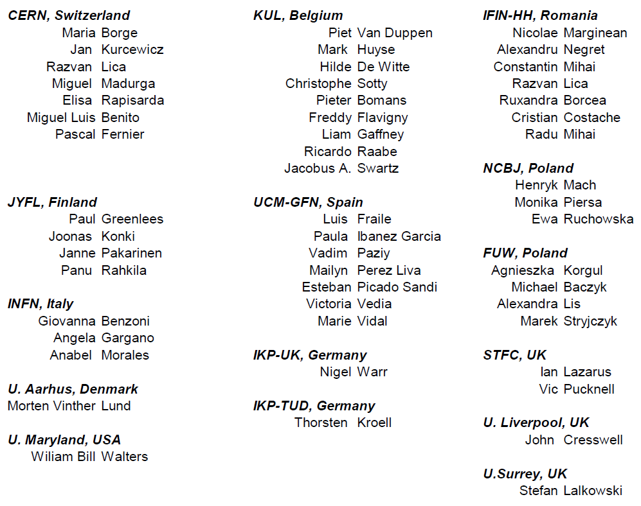
IS590 collaboration
Analysis by Razvan Lica [CERN]

Slide 29
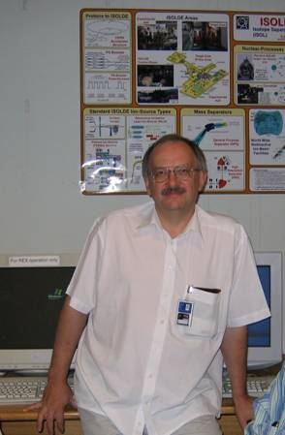
In memoriam
14 March 1952 – 15 December 2014

