Slide 1
Search for Triaxial Deformation in Neutron-Rich Mo/Ru Nuclei
Daryl Hartley
US Naval Academy
Support from the National Science Foundation is Gratefully Acknowledged

Slide 2
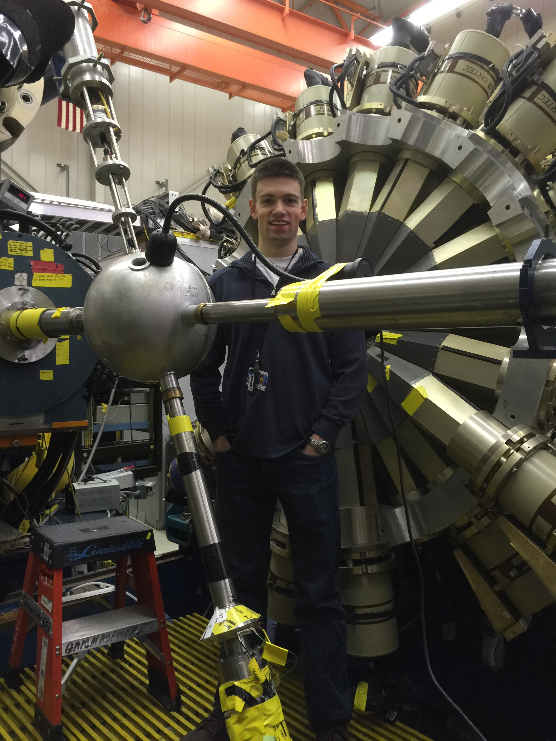
Gammasphere + ²⁵²Cf = Success
In the late 90’s, Joe Hamilton (Vanderbilt) put a ²⁵²Cf source inside Gammasphere over Christmas holidays
Many projects for Ph.D students and post-docs ever since (he even offered me some data)

Slide 3
Gammasphere + ²⁵²Cf = Success
Since 1998, his group has had >140 publications or proceedings from these data
A wide variety of physics was studied
  Chirality
  Octupole correlations
  Search for double γ-vibrational bands

Slide 4
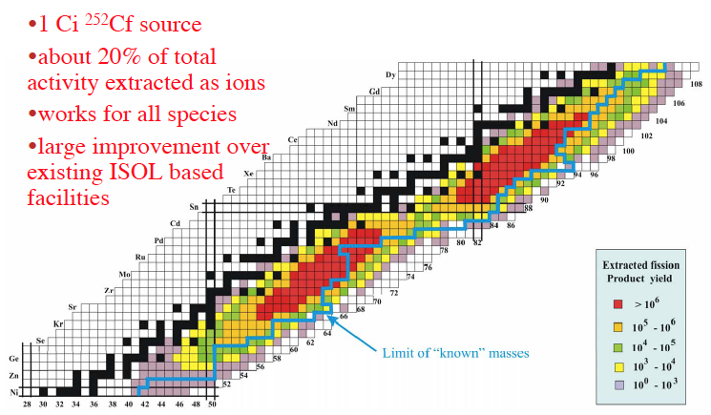
Wide Range of Nuclei Produced

Slide 5
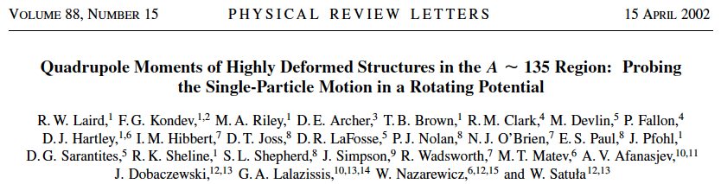
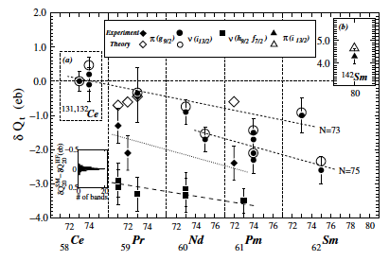
Comparative Analysis Free From Systematic Uncertainties

Slide 6
Triaxial Deformation
Energies of 1st and 2nd 2⁺ states plotted
Zr symmetric, well-deformed
Lowering of 2₂⁺ states in Mo and Ru may indicate presence of significant γ deformation (stable or vibrational)

Slide 7
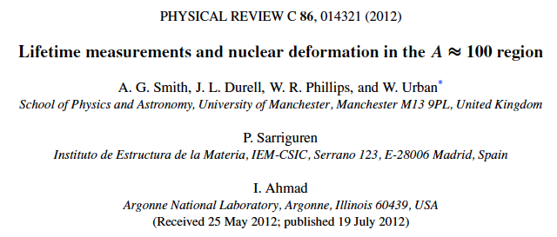
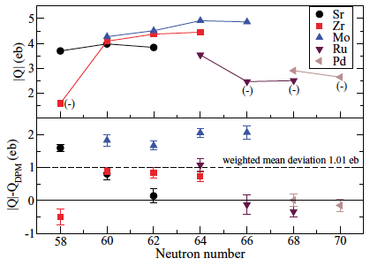
Theory Has Trouble With Mo’s
Difference between Q predicted by Skalaski et al., and those measured at
I ≈ 10 ħ

Slide 8
How Well Known are Half-lives of 2₁⁺ in Mo (Z = 42)?
LBNL: “plunger technique”

Slide 9
How Well Known are Half-lives of 2₁⁺ in Mo (Z = 42)?
LBNL: “plunger
technique”

Slide 10
How Well Known are Half-lives of 2₁⁺ in Mo (Z = 42)?
¹⁰⁰Mo(¹⁸O,¹⁶O)
DSAM

Slide 11
How Well Known are Half-lives of 2₁⁺ in Mo (Z = 42)?
β-γ(t) timing
Notes:
Liang from Julich

Slide 12
How Well Known are Half-lives of 2₁⁺ in Mo (Z = 42)?
γ(t)-γ(t)-γ(t) with GS
Differential Plunger
β-γ(t)
Notes:
Penttila from Jyvaskyla

Slide 13
B(E2) Rates for Mo

Slide 14
What We Can Do…
Get first measurement of ¹¹⁰Mo half-life, and much better measurement of ¹⁰⁸Mo
Obtain half-lives of the 2₁⁺ states in ¹⁰²⁻¹¹⁰Mo using the same technique and in the same environment
Eliminate systematic differences due to various timing methods and different experiments
Track deformation with N [B(E2) rates]
What about the Ru’s?

Slide 15
Half-lives in Ru (Z = 44) Nuclei
LBNL: “plunger technique”

Slide 16
Half-lives in Ru (Z = 44) Nuclei
LBNL: “plunger
technique”

Slide 17
Half-lives in Ru (Z = 44) Nuclei
β-γ(t)
Notes:
Schoedder – Jyvaskyla/Mainz

Slide 18
Half-lives in Ru (Z = 44) Nuclei
βγγ(t)
Notes:
Mach – Uppsala/Jyv

Slide 19
B(E2) Rates for Ru

Slide 20
Where We Stand With Ru’s
So the Ru’s half-lives are in better shape than the Mo’s
But the ¹¹²Ru needs to be measured again, and we should be able to make the first measurement of ¹¹⁴Ru
The second 2⁺ states are low enough where we can measure their half-lives as well!
Static or vibrational γ deformation in ^{110,112}Ru?

Slide 21
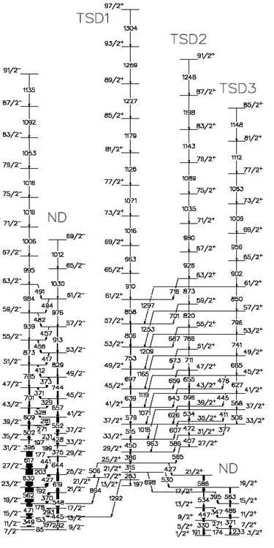
Wobbling Normally a High-Spin Behavior
Experimental proof of static triaxial deformation
First observed in ¹⁶¹Lu
  D.R. Jensen et al., Phys. Rev. Lett. 89, 142503 (2002)
Family of bands decaying into each other

Slide 22
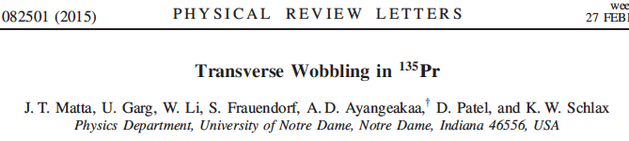
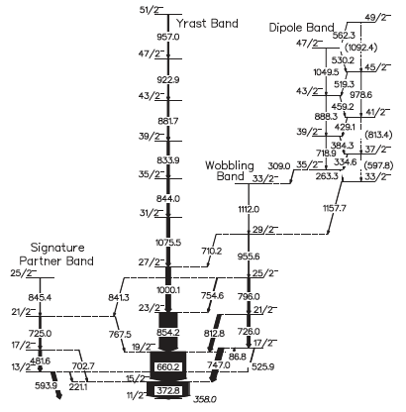
Now seen at low spin in ¹³⁵Pr
But all wobbling has only been
observed in odd-A nuclei
Where is it in even-A nuclei?

Slide 23
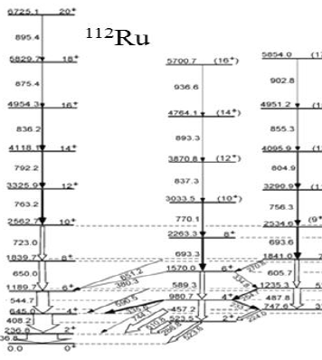
Wobbling in ¹¹²Ru?
Wobbling can occur for stable γ deformation
Hamilton’s group is suggesting the γ band in ¹¹²Ru is actually a wobbling band
  J.H. Hamilton et al., Nucl. Phys. A 834, 28c (2010)

Slide 24
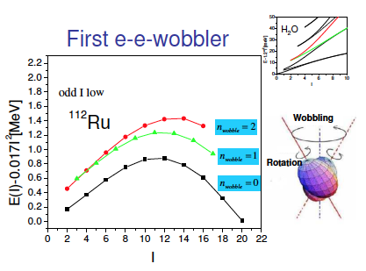
Wobbling in ¹¹²Ru?
Wobbling can occur for stable γ deformation
Hamilton’s group is suggesting the γ band in ¹¹²Ru is actually a wobbling band
  J.H. Hamilton et al., Nucl. Phys. A 834, 28c (2010)
Based on energy splitting – odd spin lowering in energy

Slide 25
Measure t_{1/2} of 2₂⁺ States to Help Determine if These are Wobbling or Vibrational Bands

Slide 26
Summary
²⁵²Cf + Gammasphere + FATIMA opens many physics opportunities
Systematic measurement of half-lives in scores of nuclei will be fantastic
Obtain t_{1/2} for ¹¹⁰Mo for the first time, and get better systematic values to track deformation effects in Z = 42 nuclei
Obtain t_{1/2} for 2₂⁺ states in ^{108,110,112}Ru to investigate static vs. vibrational γ deformation

Slide 27
Comparison of Mo’s with Möller

Slide 28
Comparison of Ru’s with Möller

Slide 29
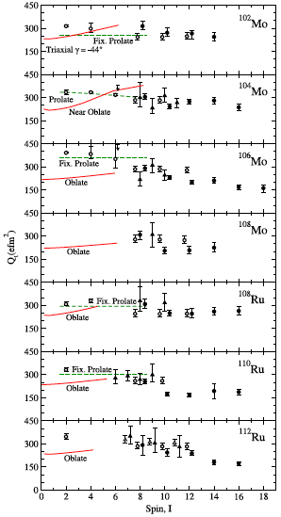
More Problems
J.B. Snyder et al., Phys. Lett. B 723, 61 (2013)
Relativistic mean field + BCS theory
Oblate predicted as ground-state shape
But the “excited” prolate minimum fits experiment better

