Slide 1




First results of the EXILL&FATIMA campaign at the Institut Laue Langevin
J Jolie¹, J.-M. Régis¹, D. Wilmsen¹, N. Saed-Samii¹, N. Warr ¹ , G. De France², E. Clement², A. Blanc³, M. Jentschel³, U. Köster³,
P. Mutti³, T. Soldner³, G.S. Simpson⁴, W. Urban⁵, A.M. Bruce⁶, S. Lalkovski⁶, O. J. Roberts⁶, L.M. Fraile⁷, H. Mach⁷, Th. Kröll⁸,
Zs. Podolyak⁹, P.H. Regan⁹, W. Korten¹⁰, C. A. Ur¹¹, N. Marginean¹¹
¹IKP, University of Cologne, Zülpicher str. 77, D-50937 Köln, Germany,
²GANIL, BP 55027, 14076 Caen CEDEX 5, France
³ILL, 71 Avenue des Martyrs 38042 Grenoble CEDEX 9, France
⁴LPSC, 53 rue des Martyrs, Grenoble, 38026, France
⁵Faculty of Physics, University of Warsaw, ul. Hoza 69, PL-00-681 Warsaw, Poland
⁶SCEM, University of Brighton, Lewes Road, Brighton BN2 4GJ, UK
⁷Departamento de Fisica Atomica y Nuclear, Universidad Complutese, 28040 Madrid Spain
⁸Institut für Kernphysik, TU Darmstadt, Germany
⁹Dep. Of Physics, Univ. of Surrey, Guildford GU2 7XH & Nat. Phys. Lab., Teddington, UK
¹⁰CEA, Centre de Saclay, IRFU, F-91191 Gif-sur-Yvette, France
¹¹Horia Hulubei NIPNE, 77125 Bucharest, Romania
Contents:
1. Introduction
2. Test of O(6) selection rule in ¹⁹⁶Pt
3. Lifetime of the first excited state in ⁹⁰Zr.
4. Conclusion

Slide 2
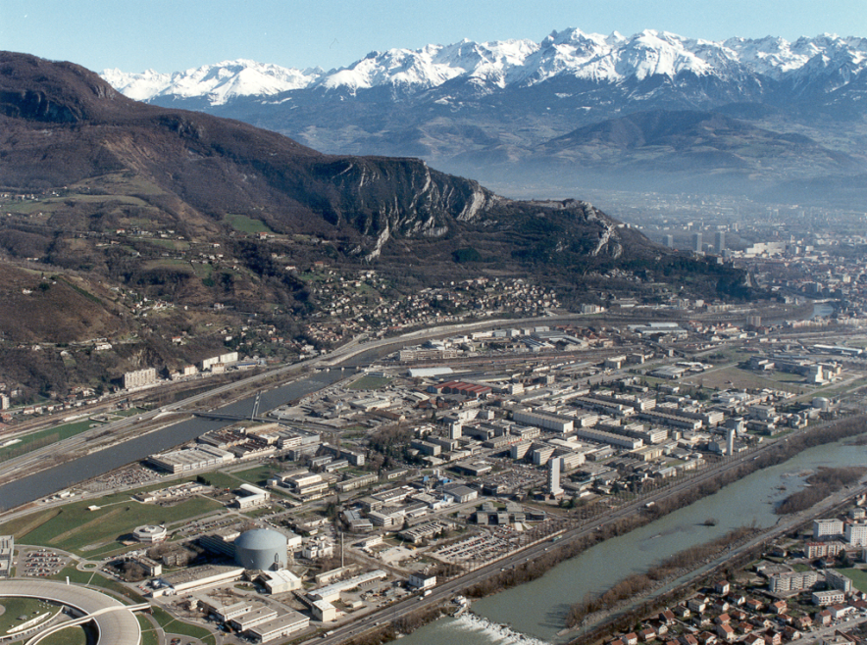
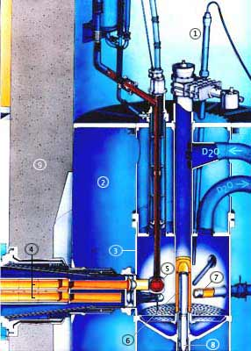
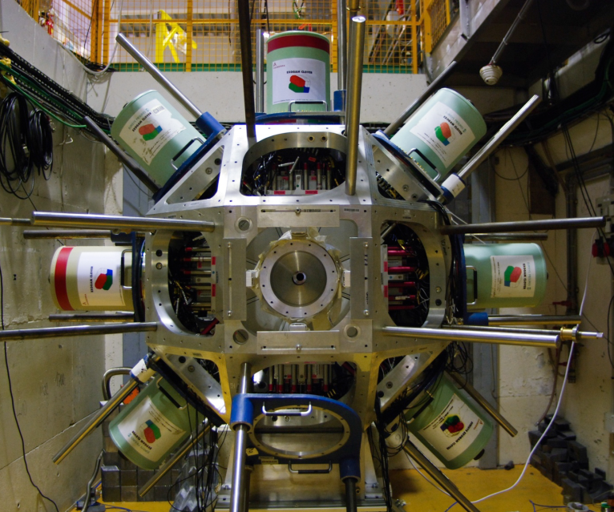
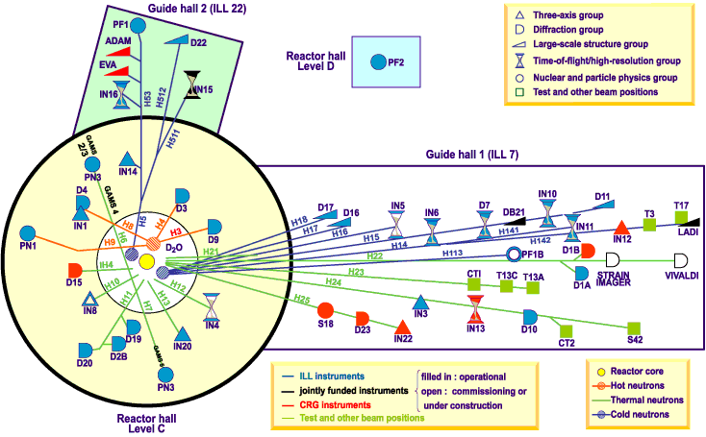
1. Introduction. EXILL = Exogam at Institut Laue Langevin
High Flux Reactor of the Institut Laue Langevin
in Grenoble France
8 Clover detectors of EXOGAM
PF1B
Cold neutrons have meV
energies
Flux up to 1.3 x 10¹⁰ n/s/cm²

Slide 3
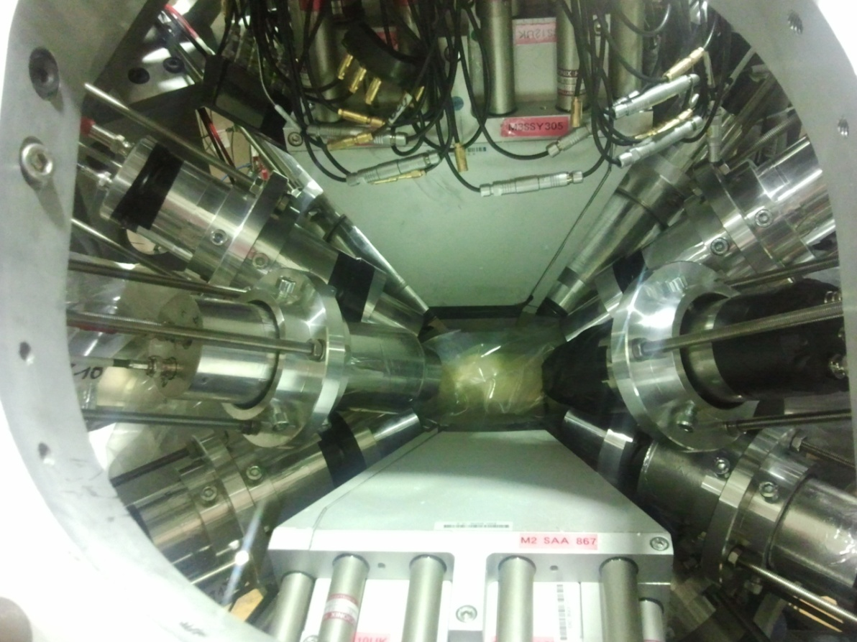
EXILL&FATIMA set-up for fast timing
FATIMA = FAst TIMing Array
FATIMA + EXOGAM
8 Ge Clover detectors from
EXOGAM with BGO shields
16 LaBr3(Ce) scintillators
from FATIMA
⁶
(n,fission) EXILL&FATIMA experiments
²³⁵U
²⁴¹Pu J.M. Régis (Köln)
(n,gamma) EXILL&FATIMA experiments
⁴⁶Ca(n,γ) ⁴⁷Ca. S. Leoni (Milano)
²⁰⁹Bi(n,γ) ²¹⁰Bi. B. Fornal (Warsaw)
¹⁹⁵Pt(n,γ) ¹⁹⁶Pt. J. Jolie (Köln)
of the 128 possible LaBr3-LaBr3 combinations for fast timing only 96 could be used for fast timing due to Compton scattering between neighboring detectors.

Slide 4
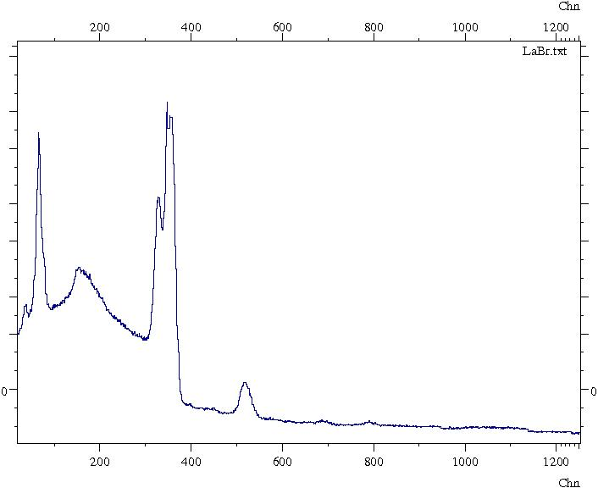
Cold neutron flux of
2⋅10¹⁰/(ns ⋅ cm²) from
the ILL reactor with but
20cm by 12cm beam.
Collimated to 1cm diameter beam
of 10⁸/(ns ⋅ cm²) on target
356
²³⁵U(n,fission)
Ge singles
333
¹⁹⁵Pt(n,γ)
LaBr₃ singles

Slide 5
The Generalized Centroid Difference (GCD) method for γ-γ fast timing arrays
[J.M. Régis et al., NIM A 726 (2013)191]
The superposition of the N(N-1)/2 (aligned) time difference spectra:
This procedure is mathematically equivalent to the definition of the mean:
The mean prompt response difference PRD describes the combined zerotime vs. energy (timewalk)
characteristics of the whole FATIMA spectrometer.

Slide 6
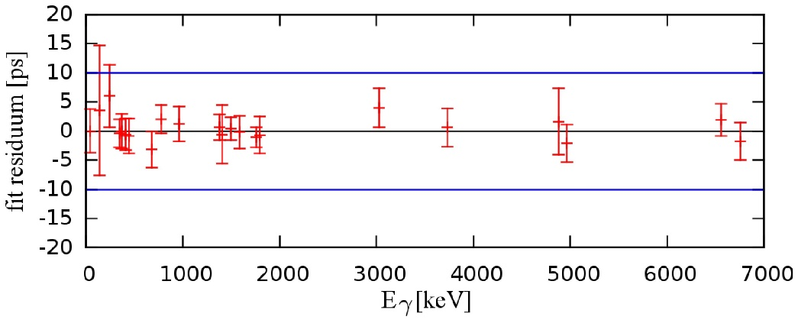
The EXILL&FATIMA PRD was measured with a ¹⁵²Eu source (E: 40-1408 keV) and the ⁴⁸Ti(n,γ) ⁴⁹Ti reaction ( E: 137-6760 keV)
⁴⁸Ti(n,γ) ⁴⁹Ti
The accurracy of the PRD is 10 ps.
J.M. Régis et al. NIMA 763 (2014) 210

Slide 7
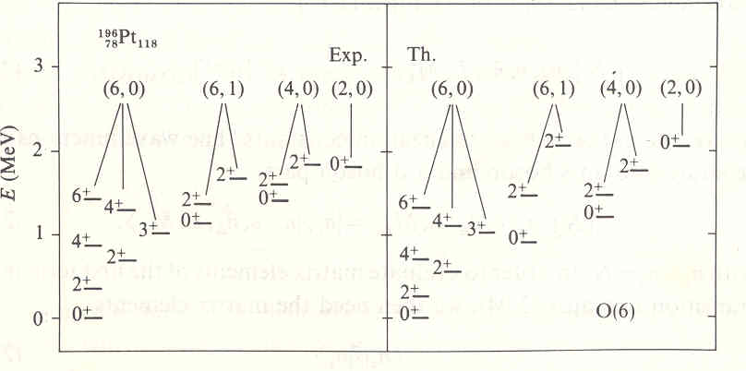
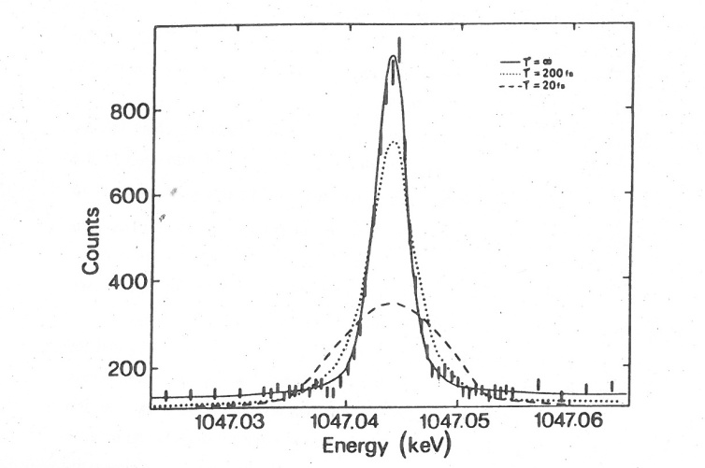
2. Test of O(6) selection rule in ¹⁹⁶Pt
The O(6) limit of the sd interacting boson model
E_{γ}=1047 keV
is an SO(6) generator
Test of O(6) selection rule in 1990 using lifetime data.
τ > 1.86 ps
E2 transitions between different SO(6) representations are forbidden.
Börner, Jolie, Robinson, Casten, Cizewski
Phys. Rev. C42 (1990) R2271

Slide 8
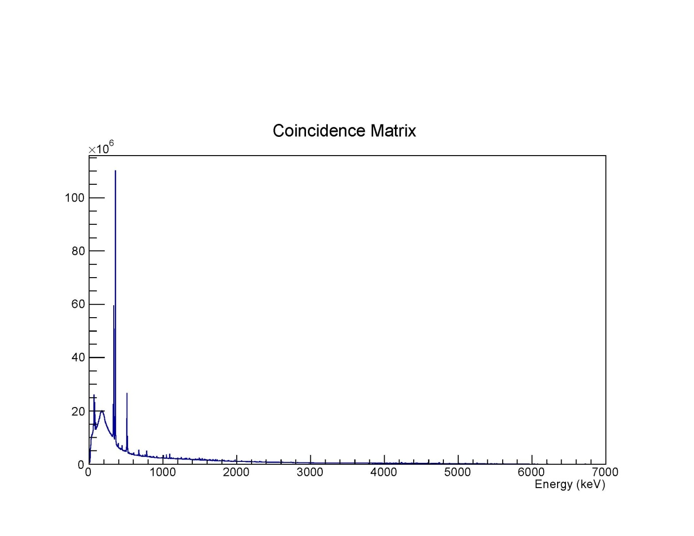
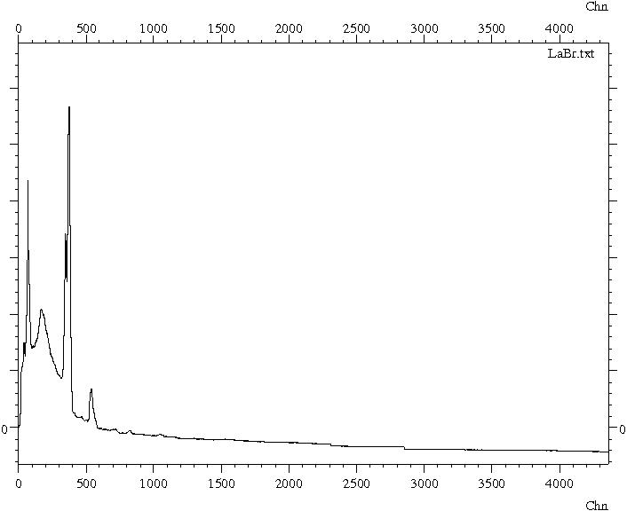
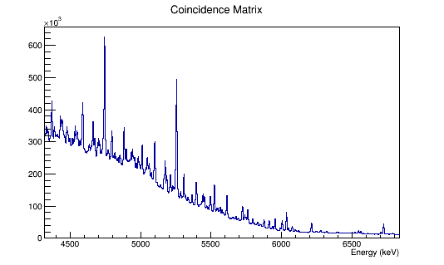
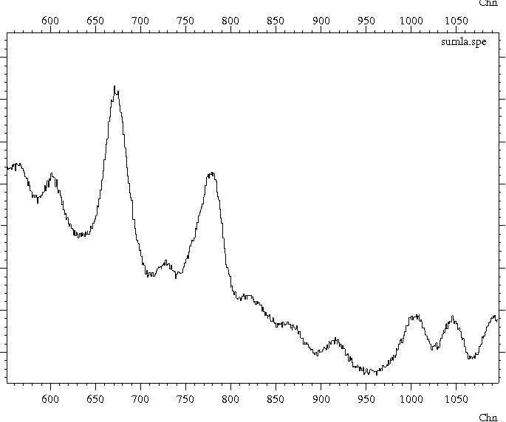
In order to determine the lifetime or an upper limit of the lifetime we performed a (n,γ) fast timing measurement using the FATIMA@EXILL set up.
The experiment took place during 19 hours.
The target was 143 mg of ^{nat}Pt.
The thermal cross section for ¹⁹⁵Pt(n,γ)¹⁹⁶Pt is 28 barns and dominates over the ones of the other Pt isotopes.
The Ge countrate was 263500 Hz and the LaBr3 one 192000 Hz. Total singles: 3 10¹⁰.
Ge doubles with Compton
suppression but without add-back
LaBr3 triples projection

Slide 9
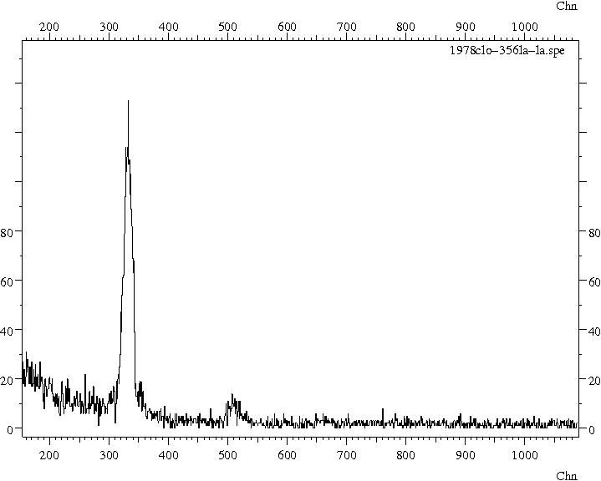
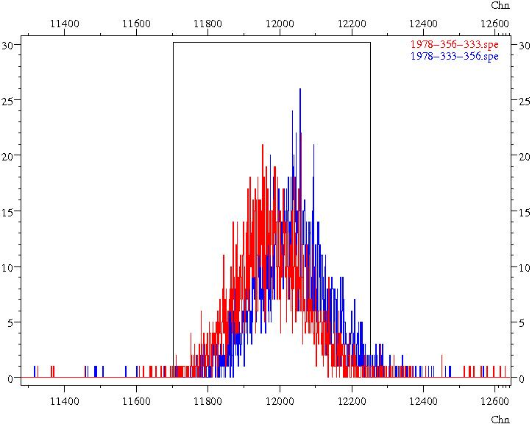
Lifetime of the first 2⁺ state
After Compton suppression and add back in Clover detectors
333 keV
Ge gate: 1978 keV
LaBr gate: 356 keV
Ge gate: 1978 keV
LaBr gates: 356 and 333 keV
Decay start
Decay stop
ΔC=108(5)ps
1+,2+
2667
1978
2+
689
333
2+
356
356
0+

Slide 10
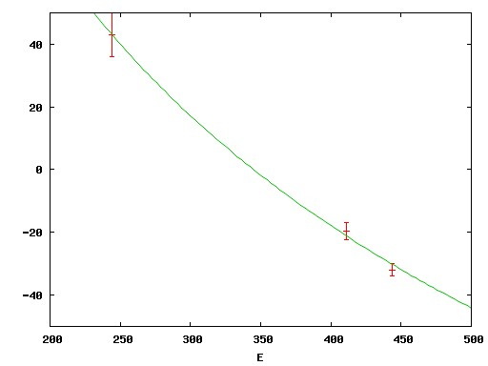
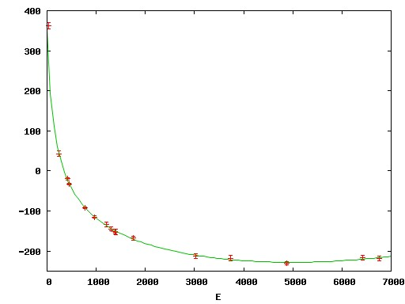
This work
Coulex
Delayed coinc
RDM
RDM+DSA
ps
60
Prompt response difference curve
from Eu source and ⁴⁸Ti(n,γ)
normalised at 344 keV
50
40

Slide 11
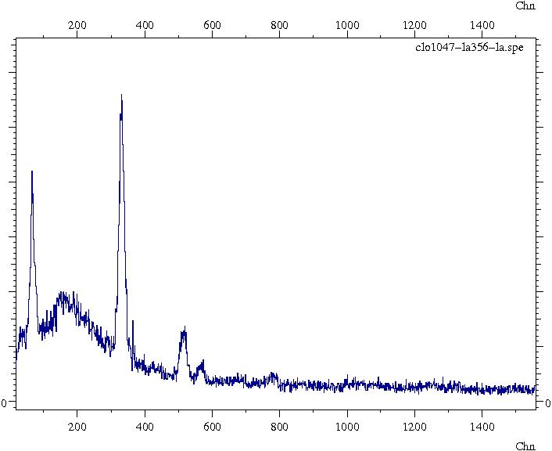
Lifetime of 1403 keV 0⁺ state
Ge gated-LaBr3 coincidences
1,2+
2184
333
1,(2)+
1970
566
Ge gate: 1047 keV
LaBr gate: 356 keV
1048
0+
1403
0+
1135
780
1047
446
2+
333
446
2+
356
566
780
356
0+

Slide 12
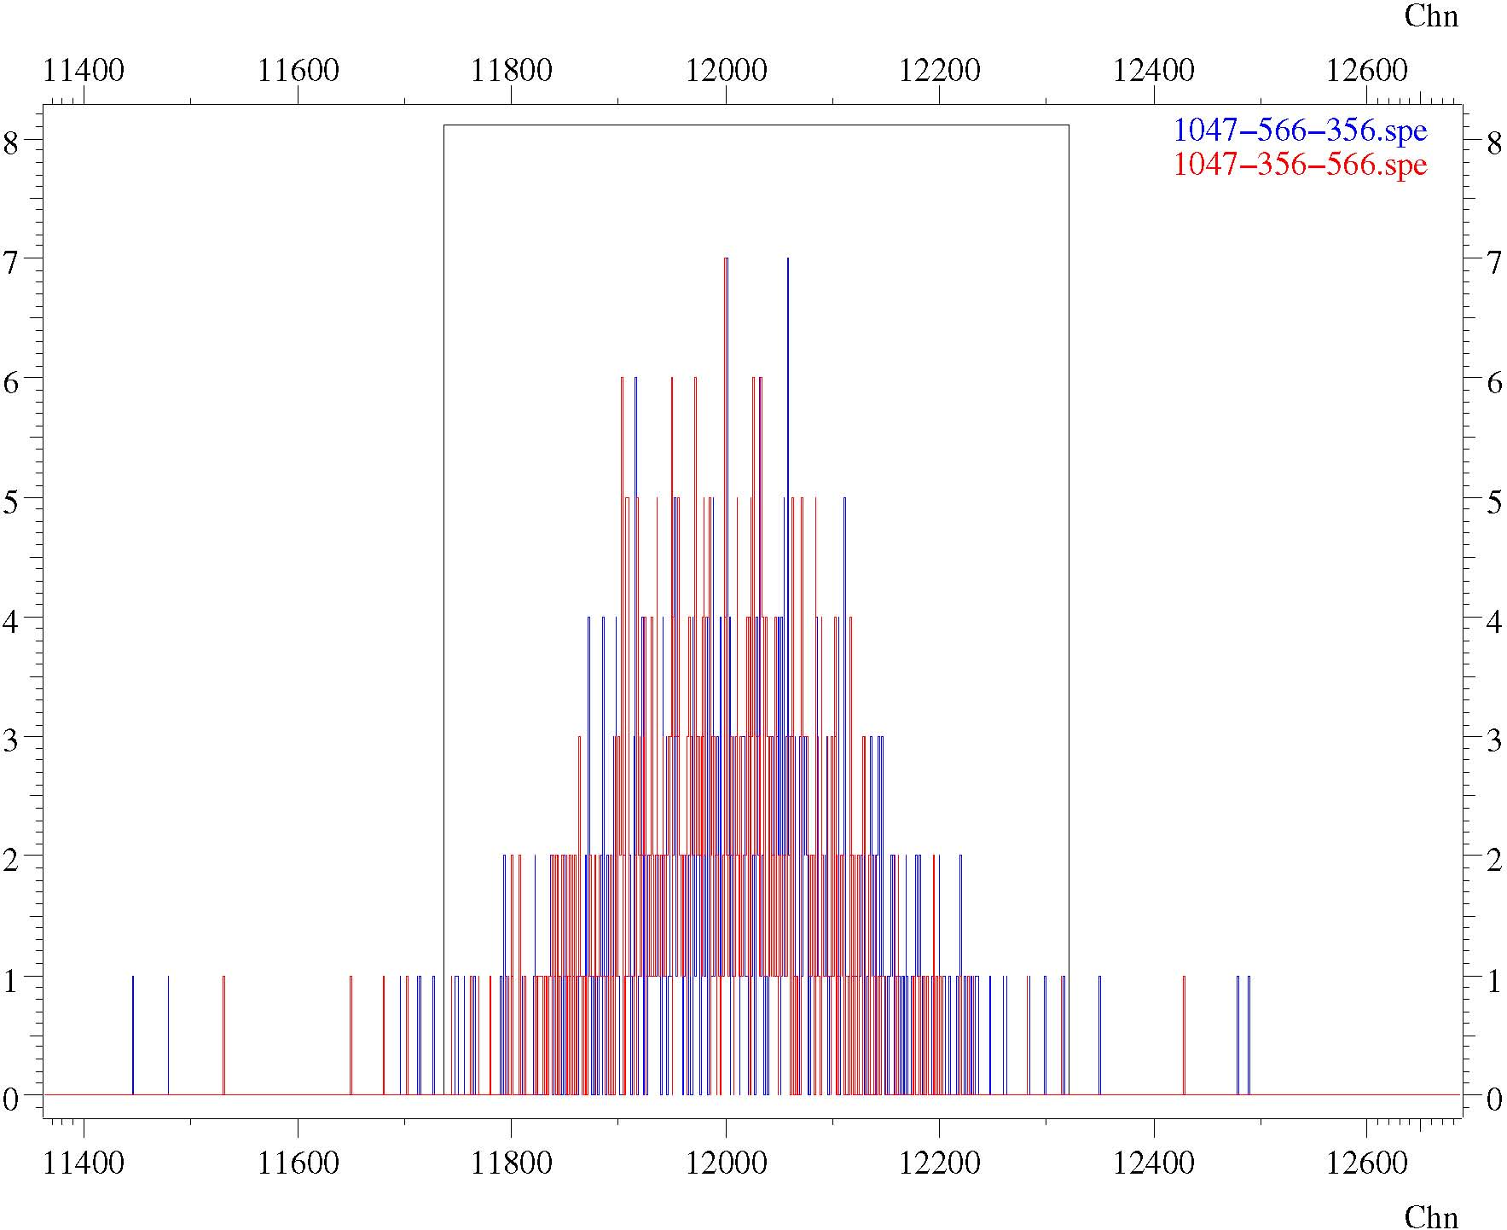
Ge gated-LaBr3-LaBr3 triple coincidences
Ge gate: 1047 keV
LaBr gates: 356 and 566 keV
Decay start
Decay stop
ΔC=53(11)ps

Slide 13
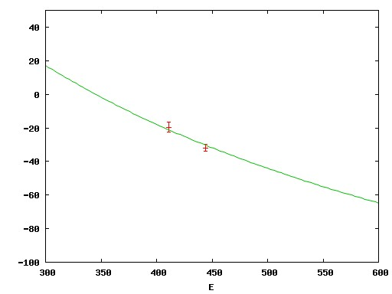
Using and the known lifetime of 2⁺₁ of 49.2(2) ps we thus obtain:
and using the lower limit from GRID one obtains:
Compared to the allowed transitions those are hindered by one to two orders of magnitude.
Compared to unpublished Gammasphere Coulex data of N.Pietralla:
an excellent agreement is reached by three very independent methods.
J. Jolie et al. Nucl. Phys. A 934 (2015) 1.

Slide 14
3. Lifetime of the first excited state in ⁹⁰Kr.
Around Z=40 a sudden onset of
collectivity is observed at N=60
in Zr and Sr but not in Kr isotopes
as revealed by our measurements
of B(E2; 2⁺ →0⁺ ) values in ^{88,92,94,96}Kr
at REX-ISOLDE. However we couldn´t
measure there ⁹⁰Kr.
⁹⁰Kr
M. Albers et al. Phys. Rev. Lett. 108 (2012) 062701
To determine the B(E2; 2⁺ →0⁺ ) value in ⁹⁰Kr we used the cold neutron induced fission of ²³⁵U.
Note that ⁹⁰Kr is directly obtained as fission product with a yield of 4.4%.
The target was surrounded with thick Be backings to stop the fission fragments within one ps.
Gating can be done on the ground state transition of the other fission fragment to clean up the
spectra, i.e. on 2⁺ →0⁺ transition from ¹⁴⁴Ba for ⁹⁰Kr.
Data was taken during 12 days.

Slide 15
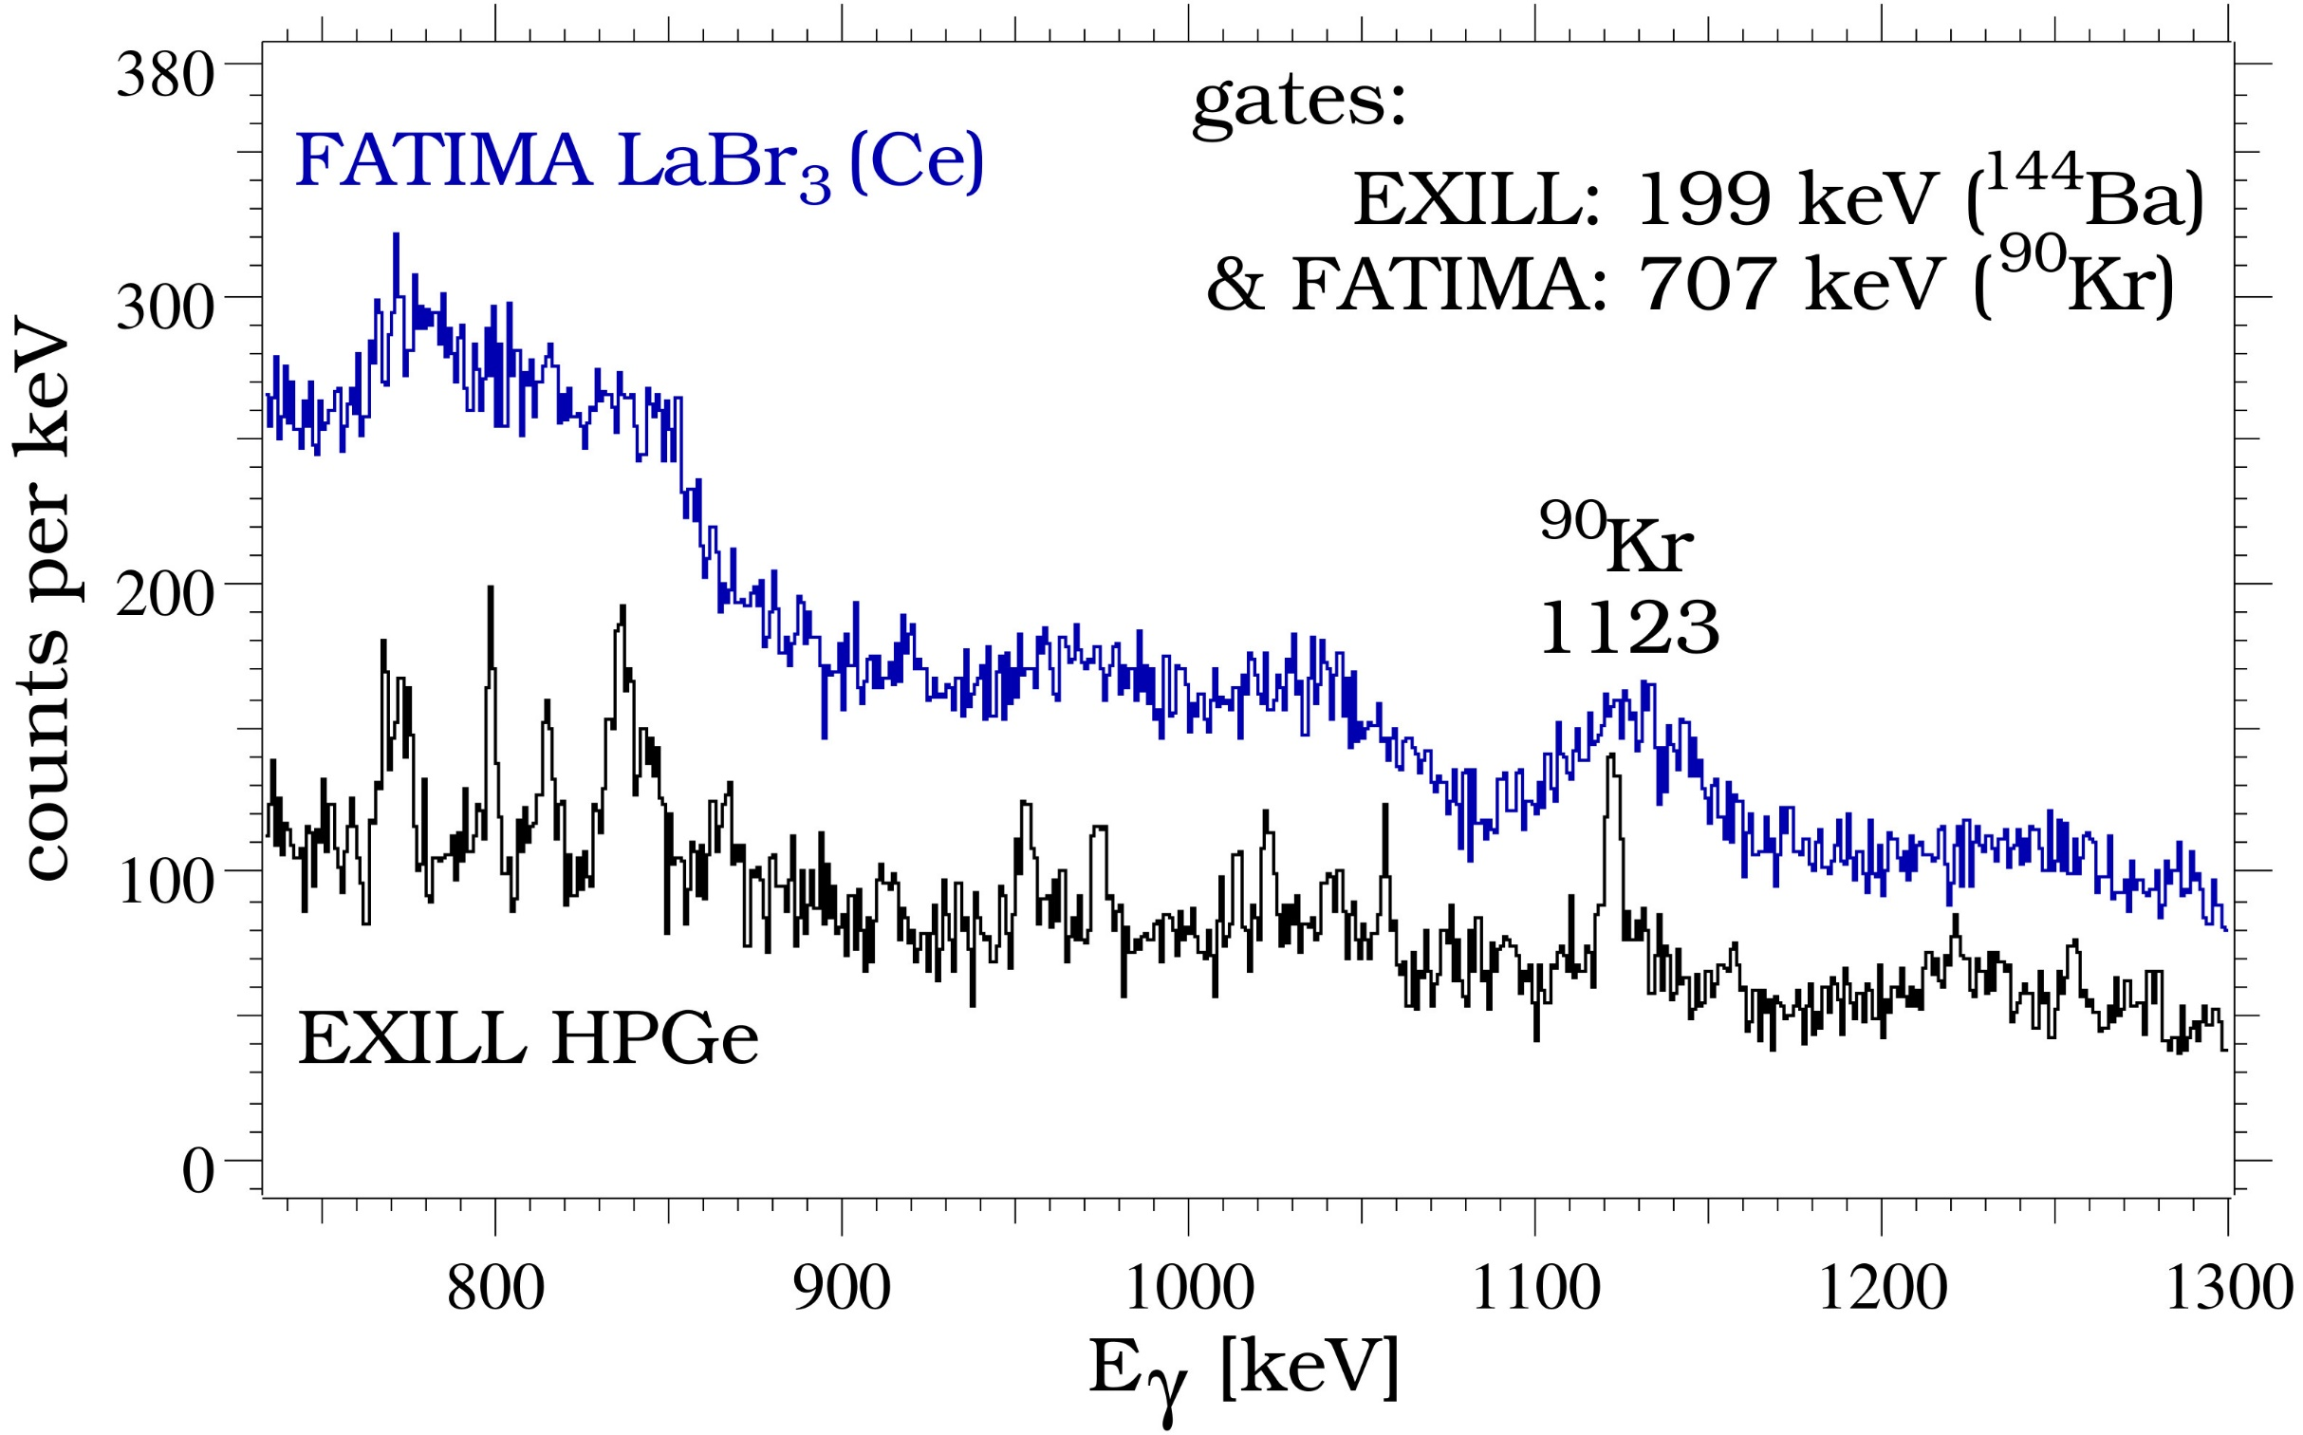
Double gated coincidence spectrum
4⁺
2⁺
1123
2⁺
707
0⁺
⁹⁰Kr

Slide 16
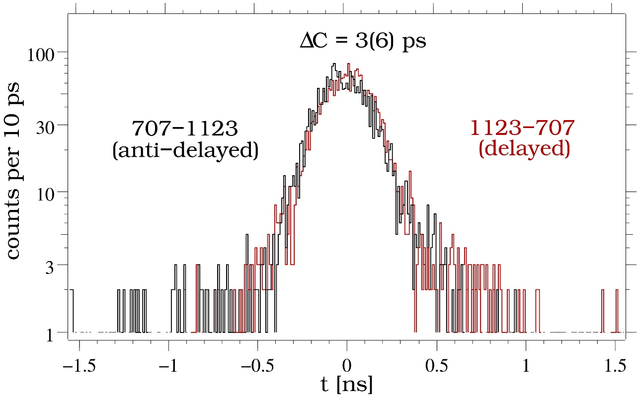
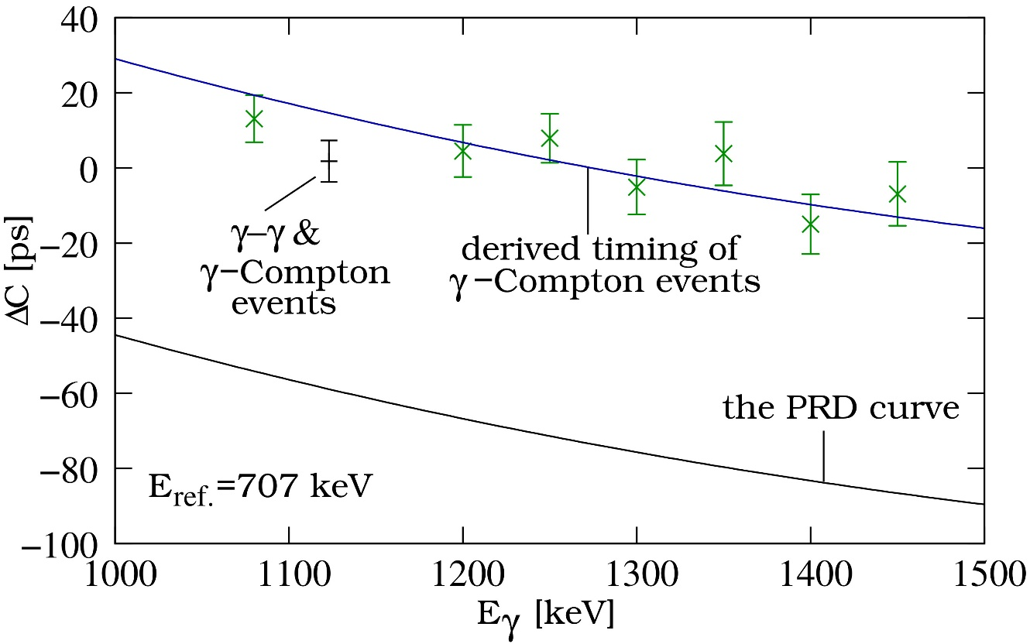
A Compton correction is needed:
With the peak to background (ptb) ratio of 0.36
J.M. Régis et al. Phys. Rev. C 90 (2014) 067301

Slide 17
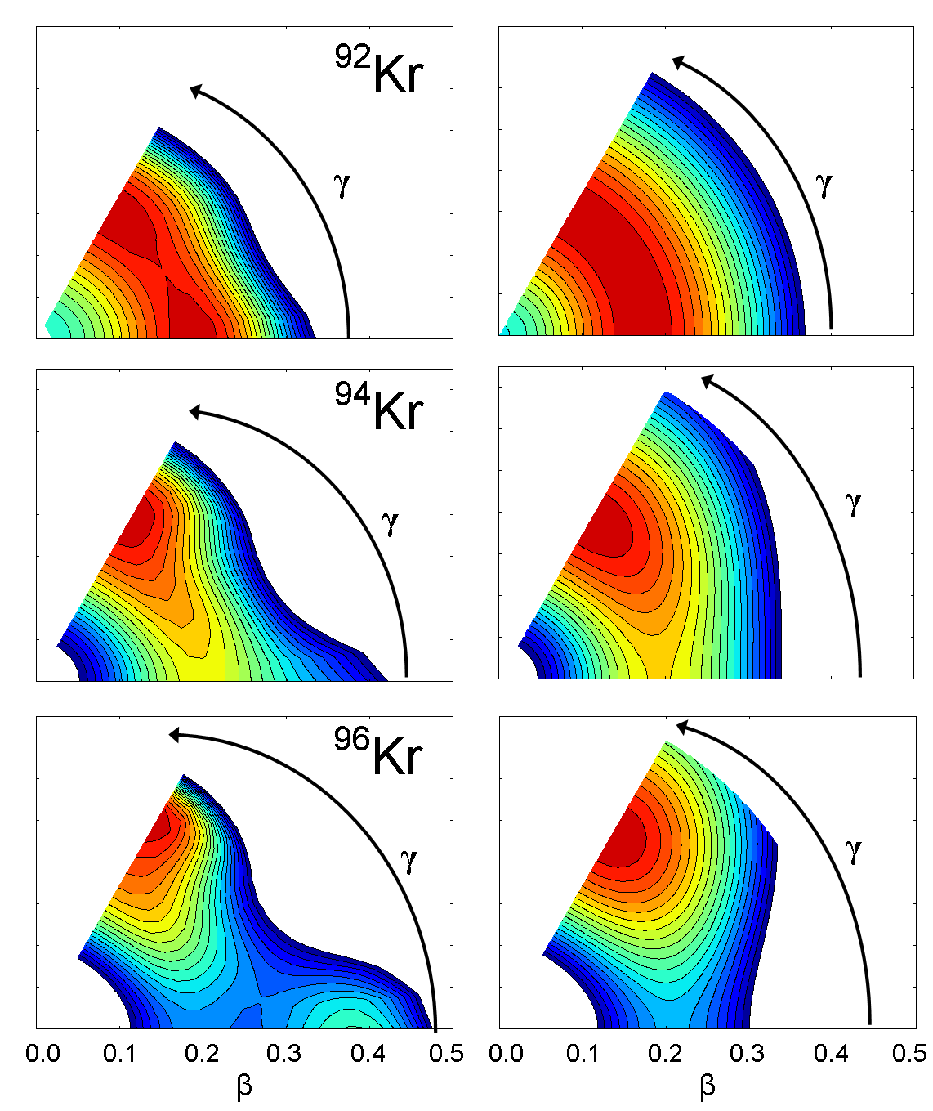
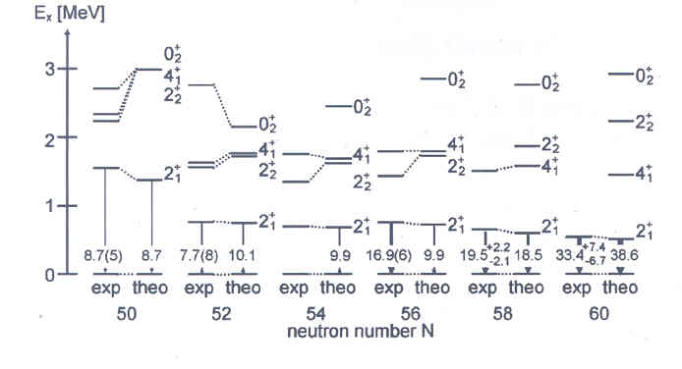
Comparison with IBM-2 predictions based on mean field calculations
mean-field
IBM-2
M. Albers et al., Phys. Rev. Lett.108 (2012) 062701

Slide 18
4. Conclusion
The EXILL&FATIMA campaign at ILL delivered excellent data.
The new generalized centroid difference method works marvellous.
For the first time an absolute B(E2) values between states with different O(6) quantum
numbers could be measured and was found to be:
compared to the allowed transitions those are hindered by one to two orders of magnitude.
For the first time the B(E2; 2⁺ →0⁺ ) value in ⁹⁰Kr could be measured completing our systematics in very
neutron rich Kr isotopes.
A lot more has to follow from the complete analysis of the EXILL&FATIMA data.
Thanks a lot for your attention.

Slide 19
The Generalized
Centroid-Shift method
W. Andrejtscheff et al., NIM 204 (1982) 123-128
N calibrations of the zero-time response
of N detectors.
Each γ−γ event is adjusted by 2 corrections.
Each corrected γ−γ event is incremented in
the “start” and the “stop” time spectra
(after corrections, the timing is symmetric).
Symmetric (E,E,t) matrix.
Due to corrections, the zero time t₀ is constant.
|C-t₀|=τ
(ΔC=2τ, as the identical time spectra
are mirrored with respect to t₀)
Major working time: N to 2N days.
Systematic error = ?
The Generalized
Centroid Difference method
J.-M. Régis et al., NIM A 726 (2013) 191-202
No calibrations.
No corrections.
The timing is asymmetric.
Distinction between start and stop events and
incrementation in the according time spectrum.
Asymmetric (E_{start},E_{stop},t) matrix.
The zero time is not constant.
ΔC=PRD+2τ
(calibration of the PRD curve,
the combined γ−γ zero time of FATIMA)
Major working time: 1 to 2 days.
Systematic error = 1/2 of PRD accuracy (~5 ps)

Slide 20
Warning when using
time response from ⁶⁰Co
(or ²⁴Na).
64 ps
ΔC [ps]
The PRD curve
E_{ref.}=1333 keV
E_{γ} [keV]
See also H. Mach et al. Nucl. Phys. A 523 (1991) 197 section 2.3.

