Slide 1









Shape Evolution and Shape Coexistence in Neutron Rich A~100 Nuclei
Wolfram Korten
CEA Saclay, France
DSM-IRFU
FATIMA Workshop
March 20th, 2015

Slide 2
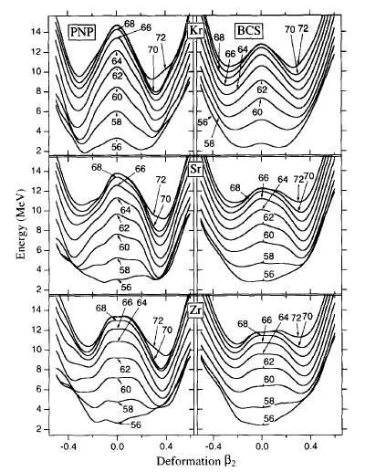

Shape evolution in neutron-rich nuclei around A~100
¹⁰⁰Ru
¹⁰²Ru
Kr
¹⁰⁴Ru
¹⁰⁶Ru
¹⁰⁸Ru
⁹⁶Mo
⁹⁸Mo
¹⁰⁰Mo
¹⁰²Mo
¹⁰⁴Mo
¹⁰⁶Mo
¹⁰⁸Mo
⁹⁴Zr
⁹⁶Zr
⁹⁸Zr
¹⁰⁰Zr
¹⁰²Zr
¹⁰⁴Zr
¹⁰⁶Zr
⁹⁶Sr
Sr
⁹²Sr
⁹⁴Sr
⁹⁸Sr
¹⁰⁰Sr
¹⁰²Sr
¹⁰⁴Sr
⁹⁰Kr
⁹²Kr
⁹⁴Kr
⁹⁶Kr
⁹⁸Kr
¹⁰⁰Kr
¹⁰²Kr
⁹⁰Se
⁹²Se
⁹⁴Se
⁹⁶Se
⁹⁸Se
Zr
HFB+GCM(GOA) calculations
with Gogny D1S force,
J.P. Delaroche et al., PRC 81 (2008)
HF-BCS mean field calculations
J. Skalski et al., NPA617 (1997) 282
Rich variety of nuclear shapes
Oblate and prolate minima, varying with (Z,N)
Shape coexistence
Triaxial degree very important, e.g. Ru isotopes

Slide 3
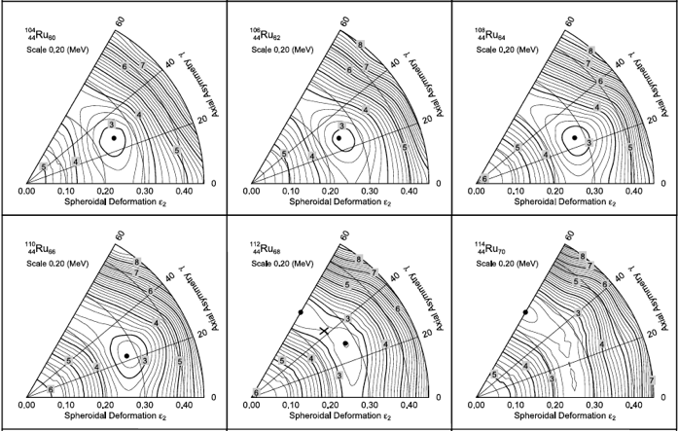
Shape evolution in neutron-rich nuclei around A~100
Potential energy surfaces for 44Ru isotopes from FRLDM model
P. Moeller et al., At. Data Nucl. Data Tabl. 94 (2008)

Slide 4
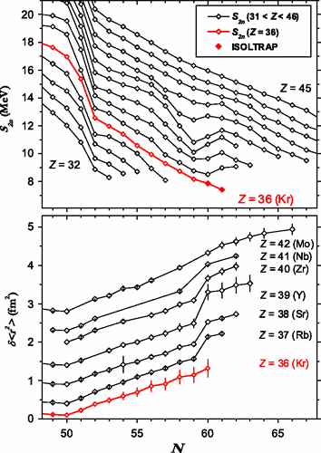
Evidence for shape changes at N=60
Excitation energies of
first 2⁺ and 4⁺ states
Two-neutron separation energies (S_{2n})
and mean square radii (δ<r²>)
S. Naimi et al., PRL 105 (2010) 032502

Slide 5
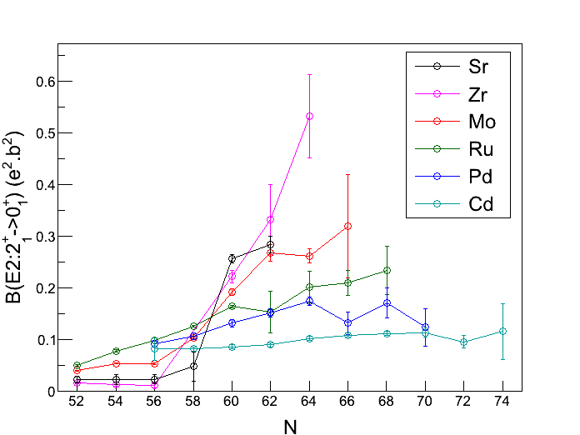
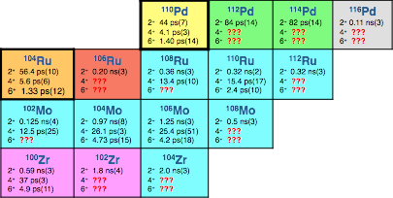
Shape evolution in neutron-rich nuclei around A~100
N=60
Need for more detailed information
→ collectivity beyond first 2⁺ state
→ in more neutron rich nuclei
→ quadrupole moments (Coulex)
Life time measurements in more neutron-rich isotopes and towards higher spins
wide range of lifetimes from (a few) picoseconds to several nanoseconds
Étude de la structure des noyaux riches en neutrons dans la région A~100

Slide 6
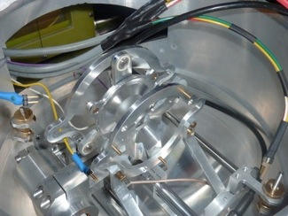
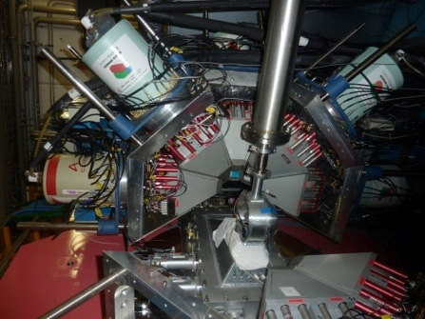
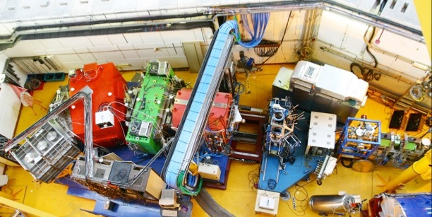
In-flight studies of fission fragments at GANIL (E604)
Fusion-fission reaction ²³⁸U + ⁹Be in inverse kinematics (E* ≈ 45 MeV)
Target
⁹Be 2.3 mg/cm²
Degrader
²⁴Mg 5 mg/cm²
θ=20°
Focussing quadrupoles
MWPPAC - ToF
²³⁸U 6.2 MeV/u
Dipole
v/c ~ 0,1
d
Drift chambers – x,y,θ,φ
Cologne Plunger
7 distances :
35 →1550 μm
τ ~ 1- 100 ps
EXOGAM
10 Ge Clover det.
Ionisation chamber - ΔE
Silicium detectors - E_{res}
VAMOS spectrometer
Fission fragment identification
in q, M and Z
￼
Étude de la structure des noyaux riches en neutrons dans la région A~100

Slide 7

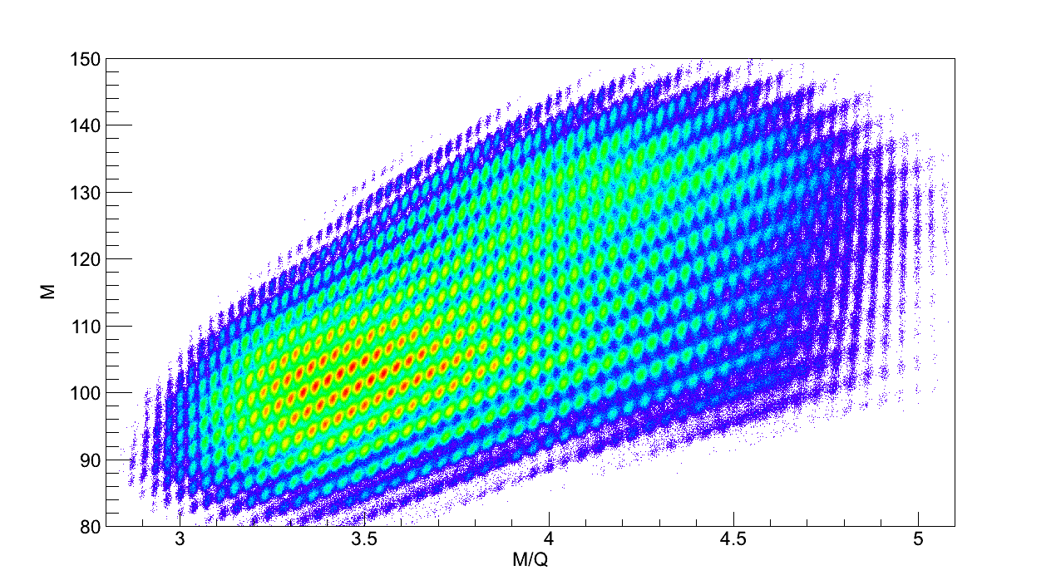
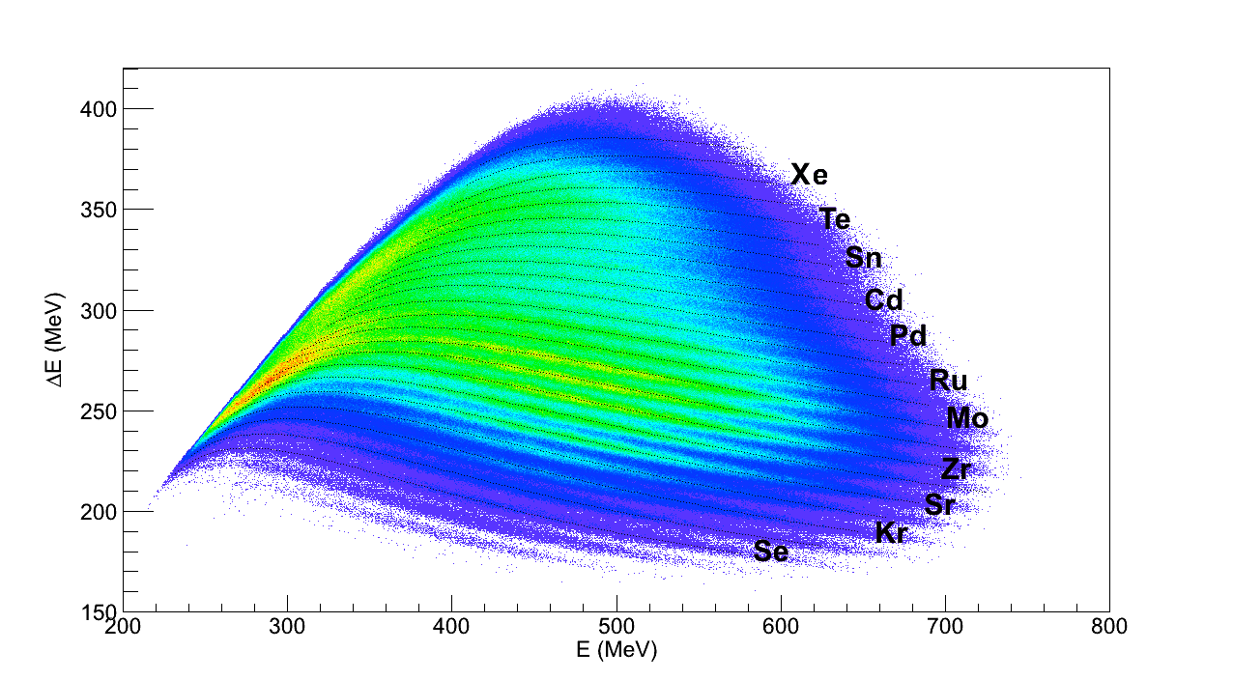
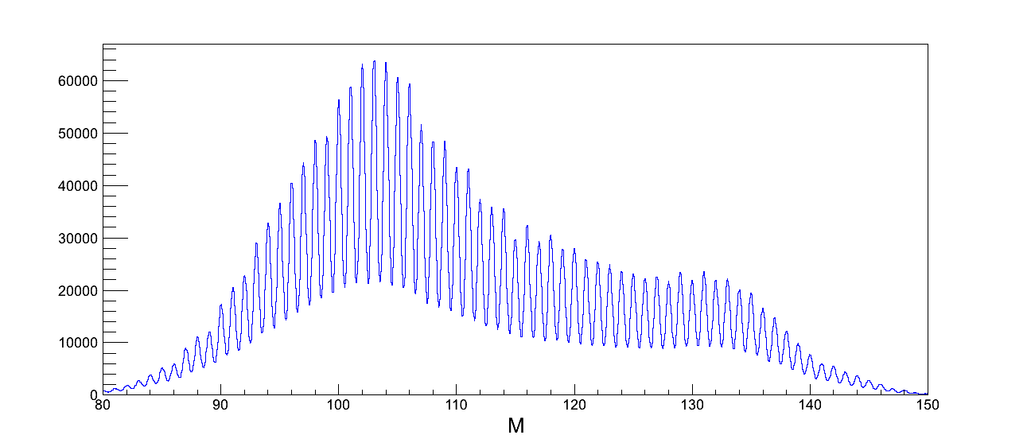
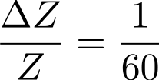
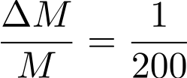
Fission fragment detection with VAMOS
pioneered by A. Shrivastava, F. Rejmund et al, Phys. Rev. C80 091305(R) (2009)
Mass [amu]
ΔE [MeV]
M/q
E [MeV]
⁹Be(²³⁸U,ff)X at 6.5 MeV/u
Z and A resolution
W. Korten
Mass [amu]

Slide 8
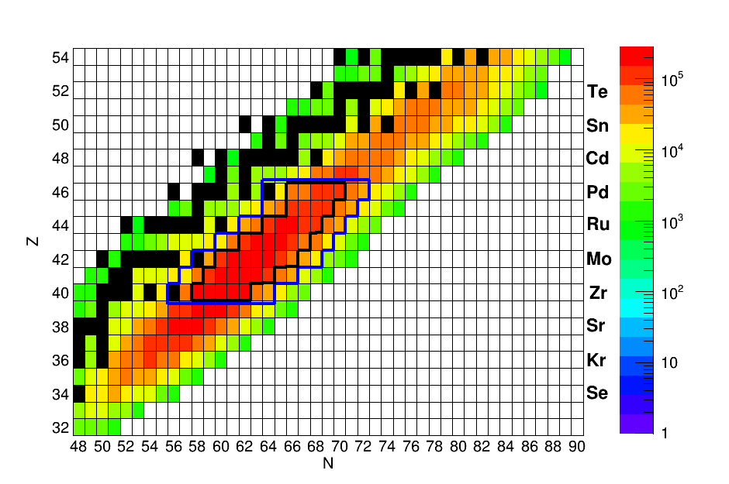
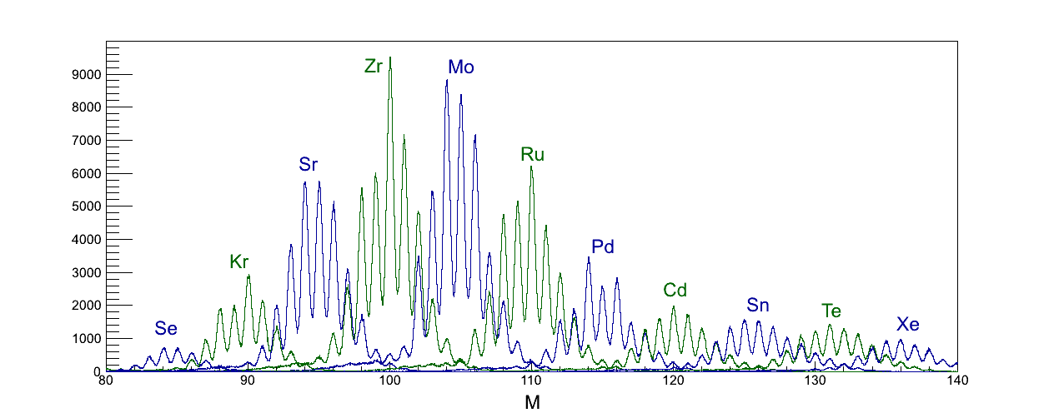
In-flight studies of fission fragments at GANIL
Yield of detected fission fragments
First RDDS measurement with isotopically identified fission fragments
Spectroscopy of more than 100 isotopes from Se (Z=34) to Xe (Z=54) and up to 10 neutrons from the line of stability
Mass distribution of even Z nuclei
⁹⁸⁻¹⁰⁴
¹⁰²⁻¹⁰⁸
¹⁰⁸⁻¹¹²
¹¹²⁻¹¹⁶
L. Grente et al, Fission 2013 and to be published

Slide 9
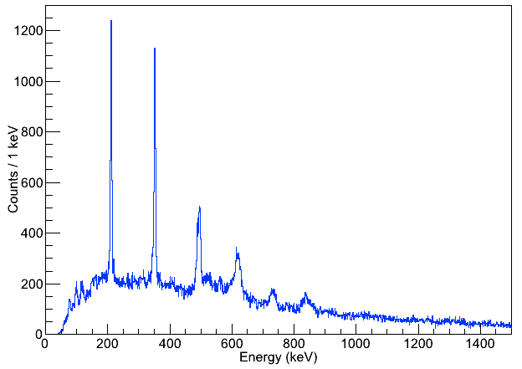
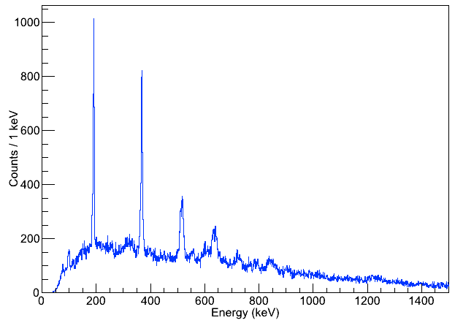
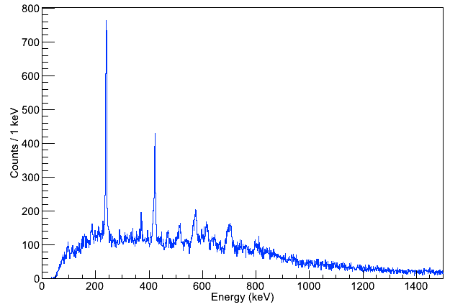
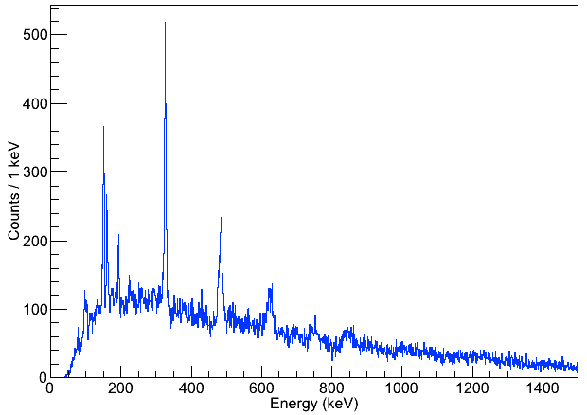
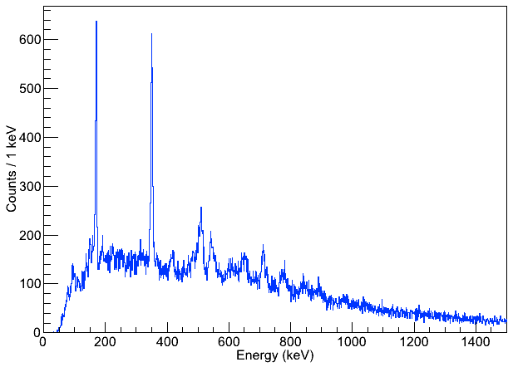
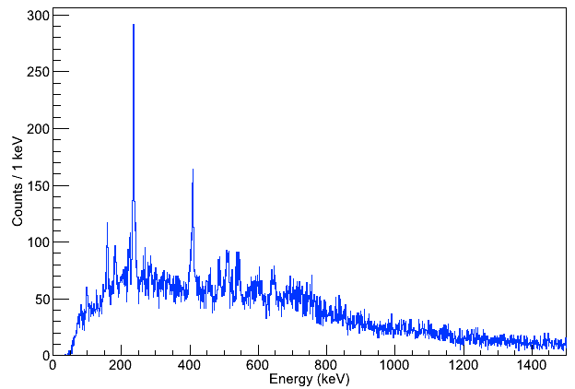
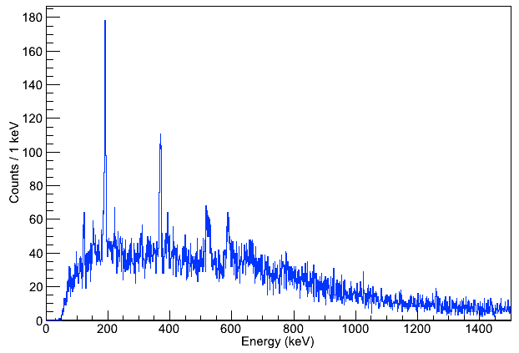
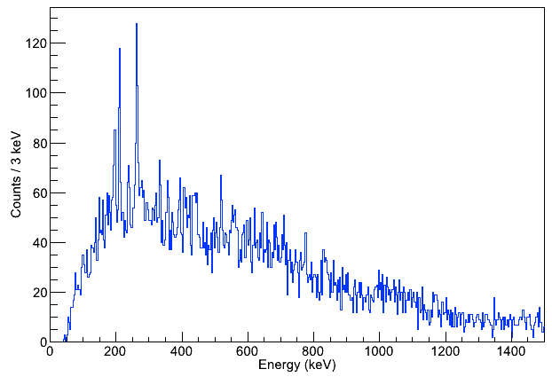
Spectra from isotopically identified fission fragments
2⁺
4⁺
¹⁰⁰Zr
τ(2⁺)
2⁺
¹⁰⁴Mo
2⁺
¹¹⁰Ru
τ(I≥4⁺)
4⁺
4⁺
6⁺
6⁺
8⁺
8⁺
10⁺
4⁺
¹⁰²Zr
τ(I≥4⁺)
2⁺
4⁺
¹⁰⁶Mo
τ(I≥4⁺)
2⁺
¹¹²Ru
τ(I≥4⁺)
2⁺
4⁺
6⁺
6⁺
8⁺
8⁺
2⁺
¹⁰⁸Mo
τ(4⁺)
2⁺
¹¹⁴Ru
no τ
⁹Be(²³⁸U,ff)X at 6.5 MeV/u
⁹⁸⁻¹⁰²Zr; ¹⁰²⁻¹⁰⁸Mo; ¹⁰⁸⁻¹¹⁴Ru
¹¹²⁻¹¹⁸Pd; ¹¹⁸⁻¹²²Cd
4⁺
6⁺

Slide 10
Lifetimes in neutron-rich A~100 isotopes
T_{1/2} from NNDC
T_{1/2} from E604
T_{1/2} from AGATA exp.
 |  |  | ¹¹⁰Pd 2⁺ 44 ±7 ps 4⁺ 4.1±0.3 ps 6⁺ 1.4±0.14 ps | ¹¹²Pd 2⁺ 84±14 4⁺ 5.4±1.7 | ¹¹⁴Pd 2⁺ 82±14 ps 4⁺ 5.7±0.9 ps 6⁺ ??? | ¹¹⁶Pd 2⁺ 110±30ps 4⁺ 8.7±1.2 ps 6⁺ 2.6±0.9 ps | ¹¹⁸Pd 2⁺ ??? 4⁺ ??? 6⁺ ???
 | ¹⁰⁴Ru 2⁺ 56.4±1.0 ps 4⁺ 5.6±0.6 ps 6⁺ 1.3±1.2 ps | ¹⁰⁶Ru 2⁺ 200±30ps 4⁺ ??? 6⁺ ??? | ¹⁰⁸Ru 2⁺ 360±30 ps 4⁺ 13.4±1.0 ps 13.6±0.9 ps 6⁺ 2.9±0.3 ps | ¹¹⁰Ru 2⁺ 320±20 ps 4⁺ 15.4±1.7 ps 15.1±0.9 ps 6⁺ 2.4±1.0 ps 3.2±0.5 ps | ¹¹²Ru 2⁺ 320±30ps 4⁺ 14.6±2.1ps 6⁺ ??? | ¹¹⁴Ru 2⁺ ??? 4⁺ ??? 6⁺ ???
 | ¹⁰²Mo 2⁺ 125±4 ps 4⁺ 12.5±2.5 ps 9.4±1.0 ps 6⁺ 3.4±0.6 ps | ¹⁰⁴Mo 2⁺ 0.97±0.08 ns 4⁺ 26.1±0.3 ps 18.6±0.9 ps 6⁺ 4.73±15 ps 2.8±0.2 ps | ¹⁰⁶Mo 2⁺ 1.25±0.03 ns 4⁺ 25.4±5.1 ps 28.0±1.3 ps 6⁺ 4.2±1.8 ps 3.1±0.3 ps | ¹⁰⁸Mo 2⁺ 0.5 ns(0.3) 4⁺ 23.3 ps (5.1) 6⁺ ??? | ¹¹⁰Mo 2⁺ ??? 4⁺ ??? 6⁺ ???
⁹⁸Zr 2⁺ <11ps 4.9±2.6ps 4⁺ 28±3 ps | ¹⁰⁰Zr 2⁺ 590±30 ps 4⁺ 37±3 ps 18.1±1.4 ps 6⁺ 4.9±1.1 ps 3.1±0.3 ps | ¹⁰²Zr 2⁺ 1.8 ns(0.4) 4⁺ 32.1 ps (3.4) 6⁺ 4.7 ps (0.5) | ¹⁰⁴Zr 2⁺ 2.0 ns(0.3) 4⁺ ??? 6⁺ ???
Proposed new lifetime measurements:
towards more neutron-rich nuclei (¹⁰⁴Zr,¹¹⁴Ru)
towards non-yrast states and higher spins
to confirm results in γ−γ coincidences
to study odd-mass isotopes
AGATA and plunger for picosecond lifetimes using RDDS method
AGATA and FATIMA for nanosecond lifetimes using Fast Timing method

Slide 11
B(E2) values in neutron-rich A~100 isotopes
B(E2) from NNDC
B(E2) from E604 (20 data points)
B(E2) to be improved
B(E2) unknown or to be confirmed
 |  |  | ¹¹⁰Pd 2⁺ 0.174(8) 4⁺ 0.280(20) 6⁺ 0.346(34) | ¹¹²Pd 2⁺ 0.13(2) 4⁺ 0.20(4) | ¹¹⁴Pd 2⁺ 0.17(3) 4⁺ 0.29(5) 6⁺ ??? | ¹¹⁶Pd 2⁺ 0.12(2) 4⁺ 0.15(3) 6⁺ 0.17(6)
 | ¹⁰⁴Ru 2⁺ 0.163(2) 4⁺ 0.25(3) 6⁺ 0.32(3) | ¹⁰⁶Ru 2⁺ 0.15(3) 4⁺ ??? 6⁺ ??? | ¹⁰⁸Ru 2⁺ 0.20(30) 4⁺ 0.316(24) 0.320(20) 6⁺ 0.310(30) | ¹¹⁰Ru 2⁺ 0.21(2) 4⁺ 0.28(3) 0.29(2) 6⁺ 0.45(19) 0.29(5) | ¹¹²Ru 2⁺ 0.23(5) 4⁺ 0.36(5) 6⁺ ??? | ¹¹⁴Ru 2⁺ ??? 4⁺ ??? 6⁺ ???
 | ¹⁰²Mo 2⁺ 0.193(6) 4⁺ 0.27(5) 0.34(4) 6⁺ 0.23(3) | ¹⁰⁴Mo 2⁺ 0.27(2) 4⁺ 0.32(1) 0.45(3) 6⁺ 0.32(1) 0.57(6) | ¹⁰⁶Mo 2⁺ 0.262(14) 4⁺ 0.44(9) 0.39(3) 6⁺ 0.48(21) 0.53(7) | ¹⁰⁸Mo 2⁺ 0.32(10) 4⁺ 0.37(4) 6⁺ ??? | ¹¹⁰Mo 2⁺ ??? 4⁺ ??? 6⁺ ???
⁹⁸Zr 2⁺ >1.9 10⁻³ 5.5±2.8 10⁻³ 4⁺ 1.8±0.2 10⁻² | ¹⁰⁰Zr 2⁺ 0.22(1) 4⁺ 0.29(2) 0.59(5) 6⁺ 0.40(9) 0.64(8) | ¹⁰²Zr 2⁺ 0.33(5) 4⁺ 0.49(6) 6⁺ 0.45(6) | ¹⁰⁴Zr 2⁺ 0.40(6) 4⁺ ??? 6⁺ ???

Slide 12
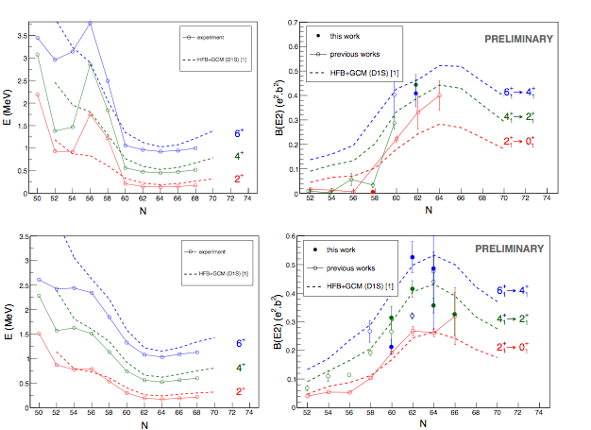
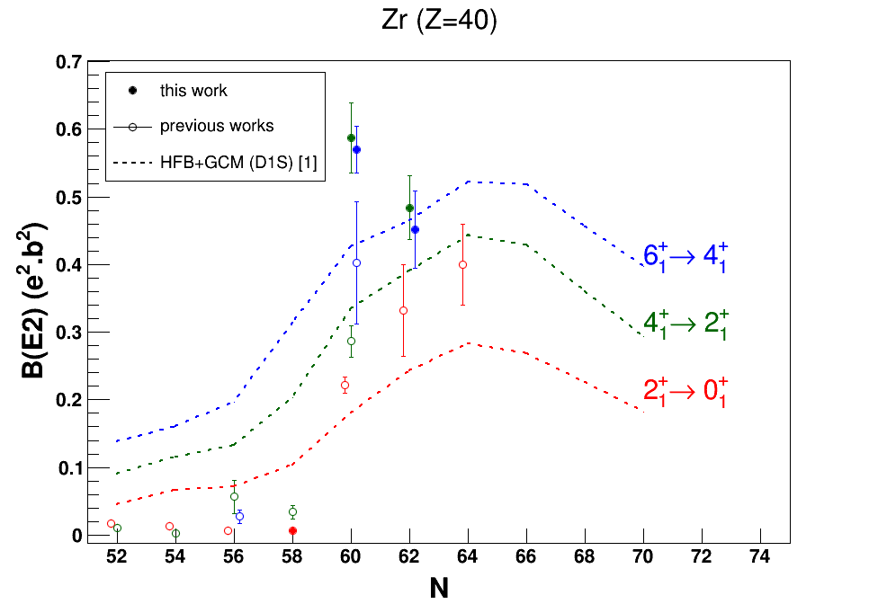
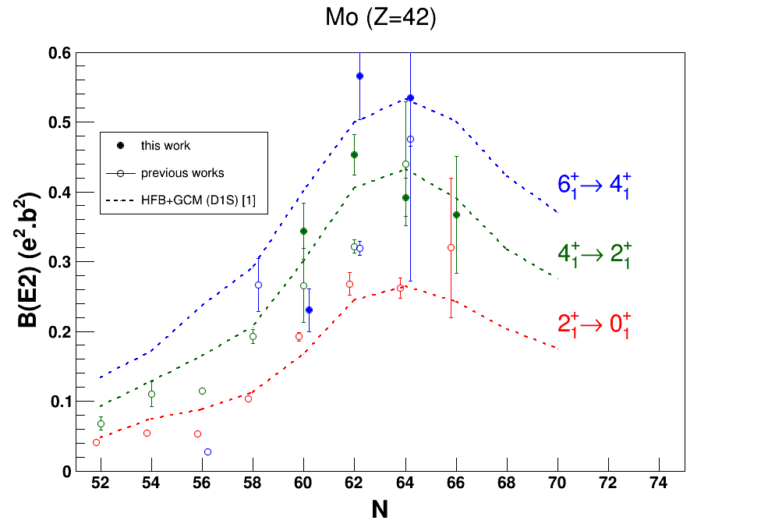
Experimental results and HFB Gogny-D1S calculations
Zr (Z=40)
Zr (Z=40)
preliminary
Mo (Z=42)
Mo (Z=42)
preliminary

Slide 13
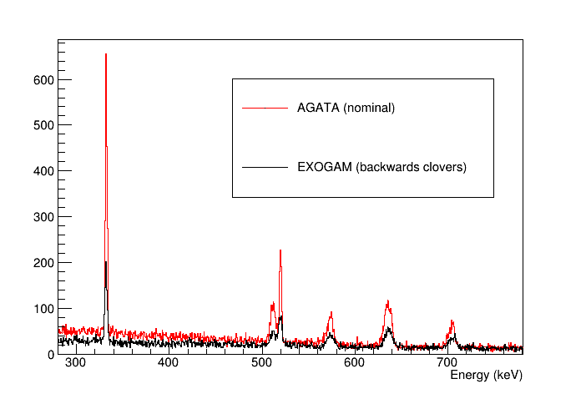
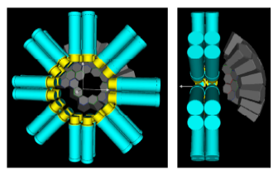
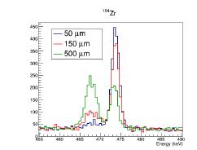
Advantages of the new AGATA-FATIMA experiment
GEANT simulation
Access to more neutron-rich nuclei
Higher efficiency (θ > 130°)
Wider lifetime range:
Plunger: ∼1 to 50ps (6-7 distances)
FATIMA: ∼50ps to several ns
Better resolution for RDDS analysis

Slide 14
To do list
Optimal geometry to optimize both Ge and LaBr₃ efficiency
→ mechanical design study
Shielding of strong magnetic stray field from VAMOS
→ In-situ test measurements needed
Thin target and high recoil velocity will let the fragments fly out of view
      → GEANT simulation needed
Possible other physics cases making use of AGATA and FATIMA with VAMOS

Slide 15
Summary
In neutron-rich A~100 nuclei nuclear shapes are rapidly evolving with proton/neutron number giving rise, e.g., to shape coexistence and possibly triaxiality
Triaxiality is a key feature to understand and predict shape coexistence in atomic nuclei
Observables related to nuclear shapes are important benchmarks for state-of-the-art nuclear structure model calculations
Lifetime measurements give important information on collective properties & add important constraints for Coulomb excitation experiments (in progress)
New AGATA-FATIMA experiment on isotopically identified fission fragments will allow to measure lifetimes in more neutron-rich nuclei, up to higher spins and for non-yrast states as well as using γγ coincidences to confirm previous results

Slide 16


Collaboration
A. Dewald, J. Jolie,
J.-M. Régis, N. Saed-Samii,
A. Goergen, F. Bello Garrote,
T.W. Hagen,M. Klintefjord,
E. Sahin, S. Siem
E. Clement, F. Farget, G. de France,
C. Michelagnoli, C. Schmidt
New collaborators welcome
J. Ljungvall, G. Georgiev,
A Goadsuff,
A. Corsi, D. Doherty,
A. Drouart, W. Korten, B. Sulignano,
C. Theisen, M. Zielinska
J.-P. Delaroche, M. Girod,
L. Grente, N. Pillet
M. Carpenter, R. Janssens,
T. Lauritsen, D. Sewerenyak, S. Zhu
D. Sohler, I. Kuti, Zs. Vajta,
J. Timar, Zs. Dombradi
J. Gerl, C. Louchart,
D. Ralet, S. Pietri

Slide 17
Thank you for your attention
Wolfram KORTEN - ANL - October 21, 2014

Slide 18
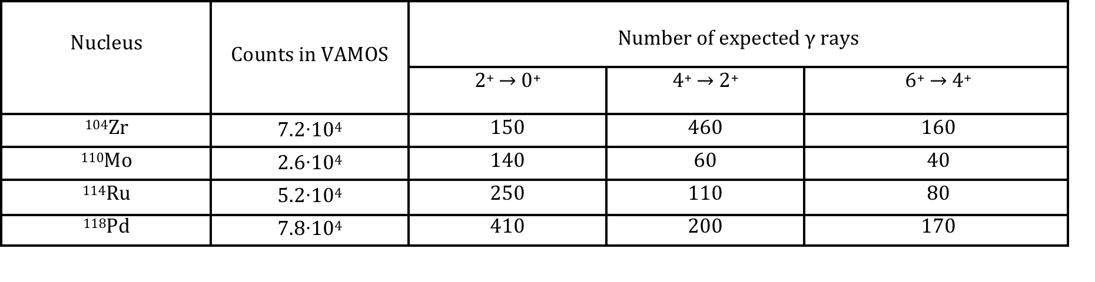
Preliminary beam time estimate and request
Experimental improvements compared to E604
AGATA efficiency x 2.5 (θ > 130°)
VAMOS readout x 2
FATIMA to measure “longer” lifetimes
5 in γ singles
13 in γγ coincidences
VAMOS-FATIMA timing for ns lifetimes
Achievable statistics per 3 UT for most neutron-rich nuclei
Beam time request: 30 UT
24UT for 7 plunger distances (10-500 μm) and no degrader
6 UT for VAMOS set-up and calibrations (¹⁹⁷Au/⁹³Nb)

