Slide 1
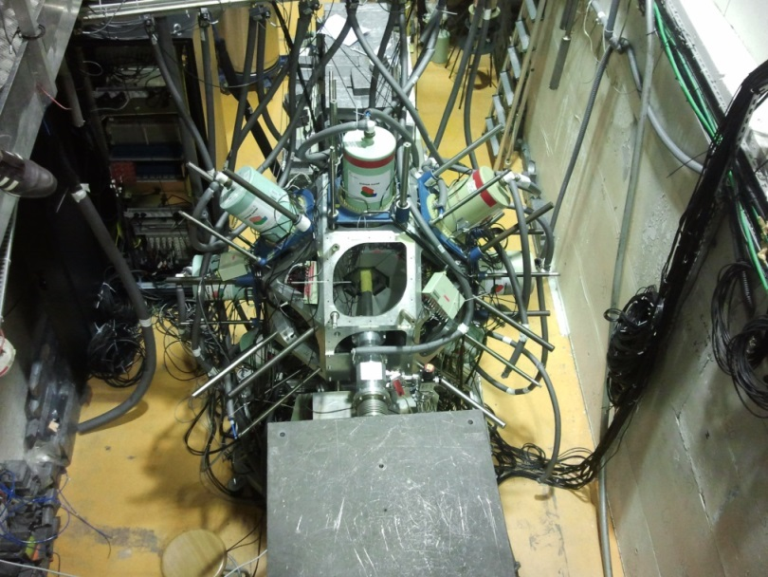
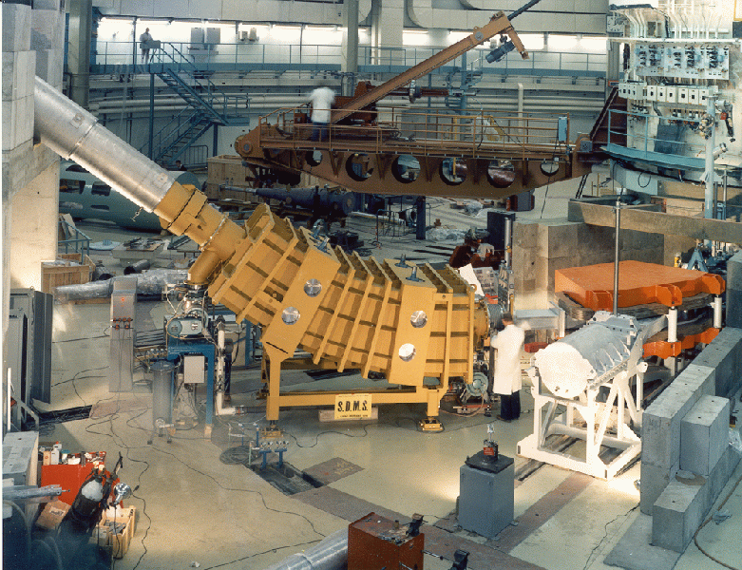
Recent results of fast-timing experiments in Grenoble
Gary Simpson
University of the West of Scotland

Slide 2

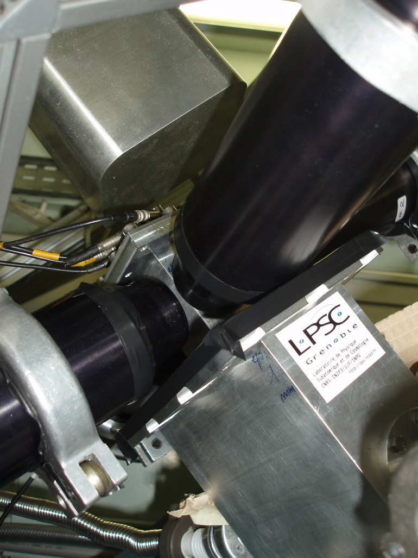
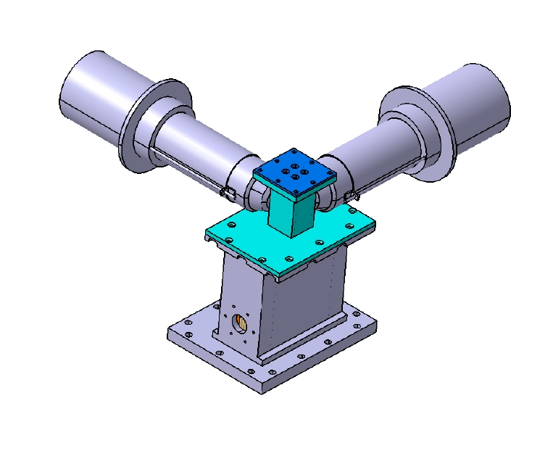
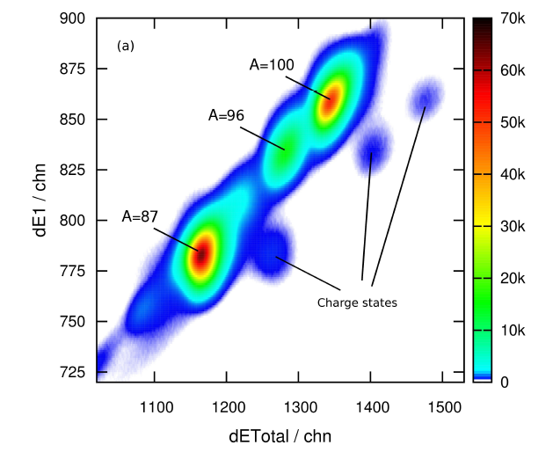
Fast-timing from below isomers ion-γ−γ
Use selectivity of spectrometer + isomer decay
Know what isomer is
μs
γ₁
start
T_{1/2}
γ₂
stop
TAC

Slide 3
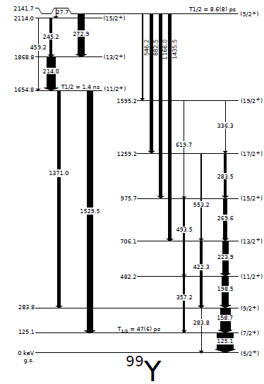
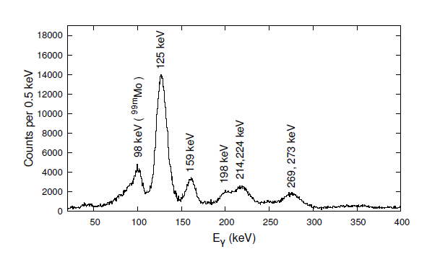
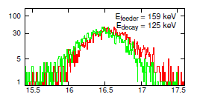
Example of results
(Thesis of M. Rudigier IKP 2014)

Slide 4
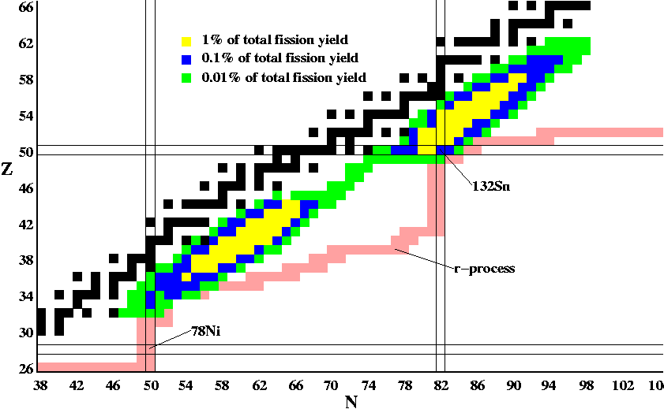
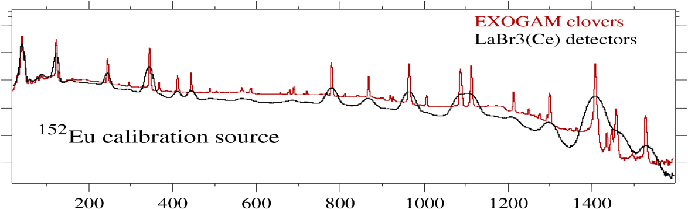

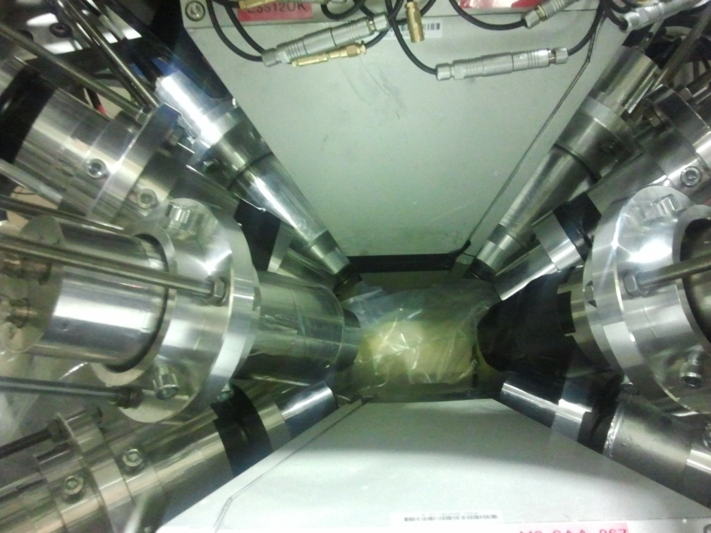
In-beam experiments EXILL+ FATIMA (neutron beam) –see Nuclear Physics News
log counts
Energy (keV)

Slide 5
Electronics setup
16 detectors, 15 TACs
Fan in-out
TAC
Detector
anode
to
other TACs
V1724
time
dynode
start
RC
stop
Fan in-out
V1724
Energy
other detectors
delay
All energy and TAC signals were recorded in time-stamped free format

Slide 6
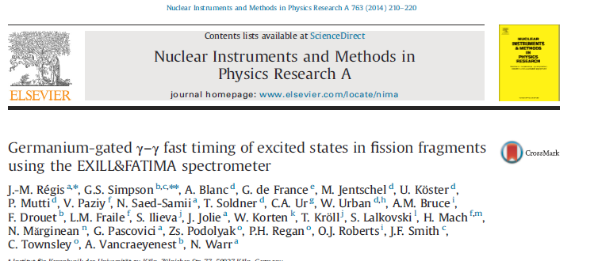
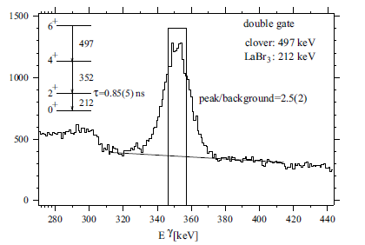
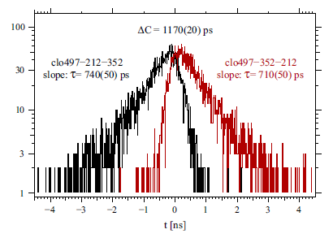
¹⁰⁰Zr

Slide 7
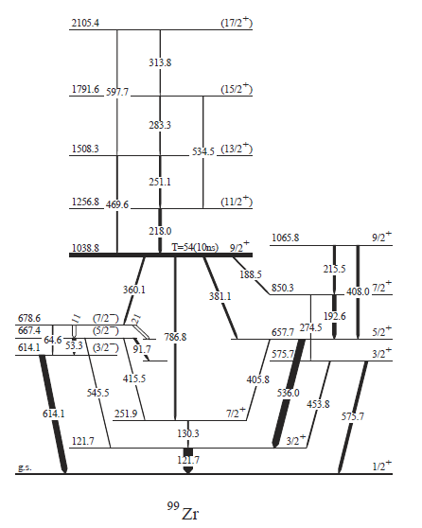
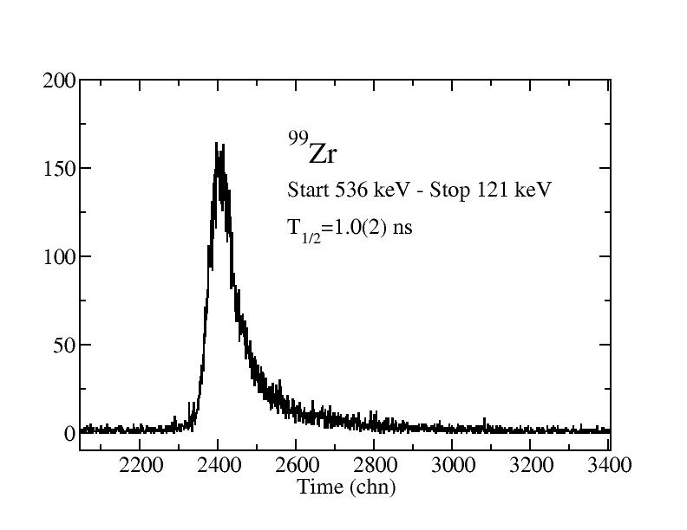
⁹⁹Zr
Pietro Spagnoletti, UWS

Slide 8
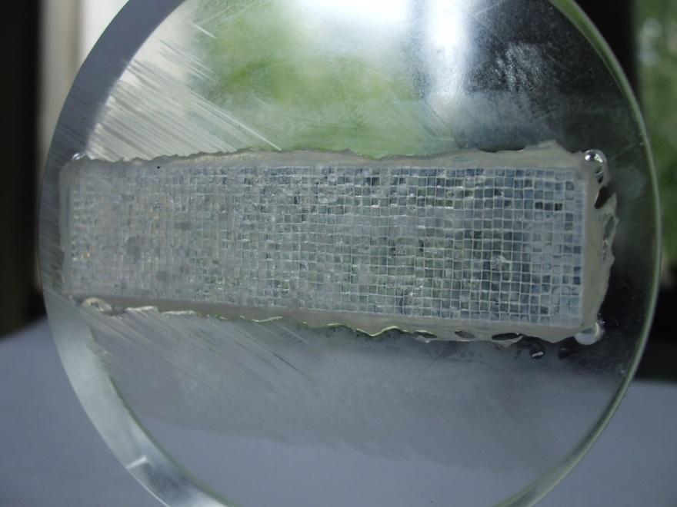
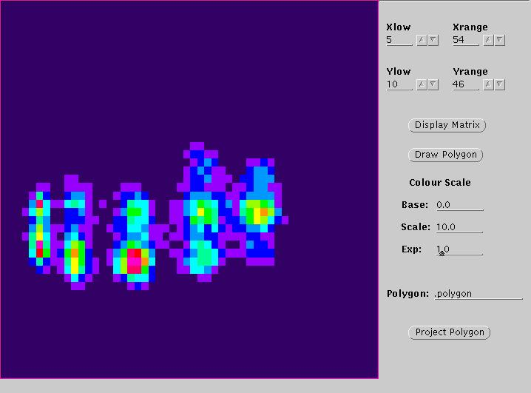
beta detector
LPSC Grenoble (G. Simpson, G. Gey, J. F. Muraz, A. Pellisier)
Need good time resolution for β−γ timing
  Scintillating fibre optics (radiation hard)
  DSSSDs expensive –really needed for some FATIMA experiments?
Current position resolution ~3 mm
Or use DSSSDs + fast plastics stacks

Slide 9
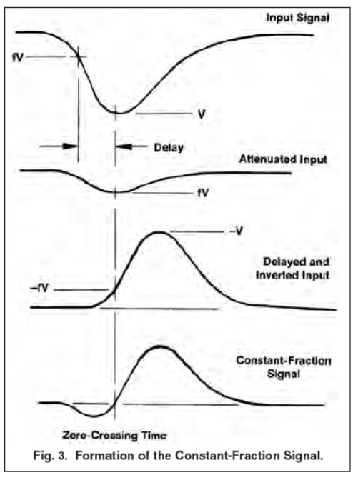
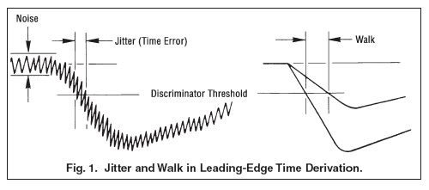
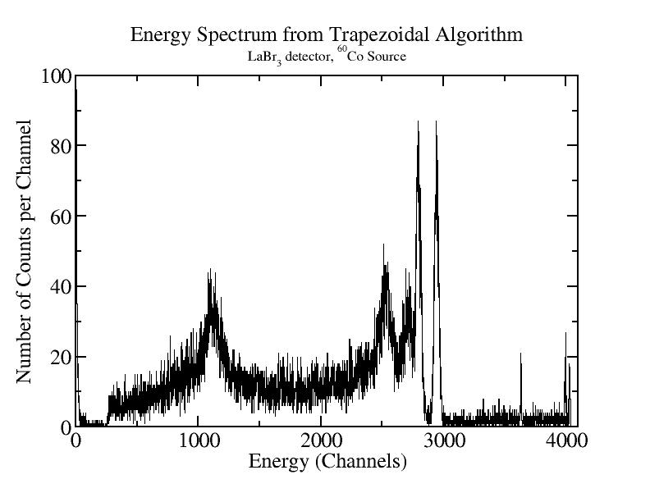

Pulse-shape analysis
5 GHz Caen V1742
NuPNET funding 2012
Energy

Slide 10
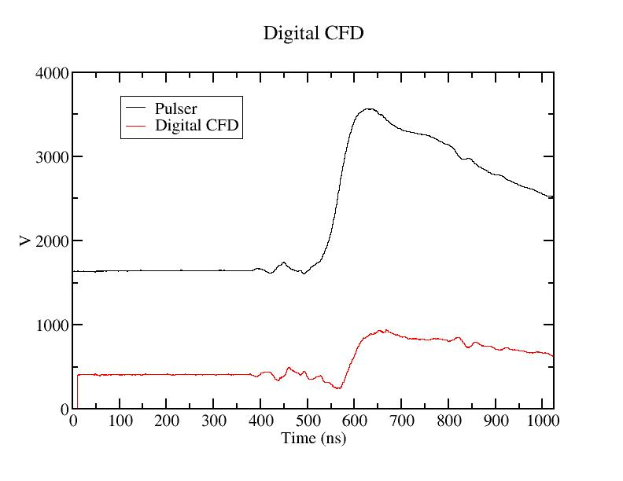
Implement digital CFD
Delay=10
Frac=0.8

Slide 11
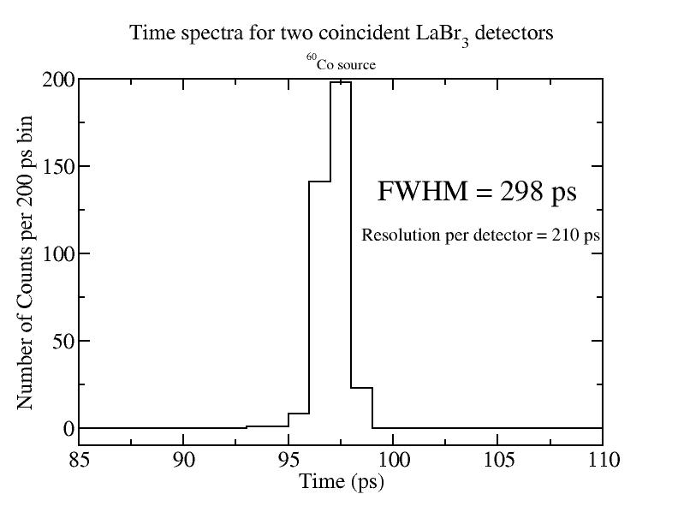
Digital LE algorithm
~45 % worse than analogue

Slide 12
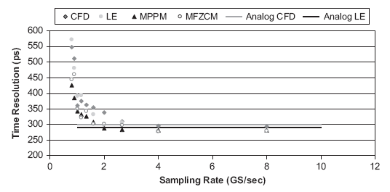
LSO crystals

Slide 13
Conclusions
Have performed fast-timing measurements of many states populated from isomeric decay
Developed fast-timing digital algorithms
Developing position-sensitive β detector
First results from fast-timing from prompt fission
Thanks to many people –FATIMA collaboration

