Slide 1
A hybrid LaBr₃-Ge array for fast timing spectroscopic studies at the IPN Orsay
J.N. Wilson¹, P.H.Regan^{2,3} ,G. Georgiev⁴, I. Matea¹, D. Verney¹, M. Lebois¹, P. Halipre¹, L. Qi¹, A. Gottardo¹, J. Ljungvall⁴, Zs.Podolyak², S.M.Judge^{2,3}, R. Shearman^{2,3}, R. Carroll², M. Rudigier², A.Pearce³, G.Lorusso^{2,3}, A.M. Bruce⁵, N. Marginean⁶, T. Kroell⁷, S. Ilieva⁷, A. Ignatov⁷, G. Fernandez⁷, V. Werner⁷, L.M. Fraile⁸,
V. Vedia⁸, J. Jolie⁹, J.M. Regis⁹, W. Korten¹⁰, J.F. Smith¹¹, P.M. McKee¹¹, E. Parr¹¹, M. Smolen¹¹, S.Lalkovski^{2,12},S. Kisyov¹², A. Görgen¹³, S.Siem¹³, K. Hadynska-Klek ¹³, E. Sahin¹³A. Oberstedt^{1,14},
G. Smith¹⁵,R. Lozeva¹⁶,S. Oberstedt¹⁷
¹Institut de Physique Nucléaire Orsay ,France
²Department of Physics, University of Surrey, UK
³National Physical Laboratory,Teddington, UK
⁴CSNSM Orsay, France
⁵University of Brighton, UK
⁶IFIN-HH. Maguerele, Bucharest, Romania
⁷TU Darmstadt, Germany
⁸U. Complutense, Madrid, Spain
⁹IFK- Köln, Germany
¹⁰CEA Saclay, France
¹¹Universiyt of West of Scotland, Paisley, UK
¹² University of Sofia, Bulgaria
¹³ University of Oslo, Norway
¹⁴ Chalmers University, Sweden
¹⁵ University of Manchester, UK
¹⁶ IPHC Strasbourg, France
¹⁷European Commission JRC-IRM, Geel, Belgium

Slide 2
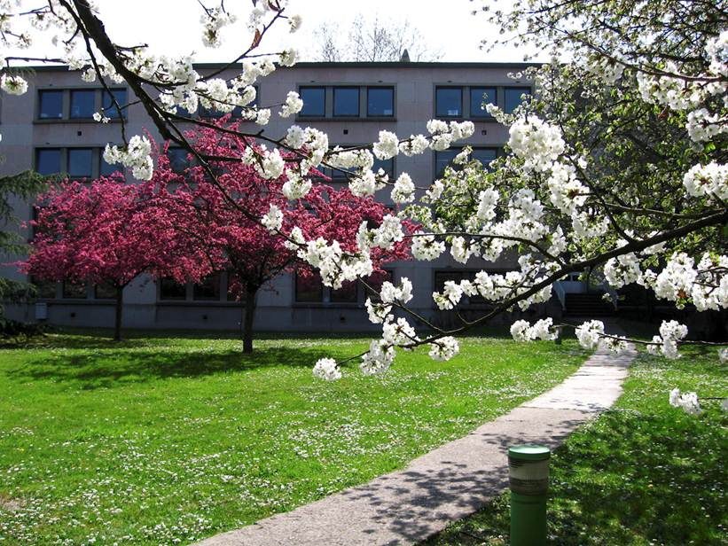
The ALTO facility of the IPN Orsay

Slide 3

the ALTO facility beams
Nuclear Reactions:
Bacchus
Nuclear Astrophysics:
Split-Pole
ISOL beams:
β-decay
LASER spectroscopy…
γ Spectroscopy:
ORGAM
Clusters

Slide 4
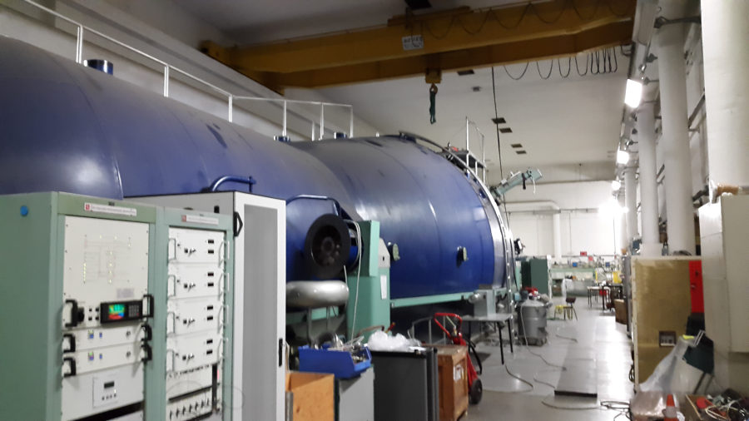
IPN Orsay ALTO facility 15 MV tandem accelerator
Diverse beams from protons to heavy ions (e.g. ¹²⁷I)
Beams of ⁴⁸Ca and ¹⁴C available
Atomic clusters (e.g. C⁶⁰)

Slide 5
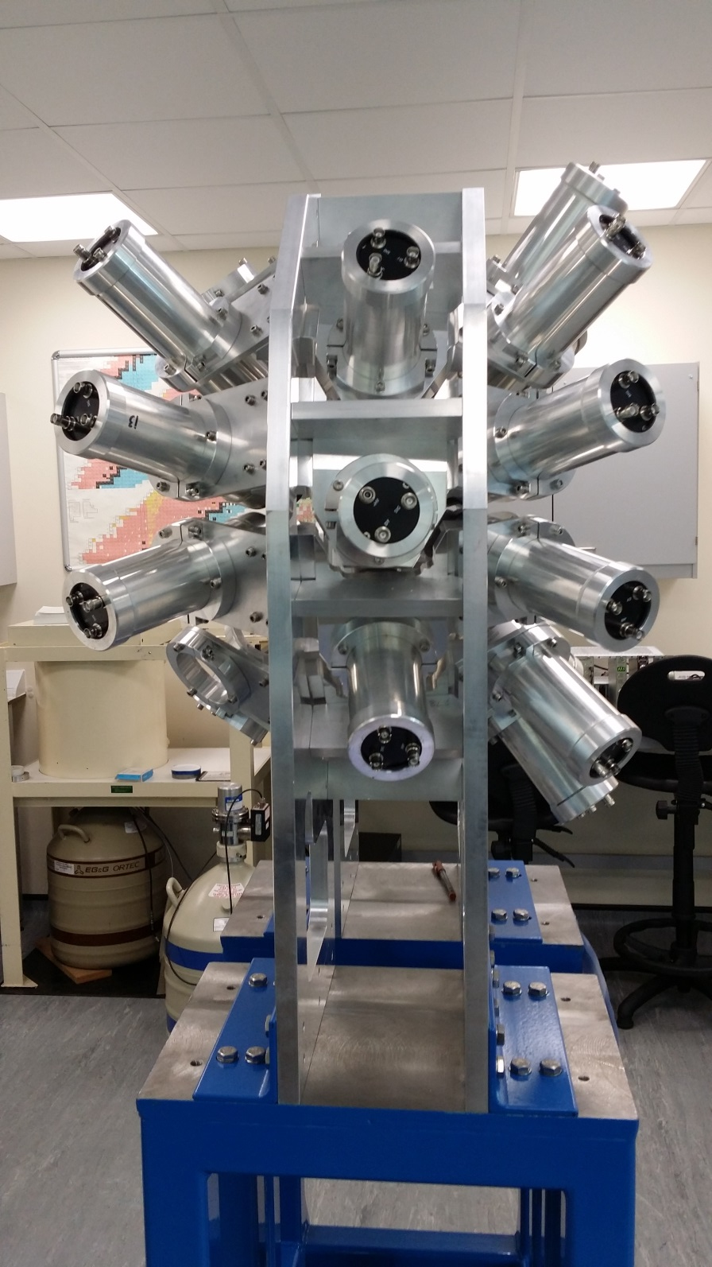
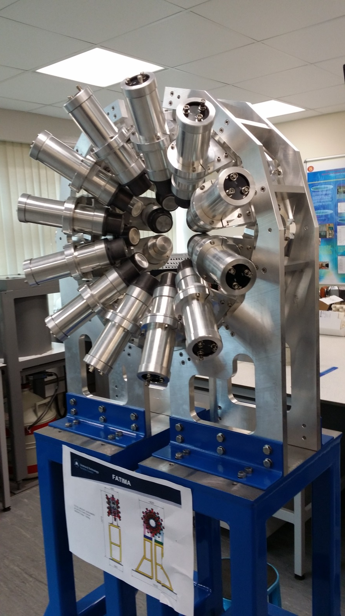

Slide 6
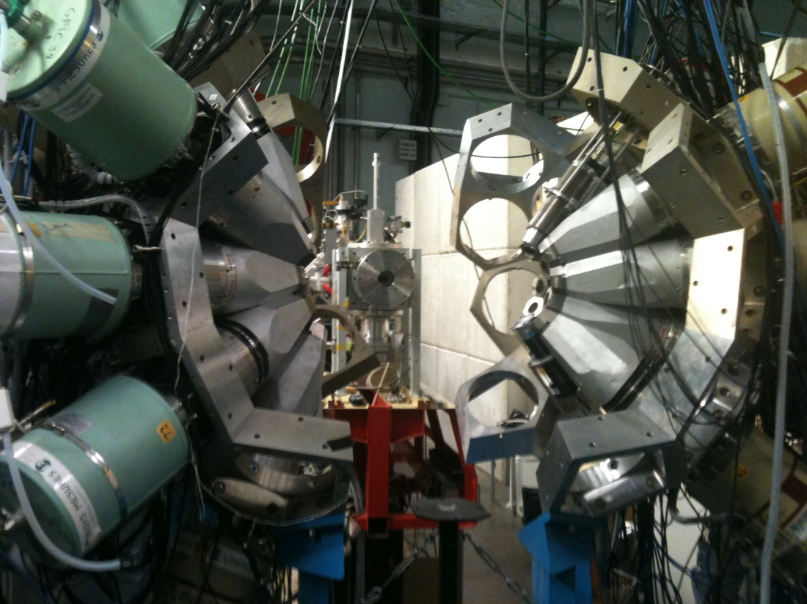
ORGAM @ ALTO, IPN ORSAY

Slide 7
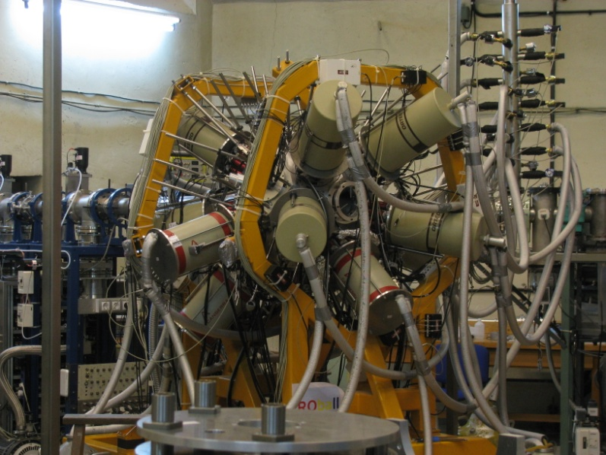
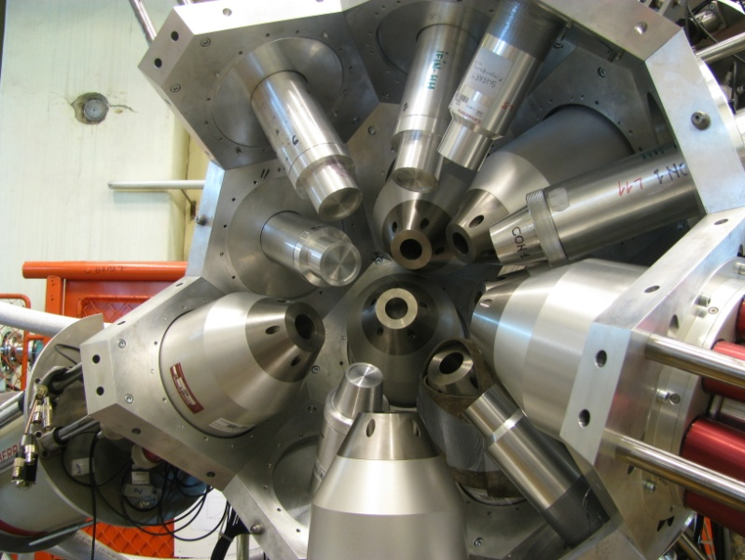
The ROSPHERE Gamma-ray Spectrometer array (at IFIN-HH Bucharest)
14 HPGe detectors (AC) are used to detect coincident γ rays:
  7x HPGe dets. @ 37º
  4x HPGe dets. @ 64º
  3x HPGe dets. @ 90º
11 LaBr₃(Ce:5%) detectors
  7x ø2”x2” and 4x ø1.5”x2” (Cylindrical) @ 37, 64 and 90º w.r.t. the beam axis.

Slide 8
Neutron production in inverse kinematics
Sample
H target
γ
n
n
n
100nA ⁷Li
13-17 MeV
n
γ
Lithium Inverse Cinematiques ORsay NEutron source
p(⁷Li,⁷Be)n reaction in inverse kinematics
Focused source of fast neutrons between 0.5 and 4 MeV

Slide 9
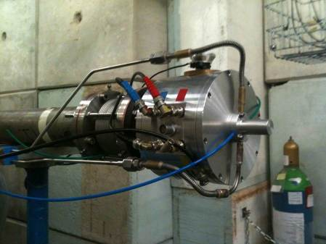
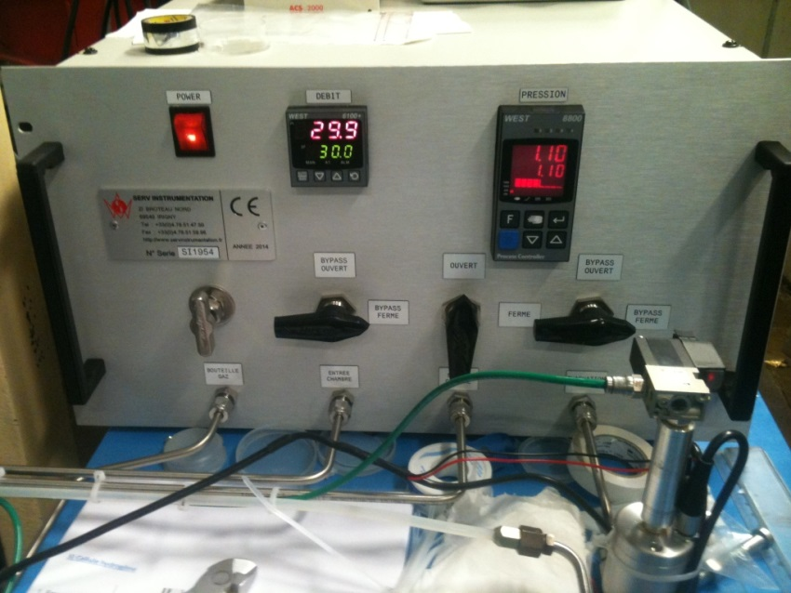
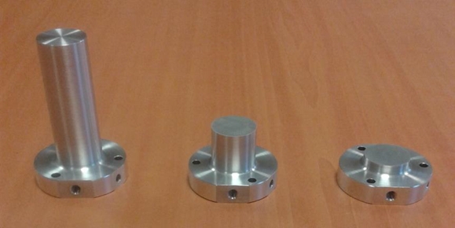
LICORNE II
H₂ pressure and low control system
Hydrogen gas cells

Slide 10
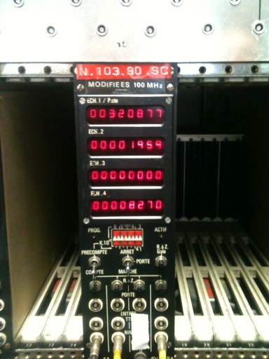
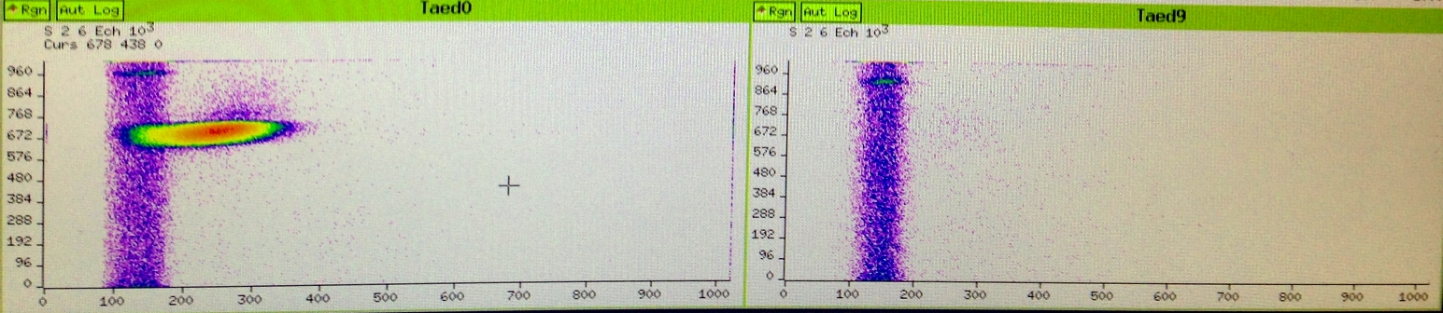
Neutron supression at 90 degrees
NE213
1.5 m
H target
n
n
n
NE213
100nA ⁷Li
17 MeV
n
1.5 m

Slide 11
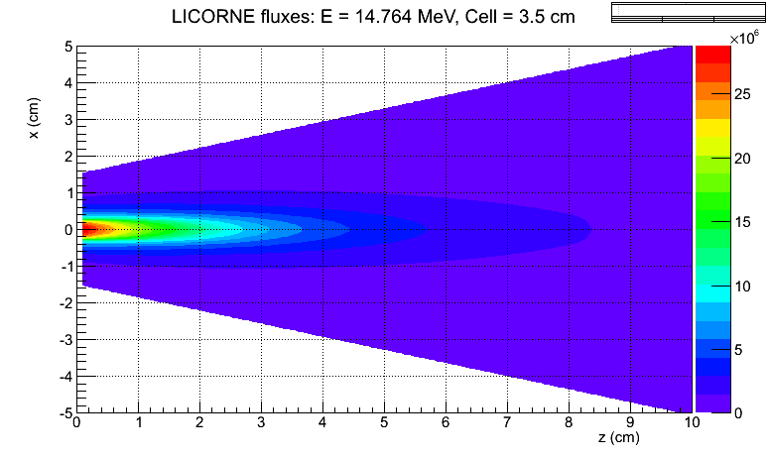
LICORNE FLUXES
0.5 < E_{n} < 2.6 MeV
10⁷ n/s/cm²
~ 90 kHz fission rate for 30g ²³⁸U sample

Slide 12
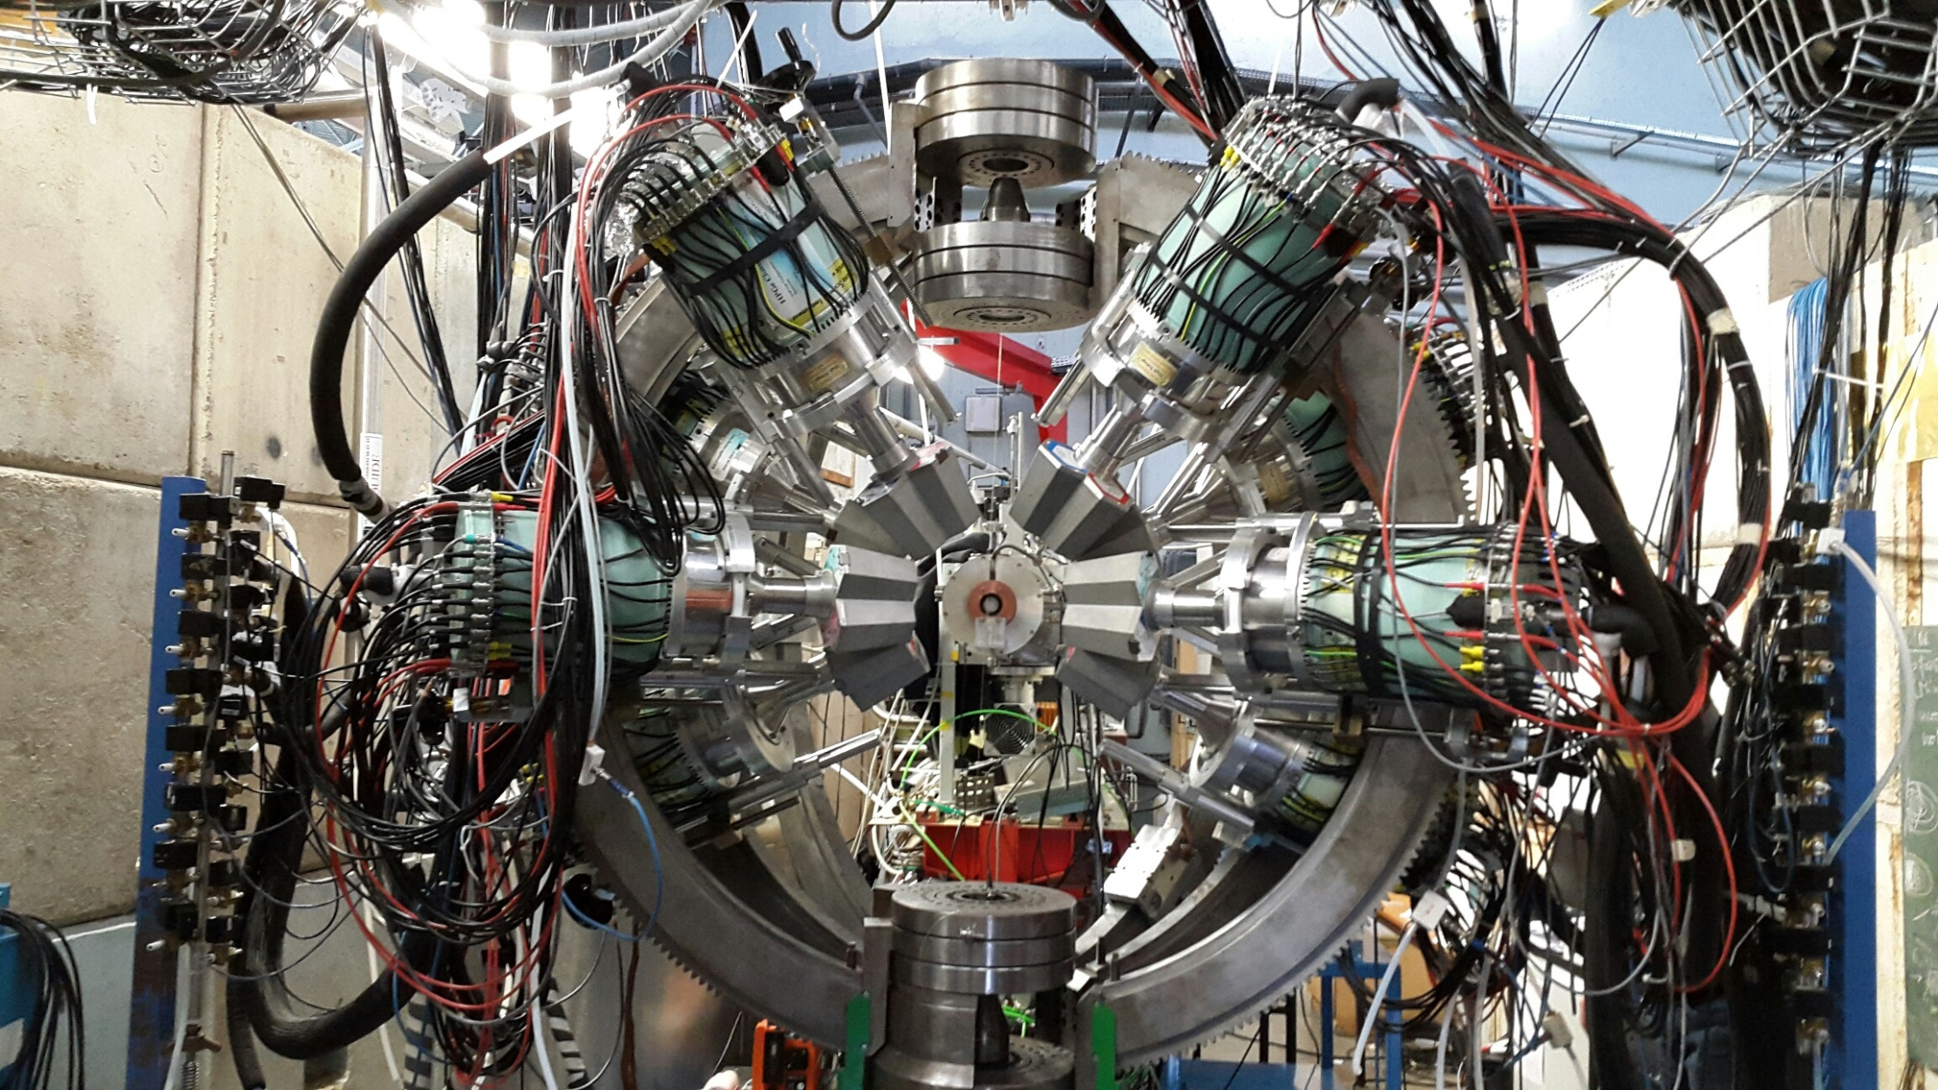

Slide 13
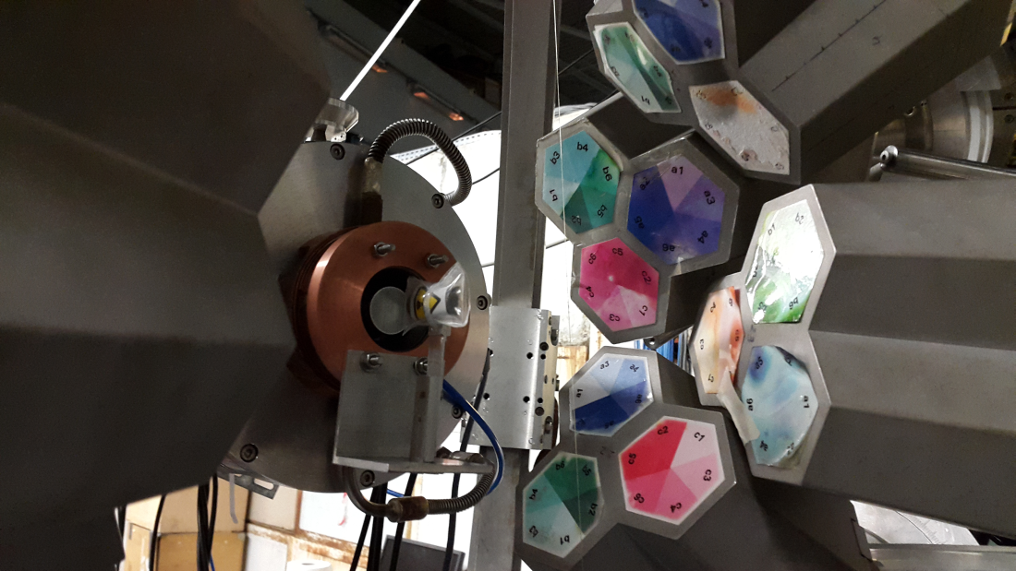
Miniball data set: ~ 5 x 10⁹ M_{γ} >= 3 events in two weeks

Slide 14
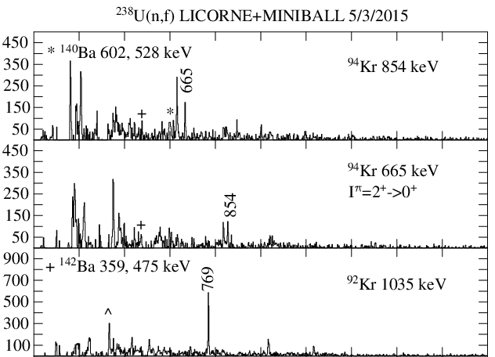
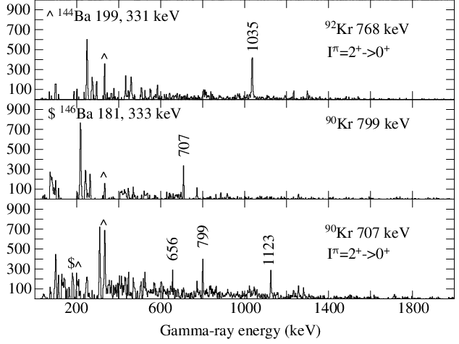

Slide 15
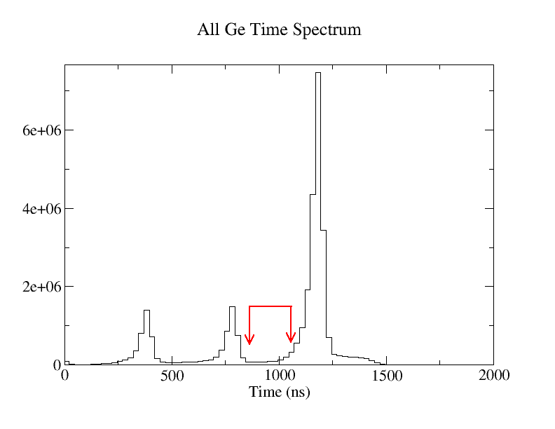
Prompt peak
400 ns

Slide 16
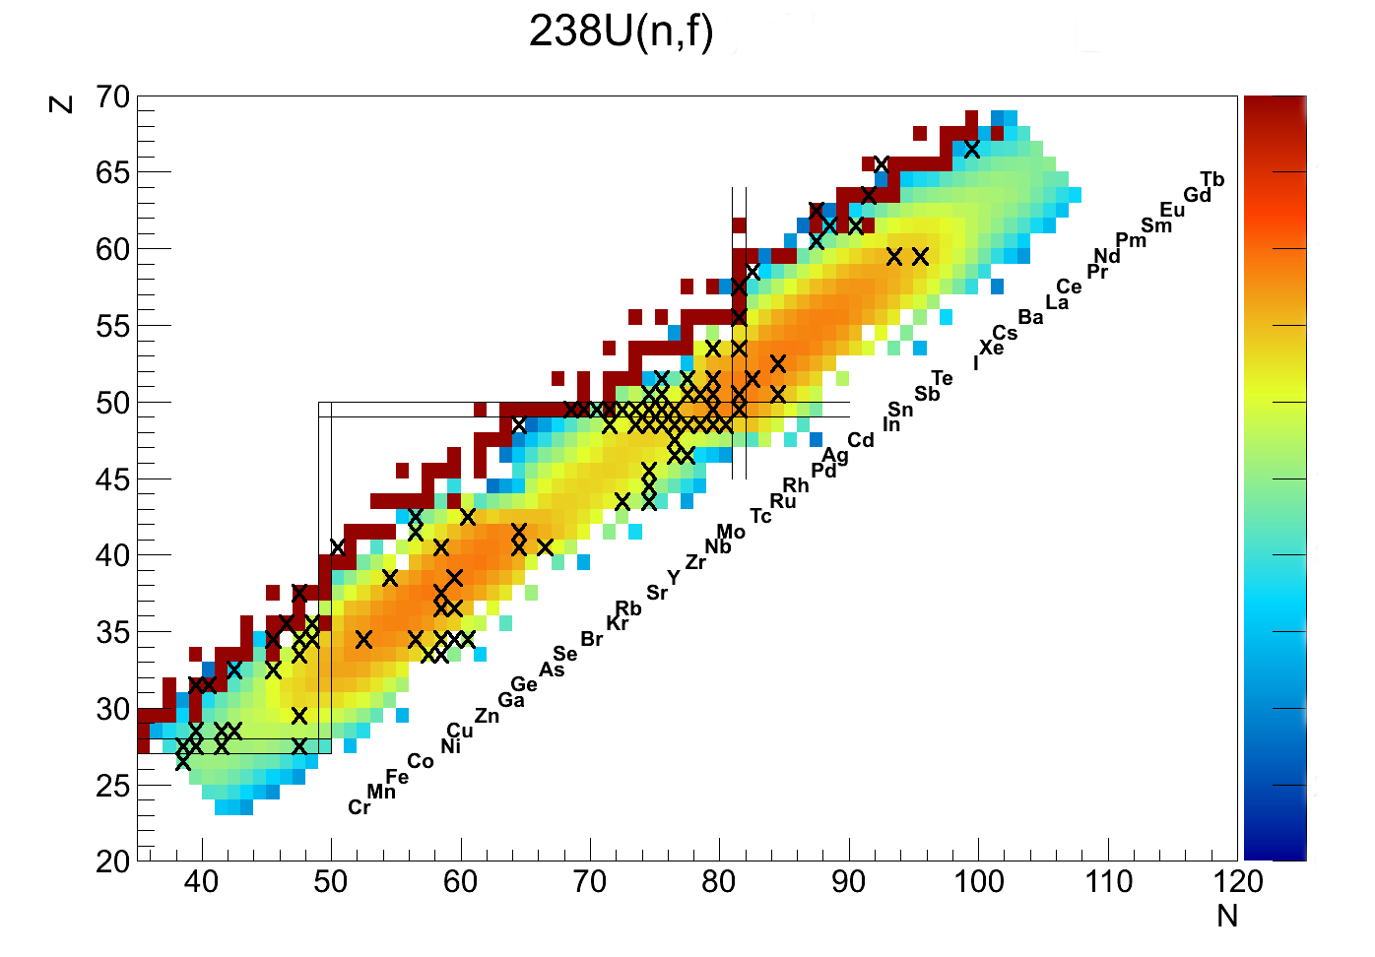
Fission Fragment Isomers (10ns - 10µs)

Slide 17
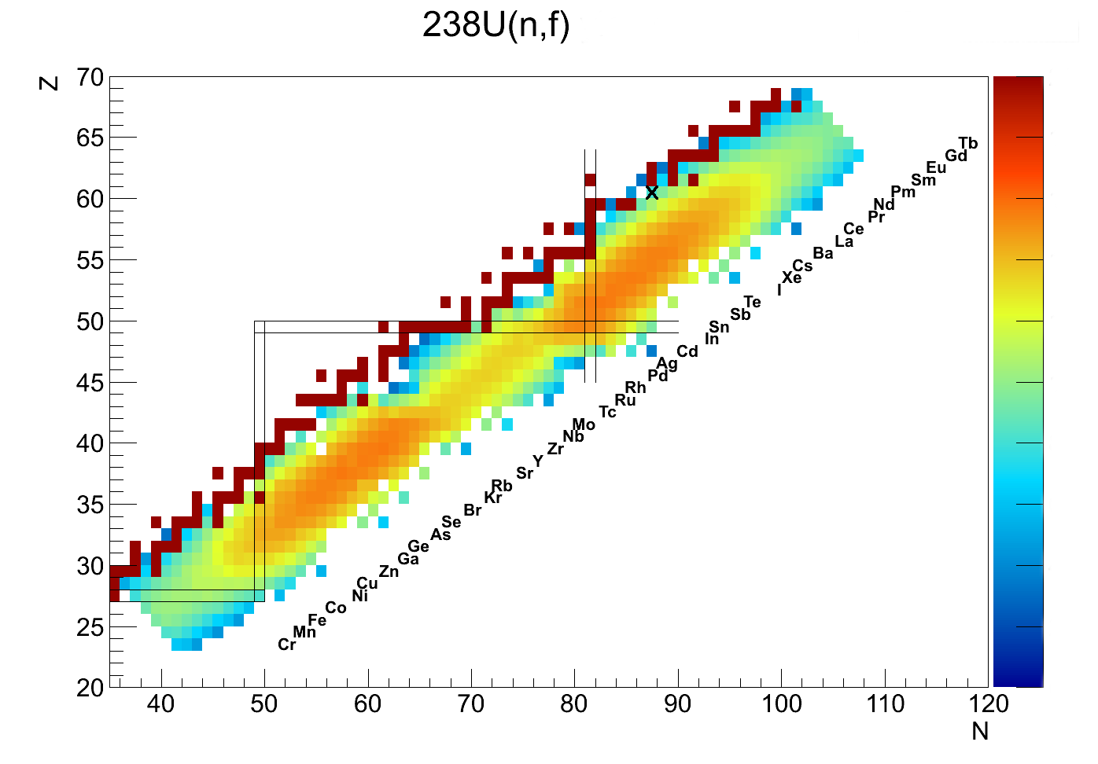
¹⁴⁹Pm

Slide 18
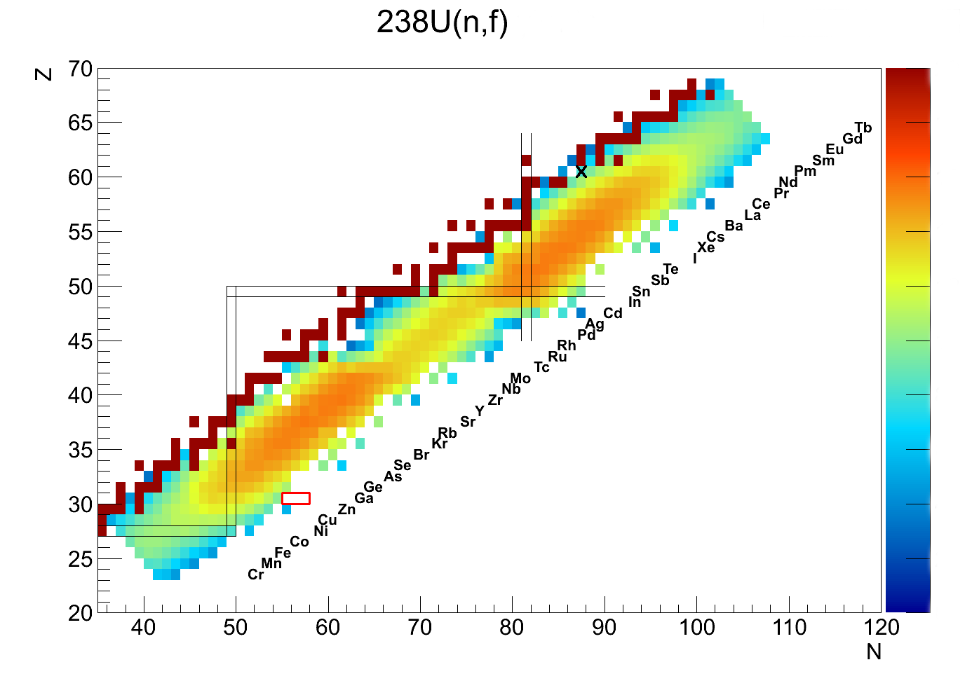
¹⁴⁹Pm^{m}
^{87,88,89}Ga

Slide 19


Slide 20
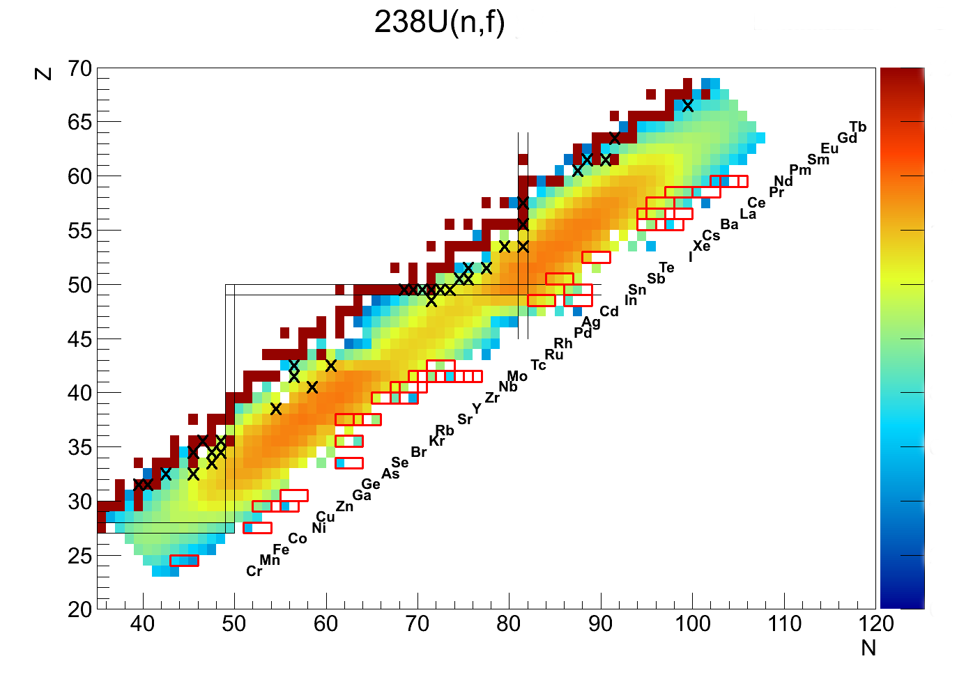
TIPS – Tagging Isomer PartnerS

Slide 21
Prompt peak
400 ns

Slide 22
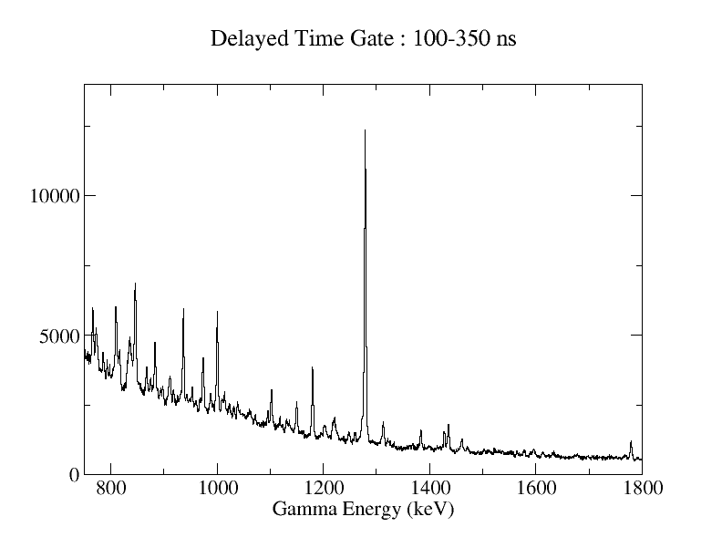
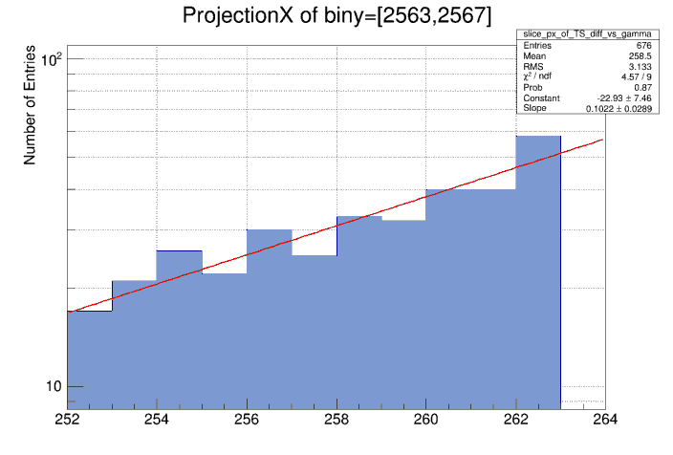
T_{1/2} ~ 170ns

Slide 23
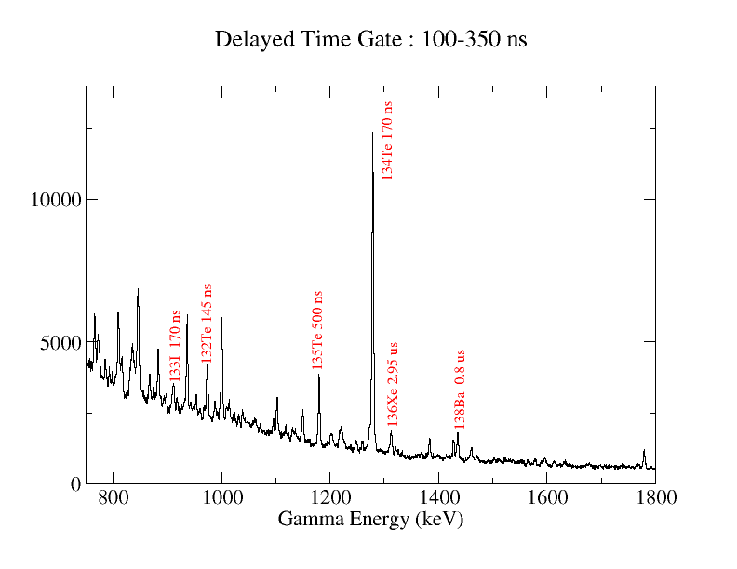

Slide 24
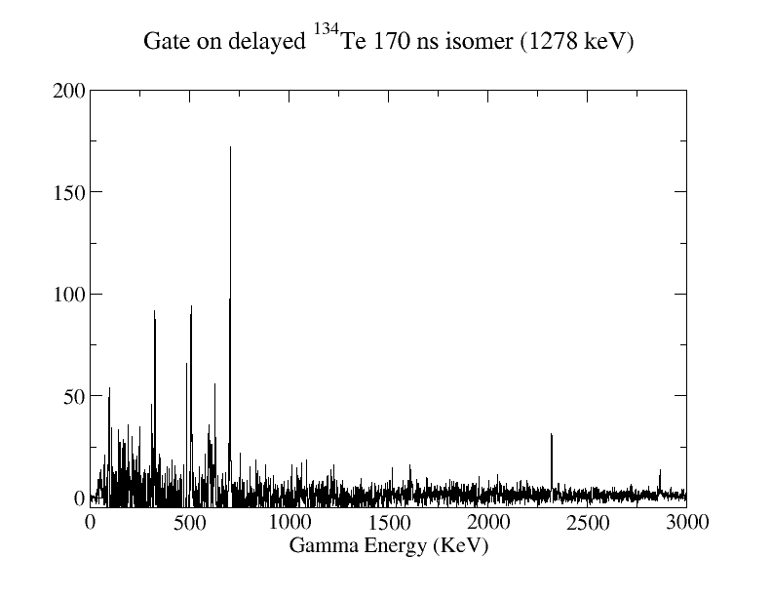

Slide 25
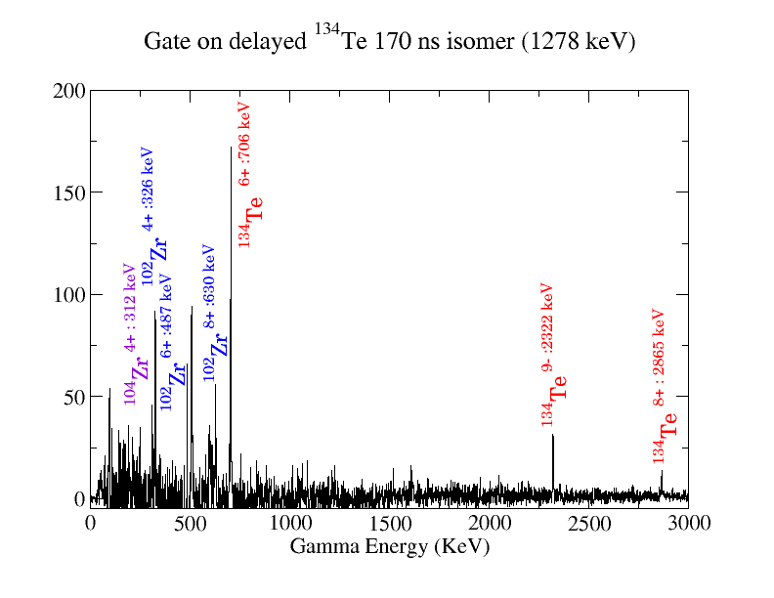

Slide 26
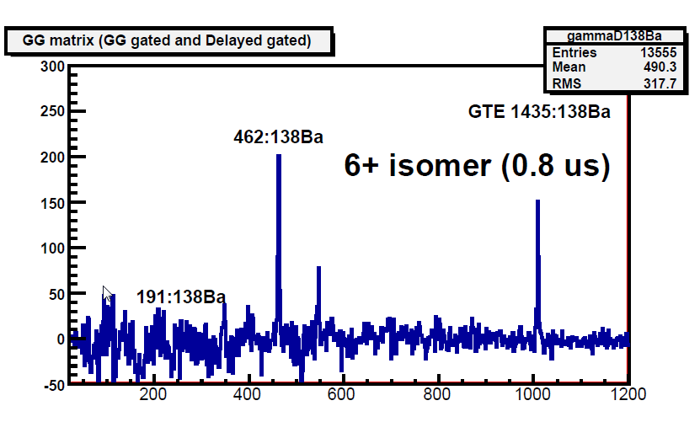
¹³⁸Ba 0.8μs Isomer
*
*
*
New Isomer in ¹³⁸Ba?

Slide 27
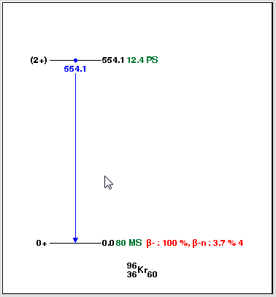
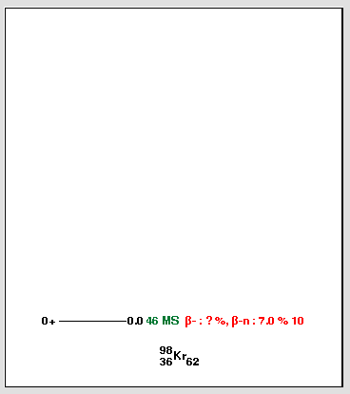
¹³⁸Ba Partners
⁹⁶Kr
⁹⁸Kr
To be continued…

Slide 28
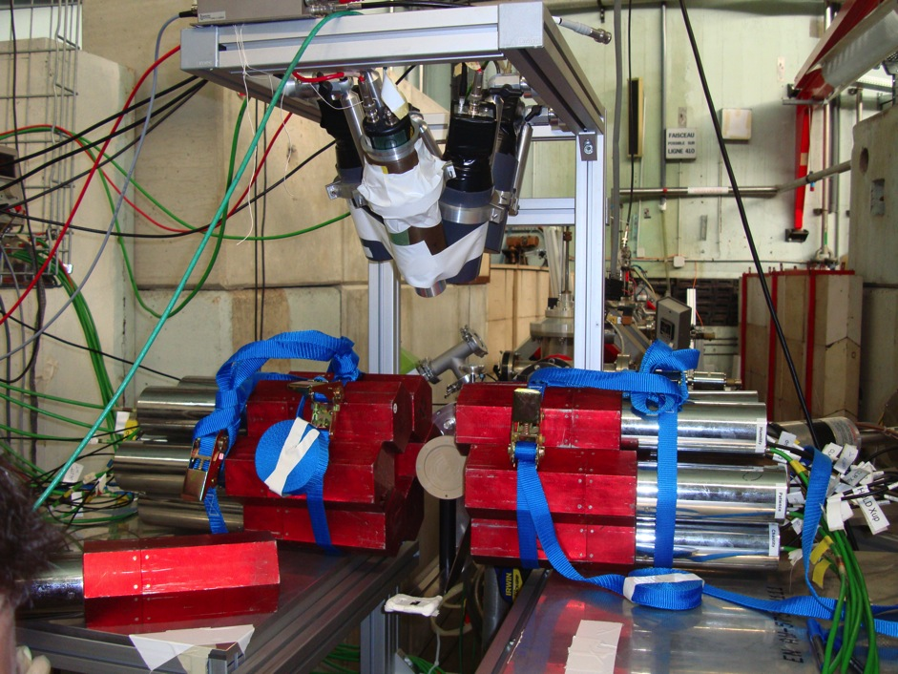
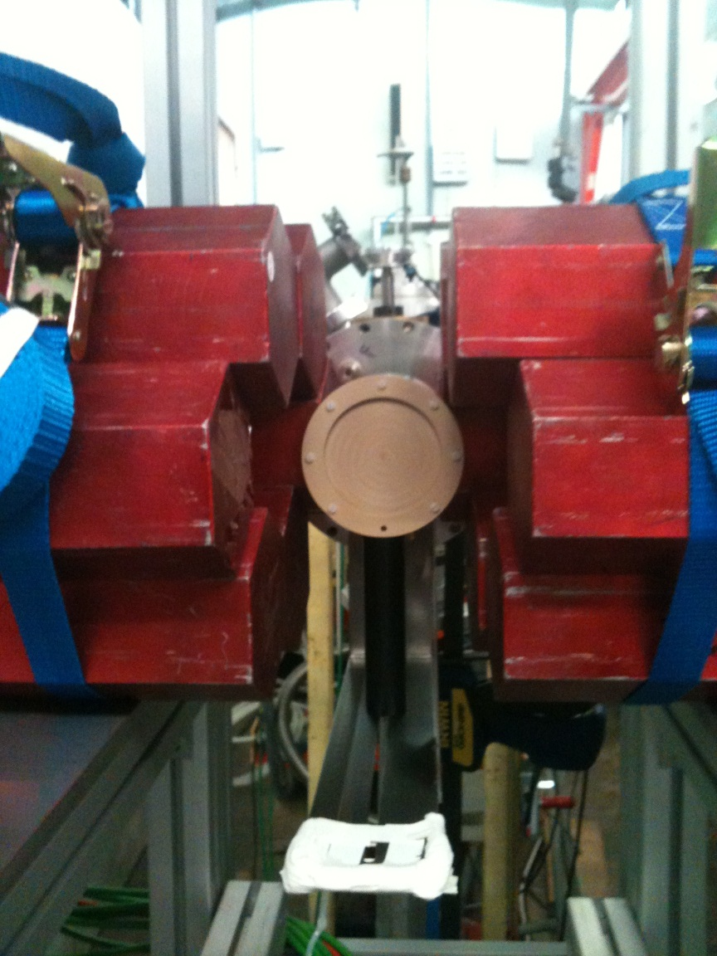
Experimental Setup: Energy dependence of prompt-γ emission. July 2013

Slide 29
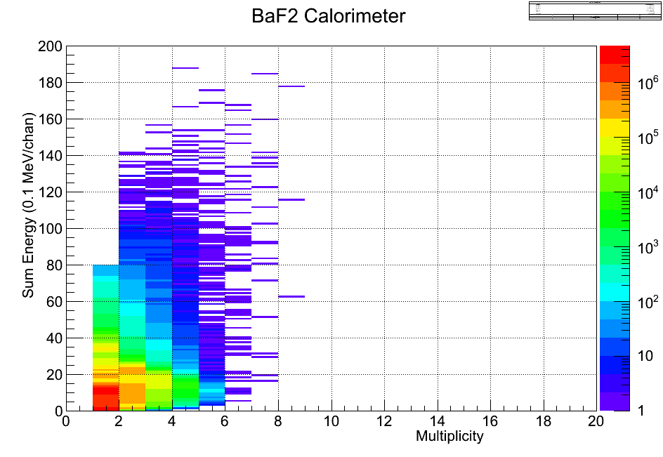
Multiplicity Versus Energy Discrimination: ⁶⁰Co

Slide 30
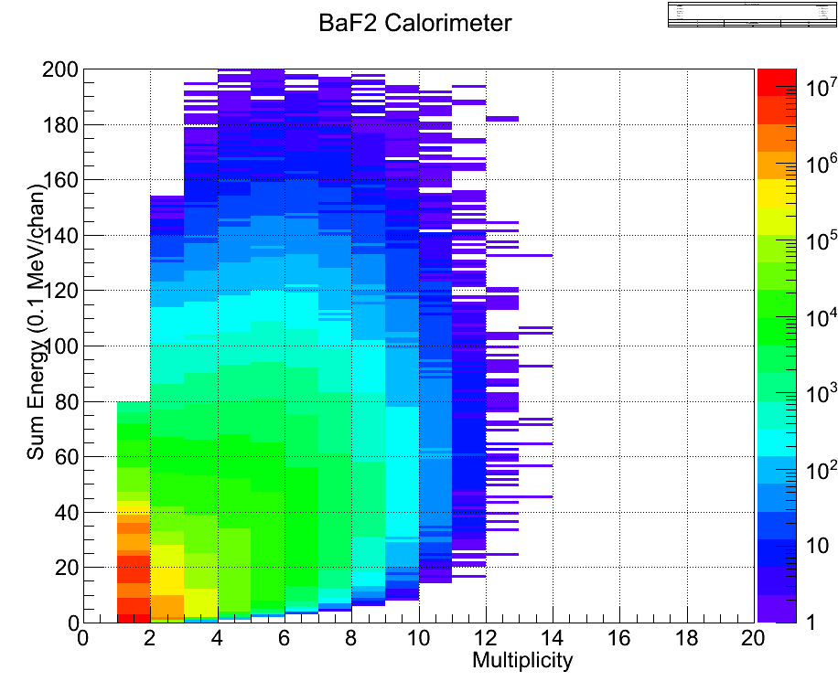
Multiplicity Versus Energy Discrimination: ²⁵²Cf
FISSION events
(n,n’)
Intrisic activity

Slide 31
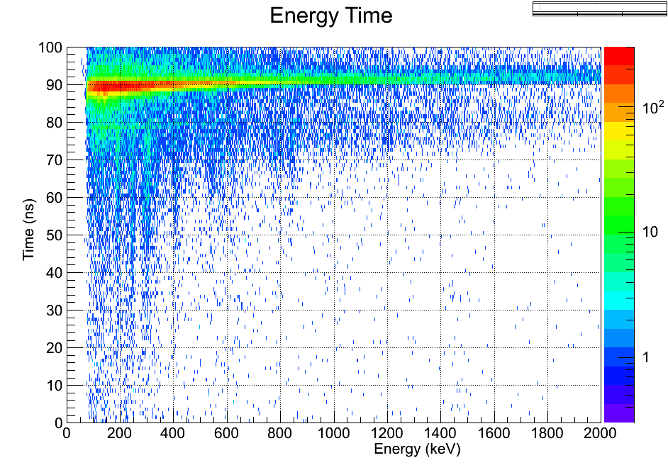
Prompt Fission GAMMA from ²⁵²Cf USING THE BaF₂ CALORIMETER

Slide 32
Ge-LaBr3 hybrid array + LICORNE
²³⁸U(n,f) or ²³²Th(n,f) reactions to study neutron rich fission fragments
Cold fission (E_{n} ~ 1.5 MeV or E_{n} ~ 2.5 MeV with 11B beam)
Lifetime measurements in hundreds of exotic nuclei
Excellent selectivity of fission fragments and their partners via isoler tagging from 1 – 50ns
Calorimeter (Ω > 50%) + beam buncher would allow very clean multiplicity/sum-energy tag on fission events

Slide 33
ν-ball
A hybrid LaBr₃-Ge array for fast timing spectroscopic studies
at the IPN Orsay
Detectors: ~20 Ge (Gamma pool + loan pool Orsay) and/or others (max ~64)
Minimum 36 LaBr3 guaranteed by FATIMA collaboration (max ~50)
Mechanics: Use/fusion of exisiting mechanical structure(s) whenever possible
Electronics: Needs investment in dedicated digital DAQ (fast timing + high energy resolution)
Time Frame: First experiments mid-to-late 2016
Campaign Duration: ~6 Months
Workshop to be held at the end of 2015 to discuss physics cases

Slide 34
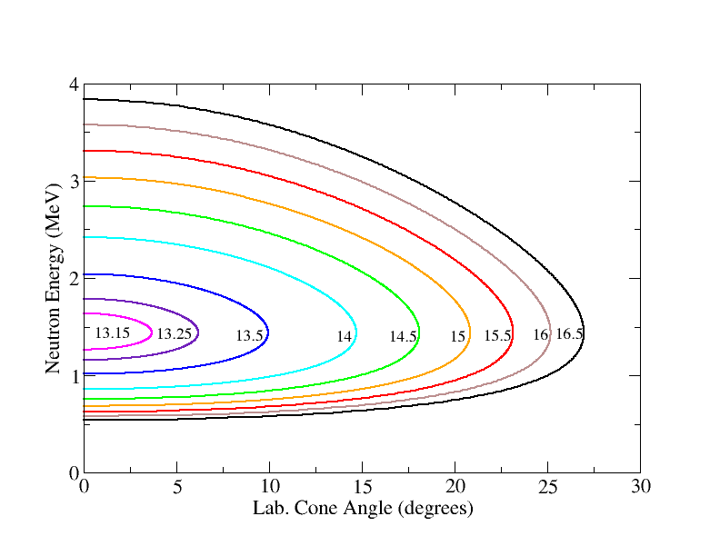
LICORNE Inverse Kinematics Curves

Slide 35

²³⁸U(n,f) physics cases using LICORNE + Miniball
Neutron-rich nuclei around and beyond ¹³²Sn (R. Lozeva)
Spectroscopy of neutron-rich fragments of 40<Z<50 (A. Gottardo)
Shape coexistence and collectivity around N=60 (M. Zielinska)
Evolution and collectivity development in the vicinity of ⁷⁸Ni (D. Verney)

